Slide 1
Risk Communication
Facilitating effective messaging in times of disaster.
Notes:
The purpose of this module is to understand the importance of risk messaging and identify the common pitfalls of communication. We will also discuss guidelines that can guide effective communication, which is necessary for effective risk mitigation.

Slide 2

Risk Communication
Messages that convey a possible risky situation, such as upcoming natural disasters
Challenges:
  Providing accurate information concisely and directly
  Not alarming individuals and/or causing uproar
  Cultural, education, and language barriers
Notes:
Once we identify a hazard that has the potential of affecting many valuable elements (families, homes, animals, the environment, etc.), we must find a way to effectively communicate the impacts of that hazard. By doing so, we can increase awareness of the hazard by reminding people of safety protocols and/or enabling them to take the necessary steps to protect other valuable elements however they see fit.
There are various challenges to conveying messages to a large audience, especially about incoming threats. These include:
Providing a message with accurate information. Spreading information that is false is not helpful to anyone and will result in a misinformed population that could take measures that put them even further at risk. Ideally, the message should be concise and direct.
Providing a message that does not cause widespread panic. If a large audience receives a message that is extremely dire and frightening, it may cause a backlash and uproar that would focus people’s attention on finding someone to blame. However, the goal should be to reduce the risk first. Thus, an alarming message should be avoided so that the population’s main concern is to increase overall safety, which is the most important task when facing a large danger.
Providing a message that can be understood by everybody. Often, messages with too much information cannot be understood by the general population. Other times, people cannot comprehend an important message about danger because it is was not provided in a language that they understand. Thus, effective communicators should consider certain barriers that exist due to the population's culture, education, and language. What are these barriers? And how do we surpass them?

Slide 3
Barriers to communication
Notes:
Let’s start by looking at what problems are faced when delivering messages related to risk.

Slide 4
Barriers, part 1
Differences in perception
  Risk messages will be interpreted in various ways
Differences in receptivity
  People may believe a risk will not affect them in any way
Lack of coordination between government and public
  Governments make risk-related decisions based on experts’ opinions, but people in high-risk areas tend to have a better understanding of the risk
  (Janmaimool and Watanabe, 2014)
Notes:
Across a large population, the perception of risk among individuals will vary. Perception refers to how people interpret their surroundings. Thus, two people who read the same book end up may have two different meanings and interpretations of the book. Similarly, if two people receive a message about a potential flood, one may not perceive the situation as risky and the other may find the situation to be extremely risky. These differences can be attributed to many different things: people’s background, past experiences with a similar hazard, level of preparedness, etc. It is difficult to account for every person’s individual perception, but it is still important to provide a message that displays the hazard and its impact accurately.
Similarly, there will likely be differences in receptivity. This means that certain people may believe that a hazard will not affect them in any way, whereas others will believe that they will be greatly affected. This can occur for a variety of reasons. For example, a person may believe that they are smarter and more well informed about the situation than the person that is delivering the message to them. Thus, they may choose to ignore the message completely.
There may be issues that exist between people and the government which can prohibit effective communication. Perhaps people simply do not trust their governments due to their past experiences. Some studies have found that people that live in high-risk areas tend to have a better understanding of the risk that they face than the government since they experience it in their daily lives. Thus, the government’s decisions may not be as impactful as predicted.

Slide 5

Barriers, part 2
Access to information
  Private companies or governments may choose to withhold information from each other or the public, making it difficult to conduct research and reach informed conclusions
Population doesn’t have a strong scientific background
  Messages may contain technical terms that are confusing
  Messages often don’t explain if/how these risks will affect people
  (Food and Agriculture Organization of the United Nations, 1998)
Notes:
Earlier, we noted that a message of risk should have accurate information. In some cases, access to that information may be limited by a variety of factors. For example, the information provider, which is likely the government or a private company, may have to withhold information regarding the disaster until it is definitively proven via research and testing. This can take a long time, but it is better than providing unverified information. Inaccurate information can cause widespread panic. In other cases, the information provided may not be thoroughly examined, which could lead to potential side-effects appearing after people have already acted on the incomplete information that they previously received.
Also discussed earlier, people in the general population may not have strong scientific backgrounds. This means that they may not know about the technical terms and definitions used by experts. Such terms would likely confuse an average person. Instead of focusing on the technical hazards themselves, it will be more impactful if the message focuses on what level of risk exists, how likely the hazard is to affect people, and what steps can be taken to reduce the risk.

Slide 6

Barriers, part 3
Mass Media
  Reporters may not accurately convey risk messages accurately due to lack of expertise in the hazard or the risk
  Media outlets may choose what information is necessary
Societal Characteristics
  Cultural factors (language differences, religious beliefs/laws, etc.) must be considered when crafting effective messages
  (Food and Agriculture Organization of the United Nations, 1998)
Notes:
The way the media reports of a hazard often affects people’s reception and perception of the hazard. This is because news – such as cable TV, newspapers, and websites – are common sources of information for most people. This can result in some problems. First, the media outlet can choose how much and what kind of information they want to convey and how they want to convey it. This is open to bias. Secondly, reporters often deliver inaccurate information because they are not experts in the hazards themselves.
As discussed earlier, the message interpretation can be influenced by cultural factors such as language. This is one of many societal characteristics. These characteristics should be considered when crafting the message to ensure that more and more people can listen to and understand the message in order to take effective risk reduction measures.

Slide 7
10 Steps for Effective communication
Notes:
Now that we have identified how risk communication can go wrong, let’s discuss 10 basic steps that allow for good communication.

Slide 8
Effective Communication, part 1
Collect data regarding the risk
Understand the scientific basis of the risk
Understand the negative impacts that may occur
Understand public perception of the risk
  Surveys, interviews, and focus groups reveal perception
Expect varying reactions to the message
  (Food and Agriculture Organization of the United Nations, 1998)
(Fischhoff, 1995)
Notes:
This ten-step process, described in this slide and the following slides, is an example of a strategy for effective communication. However, is not perfect and there is no guarantee that it will work. This is simply a guideline of things to consider when crafting a message.

Slide 9
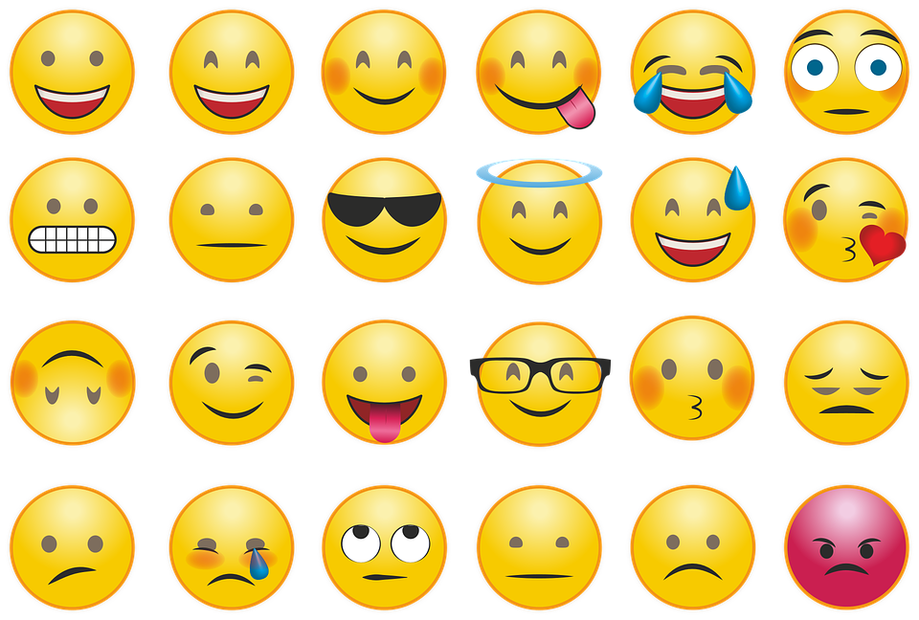
Effective Communication, part 2
Risk comparisons
  If similar risks have been faced before, risk comparison can be effective
  Do not compare a new, unfamiliar risk to a previous risk faced
Understand the importance of emotional factors
  Using logic alone is not effective, an emotional appeal can be convincing
  (Food and Agriculture Organization
  of the United Nations, 1998)
(Fischhoff, 1995)
Notes:
Risk comparisons are an important tool here. An easy way to convey the level of danger a certain population faces is by comparing it to similar experiences of the past. This will also enable the population to take measures that worked (or learn from the ones that didn’t) and implement those measures again. However, this can be risky when the new threat is not like the old threat. In this case, the comparison is unhelpful and can lead to confusion which would allow for incorrect measures being taken.
Emotion is also very important. Logical reasoning and information alone may not be effective; conveying emotions such as passion and concern can incite a population to listen and act.

Slide 10

Effective Communication, part 3
Treat the public as a partner
  Describe the risk and impacts calmly, honestly, and in an understandable way
Do not deny concerns
  Others’ concerns are legitimate and should be heard to facilitate better decision-making
Collaborate with other trusted sources
  (Food and Agriculture Organization of the United Nations, 1998)
Notes:
The more people are treated as partners, the more they are likely to trust the message. This means providing a calm, honest message in a way that is understandable to the public. This also means listening to their concerns instead of ignoring them.
Finally, it is always a good idea to have multiple sources. Facilitating teamwork between various trusted sources would result in more accurate information that is being spread to more people.

Slide 11

Effective Risk Communication:
Spreads accurate information, informing people of potential danger
Emphasizes concerns of risk
Encourages proper risk mitigation
Improves general safety
Notes:
Why does any of this matter?
Spreading accurate information allows us to inform people about the potential dangers they face. By helping them realize the risks and even providing some means to reduce that risk, they can begin taking steps to ensure their safety.

