Slide 1
Risk Management
Approaches to, problems with, and examples of controlling risk.
Notes:
The purpose of this module is to understand good practices of managing risk. We will start by defining risk management and explaining its purpose, then we will explore its connection with perception, discuss various approaches, and the standard steps of managing disasters. Finally, we will discuss how organizations manage risk, which is slightly different from how individuals handle risk.

Slide 2

Definition of Risk Management
Risk management is a systematic approach to identify, assess, and understand risk in order to guide further appropriate management decisions and actions.
(Mañez et al., 2016)
Notes:
Risk management is a straight-forward approach to describe the steps to identify and evaluate risk. Effective approaches to risk management would enable someone to identify and evaluate the risk, then use that knowledge to guide decisions and actions that can improve safety and reduce risk.

Slide 3
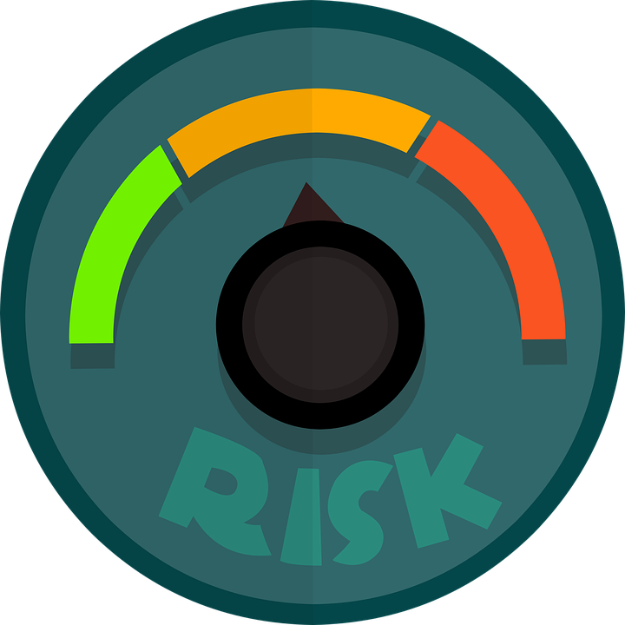
Purpose of Risk Management
“To minimize the potential harm of a risk event by implementing strategies and actions to control and reduce risk”
(Mañez et al., 2016)
Notes:
Why does this matter?
Our goal with risk management is to minimize harm. By being able to manage our risk, we become safer. Recall that risk is greatly determined by three factors: hazard, exposure, and vulnerability. By managing our risk, we attempt to reduce the risk by reducing either vulnerability or exposure, since those are two components of risk that we can change; in other words, we cannot control how severe the hazard is, but we can improve how likely we are to get caught in its path or prepare for it. One important note: managing risk does not mean that the risk is eliminated.

Slide 4

Management and Perception
Risk management is influenced by what is perceived to be risky.
Risk perception guides opinions on risk and risk management
Perception depends on past experiences, preparedness, perceived control, etc.
(Mañez et al., 2016)
Notes:
Before we can go any further on risk management, it is very important to acknowledge risk perception. To “perceive” means to experience and become aware of, and our “perception” is our interpretation of our experiences. How we manage our risk is directly determined by our perception of the risk. It is the perception of risk that guides our opinions on the level of risk and our subsequent decision-making about how it should be managed. A simple example: if we don’t perceive a hazard to be risky, we will not need to manage it.
What does this perception depend on? Well, the story of risk perception and its factors is told in Module 3. Some of these factors are past experiences, current levels of preparedness, perceived control, culture, and many more.

Slide 5

Varying Perceptions – public or expert?
Experts consider probability, public prioritizes consequences
Public may feel helpless to a hazard, perceiving it as high risk
Public has first-hand experience for what is going on
Experts disagree amongst themselves, public doesn’t know which expert to believe
(Sjöberg, 1999)
Notes:
Expert opinions are a factor of risk perception that is directly related to risk management. The opinions of experts often don’t align with the opinions of the general public, and there can be many reasons for that. This disagreement can have severe impacts because it can deter trust in the experts, the government, and risk management procedures.
The main reason for disagreement is the differing priorities. Experts tend to prioritize probability. This means that experts care more about long-term effects, such as how many people are likely to be affected over time and how it will affect the overall community (society and infrastructure) for the years to come. On the other hand, the general public prioritizes consequences. These consequences are typically short-term, such as how individual families will have the funds to cope with disasters.
In times of disasters, the public may feel helpless. By not having any tangible control over the situation, they may overestimate (or in some cases, even underestimate) the risk. This feeling of helpless can be amplified if members of the population feel that they know more than the experts because they are the ones who face the risk first-hand. If experts choose not to acknowledge the public’s perception, then this can breed mistrust between the two groups, which is not good for effective risk management.
Finally, risk management procedures can be affected by the fact that experts tend to disagree amongst themselves. When tasked with producing a plan to handle disasters, taking the opinion of tens, hundreds, thousands of experts can lead to a great variety of answers. Although this is helpful because the decision-makers can consider a variety of perceptions and perspectives, it causes confusion within the population, and it does make it harder to make the final decision.

Slide 6
Approaches to Management
    Proactive
        Pre-disaster activities associated with reducing risk
          Developing mitigation strategies, spreading awareness, etc.
    Reactive
        Post-disaster activities associated with reducing impacts
          Emergency relief, reconstruction, etc.
Notes:
There are two basic approaches to management: proactive and reactive.
Proactive refers to pre-disaster measures that can be taken to reduce risk. This includes the creation of emergency strategies, spreading effective risk messages to increase awareness, and individuals taking the necessary steps to increase their protection or reduce their exposure.
Reactive refers to post-disaster measures that can be taken to reduce impacts. This includes the use of emergency relief systems, rehabilitation and reconstruction of lost infrastructure, and perhaps the creation of new safety measures and plans for any future disasters.

Slide 7

Disaster Management
  Prediction: identify the risk source and understand potential impacts, take necessary action for mitigation
  Warning: effectively provide information to those who are exposed to a hazard so they can begin preparing
  (Moe and Pathranarakul, 2006)
Notes:
Let’s discuss a basic procedure for effective disaster management. This a very generalized guideline and will look different in practice each time it is used.
Prediction: to better prepare for a disaster, we start by identifying the risk. Then, we can consider the impacts of this risk. By doing so, we can take a better look at how we can reduce the severity of those impacts by effective mitigation planning and actions.
Warning: the warning should be concise and direct. The main purpose is to effectively provide the information necessary to reduce risk. Having more people aware of an incoming disaster results in more safety measures and awareness.

Slide 8
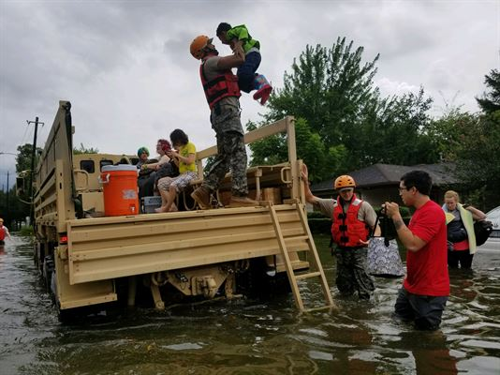
Disaster Management
  Emergency relief: provide assistance directly after a disaster
  Rehabilitation: make decisions to restore/improve the living conditions in a community, encouraging preparedness of future disaster risk
  (Moe and Pathranarakul, 2006)
Notes:
Emergency relief: this period begins directly following any disaster. The term ”disaster” implies that something of value – such as people, property, the environment, etc. – has been affected. This stage is dedicated to assisting the affected population with urgent care in any way possible. This can include medical attention, emergency extraction, etc.
Rehabilitation: This phase requires reflection on the disaster, preparedness, and response. Following that reflection, decisions can be made as to how the community can be improved via better planning or infrastructure. When considering these decisions, it is important to note the purpose is not to restore the community to the way it was pre-disaster, but rather to improve the community beyond that pre-disaster point. This phase is where we start recovering from the old disaster instead of simply responding to it, and we start encouraging better preparation for anything else that may come.

Slide 9
Disaster Management
  Reconstruction: combination of all other steps
      Keep community informed about other potential risks
      Provide mitigation activities
      Emphasize preparedness
      Provide assistance to the community wherever needed
  (Moe and Pathranarakul, 2006)
Notes:
The final step is reconstruction. Here, we take the ideas that came out of the rehabilitation phase and start applying/implementing them in society. Because the rehabilitation plans include large-scale mitigation and preparation plans, the construction of these plans can take a lot of time. Thus, reconstruction is often just seen as a constant process that never truly ends. To succeed in this phase, we should consider and combine all the preceding phases and ideally result in a better-prepared community.
Like prediction and warning, there is a need for effective communication.
Like the emergency response phase, there is direct assistance to the community, which can refer to personal care or community infrastructure.
Like the rehabilitation phase, there is an emphasis on better planning and improved mitigation strategies.

Slide 10
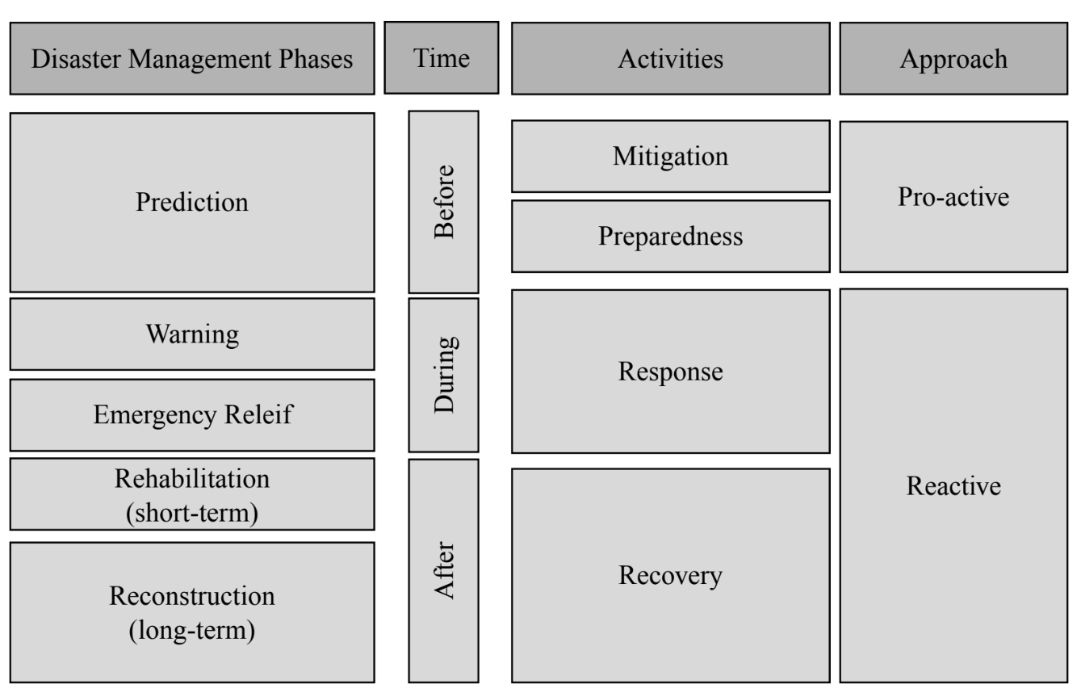
Relief
  (Moe and Pathranarakul, 2006)
Notes:
This diagram shows the phases of disaster management as they relate to time (relative to the disaster itself).
Before:
Disaster management is focused primarily on prediction: predicting any hazards, their potential damages, etc.
Activities done before the hazard are focused on mitigating and increasing preparedness
By definition, any measures taken before the hazard are pro-active
During:
Disaster management in the midst of a hazard is focused mostly on warning people and providing emergency assistance
Since the disaster has already begun, this would be considered reactive and not pro-active
After:
Short term disaster management would be focused on rehabilitating the community; long term management would be encouraging more mitigating measures and trying to improve the resilience of the community to a point where it is better now than it was before the disaster occurred
This is also reactive

Slide 11
Enterprise Risk Management (ERM)
Understand risk as it relates to an organization/company
Broad framework for risk analysis and action
Considers the entire range of risks associated with running an organization (financial, operational, strategic, hazards, etc.)
Promotes risk awareness and strategic decision-making
(Hoyt and Liebenberg, 2011)
Notes:
Organizations – such companies, government departments, charity foundations, etc. – deal with their own risks (which sometimes overlap with general societal risks, and sometimes they are not). To understand risk as it related to an organization, we use the phrase “enterprise risk management.” This is a broad framework for risk analysis and strategy.
An organization must consider the effects of the risk in many ways that large societies don’t. This includes the effects on financial stability, operations, long-term strategies (such as growth or expansion) that were set in place prior to any hazard occurring, etc. An ERM mindset can help us consider these impacts when managing risk.
In general, an ERM mindset helps promote better risk practices since it considers a large variety of factors. There is greater awareness of different types of risks in all the different activities that an organization participates in. With this awareness and knowledge, there is better decision-making.

Slide 12

Benefits of ERM to the Organization
Decreasing volatility of stock price and earnings
Reduce external capital cost
Better understanding of risk activities
  Better resource allocation
    Improving capital efficiency
    Higher return on equity
(Hoyt and Liebenberg, 2011)
Notes:
What benefit does ERM provide to an organization?
For public companies, stock prices are a general indicator of the company’s wellbeing. By effectively managing risks and making the management strategies public, the stock prices become less volatile because investors know that the company management is aware of the risk and that there are measures in place to minimize the risk.
For all organizations, ERM enables a better understanding of the risk that is associated with any/all activities that the organization engages in. This then allows the organization to better allocate its resources to ensure that the organization remains stable in the face of an internal or external disaster.

Slide 13
Value of ERM
Considers all risk avenues together, not individually
  ERM can analyze the relationship between risk sources
  Interdependencies between risk factors can be identified and managed appropriately
Allows for an organized risk profile that can be shared easily
(Hoyt and Liebenberg, 2011)
Notes:
Why does ERM matter?
ERM considers all possible risk avenues together instead of separately. This is extremely important because sources of risks are often linked together, and the impacts of risks are often amplified if multiple disasters manifest at the same time.
Thus, ERM helps organizations think about and prepare for a combination of bad scenarios, instead of one bad scenario at a time. ERM guidelines also help create a risk profile that can be easily understood by outsiders. For a public company, this helps with transparency and disclosure.

