Slide 1
Risk Perception
How past experiences determine future decisions and actions.
Notes:
The goal of this module is to gain an understanding of risk perception and its importance. We will start with basic definitions and examples, then describe and provide examples of factors and models that affect perception, and finally, discuss why perception matters for proper risk management.

Slide 2
What is Perception?
Perceive: “to become aware of, know, or identify by means of the senses” (dictionary.com)
Perception: “an interpretation or impression; an opinion or belief” (yourdictionary.com)
Notes:
Let’s start by defining “risk perception” in the way we use it in our everyday lives. The definitions presented on the slide describe how the terms ”perceive” and “perception” are used in conversational contexts and settings.
A person “perceives” something when they experience something. A person’s “perception” of something is their understanding of that thing.

Slide 3


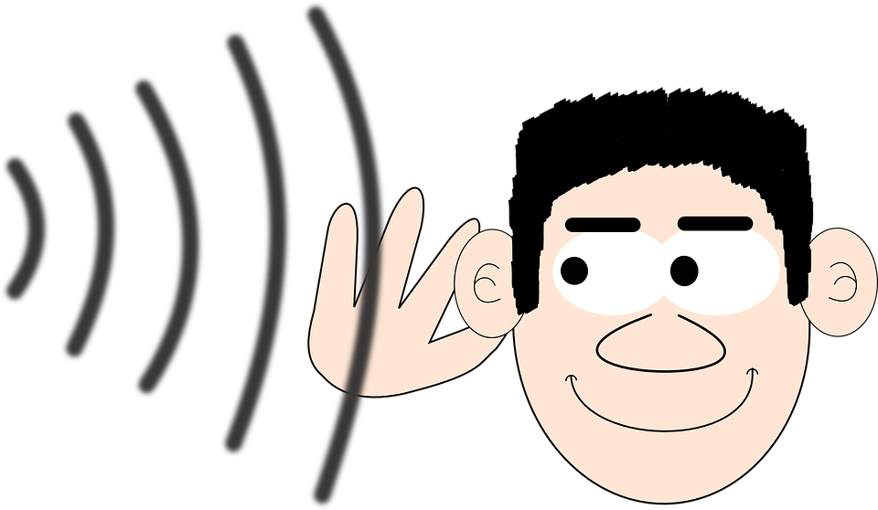
Examples of Perceiving
Notes:
As noted on the previous slide, perceiving things is about a person’s experiences. Experiences – and by extension, perceiving – is most often used when referring to the five senses: seeing, hearing, touching, tasting, and smelling.

Slide 4

Example of Different Perceptions
Notes:
Here is an example of what perception means. Looking at this photo, people may choose to focus on the white shade or the black shade. This would cause people to see, or experience, different things. Some may see two faces looking at each other (black shade), whereas others would see a goblet/trophy (white shade).

Slide 5
Defining Risk Perception
“Risk perception is a judgment of the adverse consequences of a particular hazard and can be made by an individual, a group of people, or society”
(Janmaimool and Watanabe, 2014)
Notes:
The term “risk perception” is pretty straightforward, it describes how a certain risk is perceived or understood. It generally comes up when discussing examples of natural hazards and/or threats to the environment or personal health.
Our understanding of risk is dependent on many factors that will be discussed later. But in general, today’s modern population believes they are good at assessing risk. This is due to a more educated population, generally increased awareness, stronger social networks/organizations, public media, and readily accessible information, which has helped people believe that they understand risk better.

Slide 6
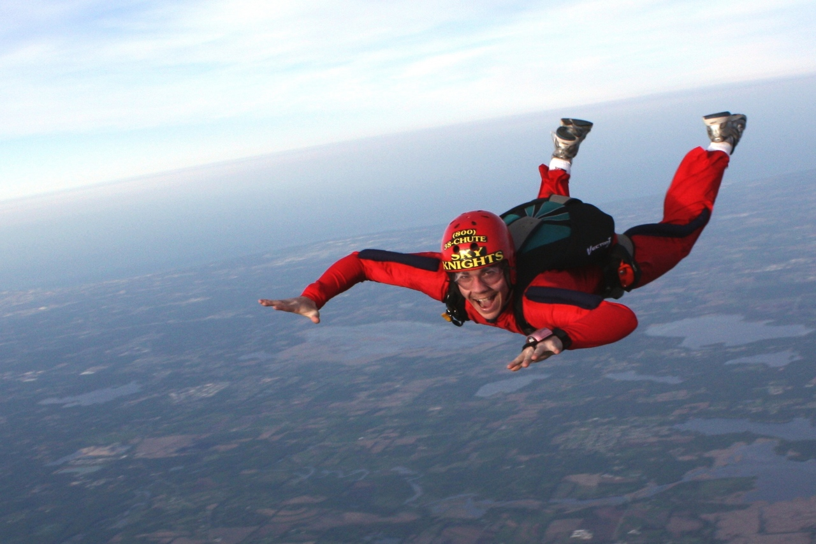
Importance of Risk Perception
“Some find certain events or situations unacceptably risky and will do their utmost to avoid being involved, while to others the same events may offer exhilaration and thrills that stimulate their whole purpose in living. There may even be others to whom the particular event is a non-issue, something to be totally ignored.”
(Young, 1998)
Notes:
Why is the perception of risk an important concept?
Risk perception can vary between different people. The same events can present a different level of risk to different people. Think about skydiving: some people put it on their bucket-list as a one-time activity, others dedicate their lives to as diving instructors, but some choose never to do it. Why is that? It is the same experience, so how is that some people look forward to it and others dread it?
This is because there are many factors that affect a person’s general understanding of risk, but most of those factors are related to preferences and judgment. Those are dependent on personal history, interpretation of available information and evidence, and life experiences. But what exactly are some of these factors?

Slide 7


Key Factors in Risk Perception
Perceived control.
  Do people believe that they can control the situation?
(Janmaimool and Watanabe, 2014)
Notes:
Perceived control refers to the level of control a person feels over a situation. In general, when people feel they are in control, they feel less at risk because they trust themselves more than someone else.
A common example can be seen by examining people’s feelings towards flying in airplanes and driving cars. Studies consistently show that airplane accidents are much safer than road accidents. This is because there are fewer cases of airplane crashes, whereas car crashes happen every day, and because there are strong emergency safety protocols in place to protect plane passengers in the event of a disaster.
Despite this, the average person is more afraid of flying in airplanes than they are to driving their car. Why could this be? This is actually due to a variety of reasons. One of the more common explanations has to do with perceived control. An average individual driver has some knowledge of their vehicle and the roads they are driving on. They also can directly control the speed and direction of travel. Thus, they feel they are in control. On the other hand, airplane passengers simply sit in an assigned seat and wait. They generally do not have knowledge about the plane’s model, and they cannot steer the plane or slow down. Thus, they feel less in control – they feel that someone else is in control, someone they do not know personally and thus may not trust as much as themselves.

Slide 8

Key Factors in Risk Perception
Previous experiences.
  Have people handled similar risks in the past?
(Janmaimool and Watanabe, 2014)
Notes:
Previous experiences also influence risk perception.
Think of this simple example: a young child has a bad, slightly painful experience at the dentist’s office. As a result, the child starts fearing dentists and decides that he will never go back to the dentist again. Another child goes to the same dentist, does not experience any issues, and is given some candy as she leaves the office. Once she is older, she decides to become a dentist.
The two children have different perceptions of dentists. Their perceptions affect their opinions of dentistry and their life choices. This is a simple example of how previous experiences and memories can affect the present moment and the future.

Slide 9

Key Factors in Risk Perception
Family concerns.
  People in larger families usually consider the risk of harmful impacts to be higher due to their concern for familial safety
(Janmaimool and Watanabe, 2014)
Notes:
Family is usually a crucial factor when it comes to decision-making. This is because people with strong familial relationships believe that their actions affect those around them. Thus, when faced with a decision involving risk, they feel like they may put their family, and not just themselves, in danger by choosing the riskier decision.
Let’s go back to the example of skydiving. If a person has strong ties to their newborn child, they may be less likely to go skydiving, even if it is something that they have wanted to experience for their entire lives. Even though the odds of a skydiving accident have not changed, the risk associated with skydiving increases because a possible accident would now affect others, such as the newborn child, and not just the decision-maker. Thus, when a family is involved, the risk is perceived to be greater because the impacts seem more severe.

Slide 10

Key Factors in Risk Perception
Analytical way of thinking.
  As individuals or as a group, people will have their own judgements of the probability of a hazard occurring, probability of negative impacts, severity of the impacts.
(Janmaimool and Watanabe, 2014)
Notes:
A person’s general thinking skills and problem-solving abilities affect how they perceive risk. This has to do with one’s judgment of the risk, the chances of a hazard occurring, and a personal evaluation of possible consequences.

Slide 11

Key Factors in Risk Perception
Trust.
  People’s sense of trust in their government, hazard experts, and family affects the way they receive risk messages and the decisions made.
  (Bronfman et al., 2015)
Notes:
Trust can also affect how people perceive risk. By trusting someone, you are more likely to listen to what they say, which ultimately impacts your own personal decisions.
Simple example: if passengers in an airplane trust the pilot, the safety equipment, and the emergency protocols, then they will be more likely to listen to the plane staff in case of emergency. Their listening will then affect the decisions that they make. If the trusted pilot tells you to put on a safety vest, you will make the active decision to do so.

Slide 12
Key Factors in Risk Perception
The type of hazard
  Some populations expect certain hazards to occur, thus making it predictable. Unforeseen hazards are more difficult for that population to adjust to.
  (Ho et al., 2008)
  People are more concerned about the severity of negative impacts, not how likely the impacts are to occur.
  (Janmaimool and Watanabe, 2014)
Notes:
Another factor is the type of hazard itself. Is it something that is widely recognized? If so, what has been heard about it, was it good news or bad? Has the hazard been previously experienced, and is it predictable? If so, what was the result last time, how severe were the consequences, and when do we expect it to happen again?
In general, people focus more on severity than likelihood. Thus, the average person will perceive greater risk when they are told that the impacts are extremely severe as compared to when they are told that the hazard is very likely to occur.

Slide 13
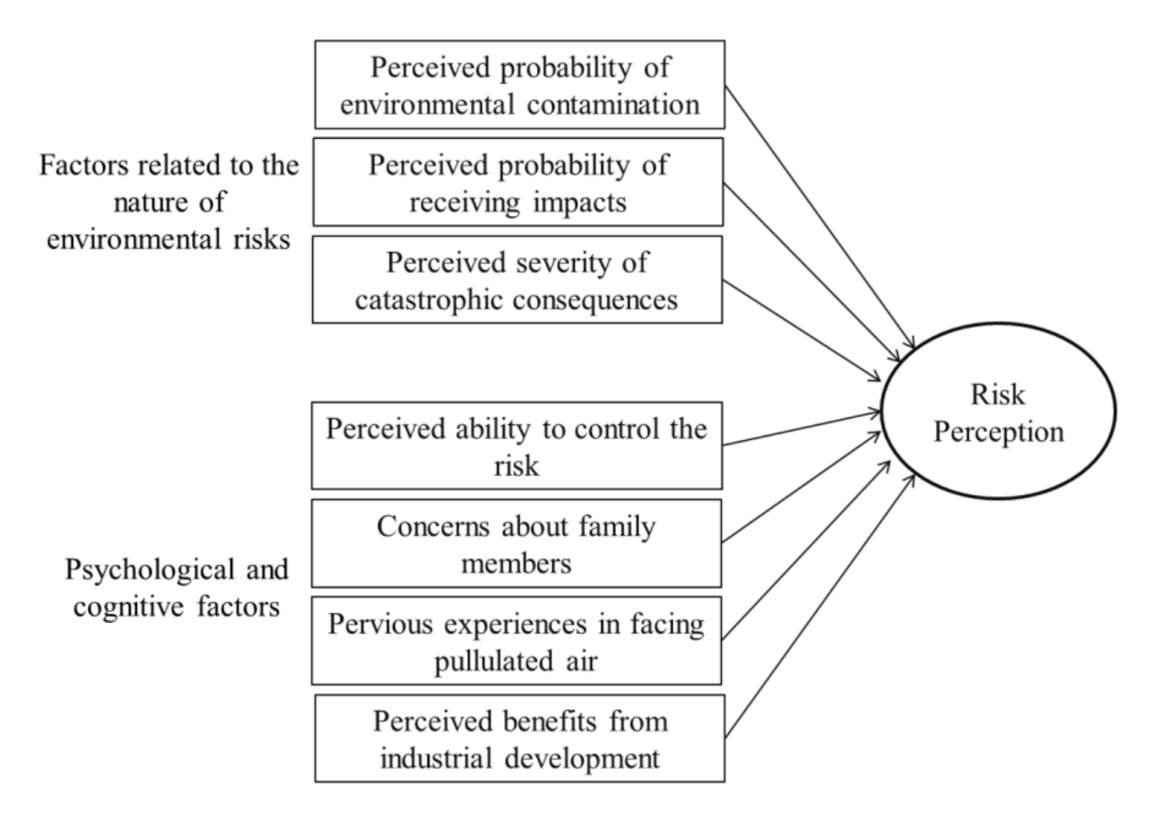
Basic Conceptual Model
of
hazard occurring
Previous experiences
(Janmaimool and Watanabe, 2014)
Notes:
Let’s look at some models and diagrams that can help us categorize factors of risk perception.
The original version of this model explores one specific hazard, possible air pollution from a factory. Some text has been changed to make sure the model is applicable to any hazard. This model categorizes factors of risk perception into two groups: factors related to the nature of the risk and psychological and cognitive factors.
The first group relates to the hazard itself and how society (any group of people) views it. The perceived probabilities of hazard occurrence, perceived probability of receiving impacts, and perceived severity of those impacts are dependent on the type of hazard and the way society views that hazard. For example, populations that are exposed to frequent floods may be well prepared, leading to lower perceived risk; that same population could have a higher perceived risk for droughts.
The second group of factors can vary among individuals. The perceived level of control, concern for other family members, and previous experiences are all dependent on an individual’s memories of their past and personal relationships with family members. Similarly, perceived benefits, if any, may only apply to certain individuals, but not necessarily all.

Slide 14
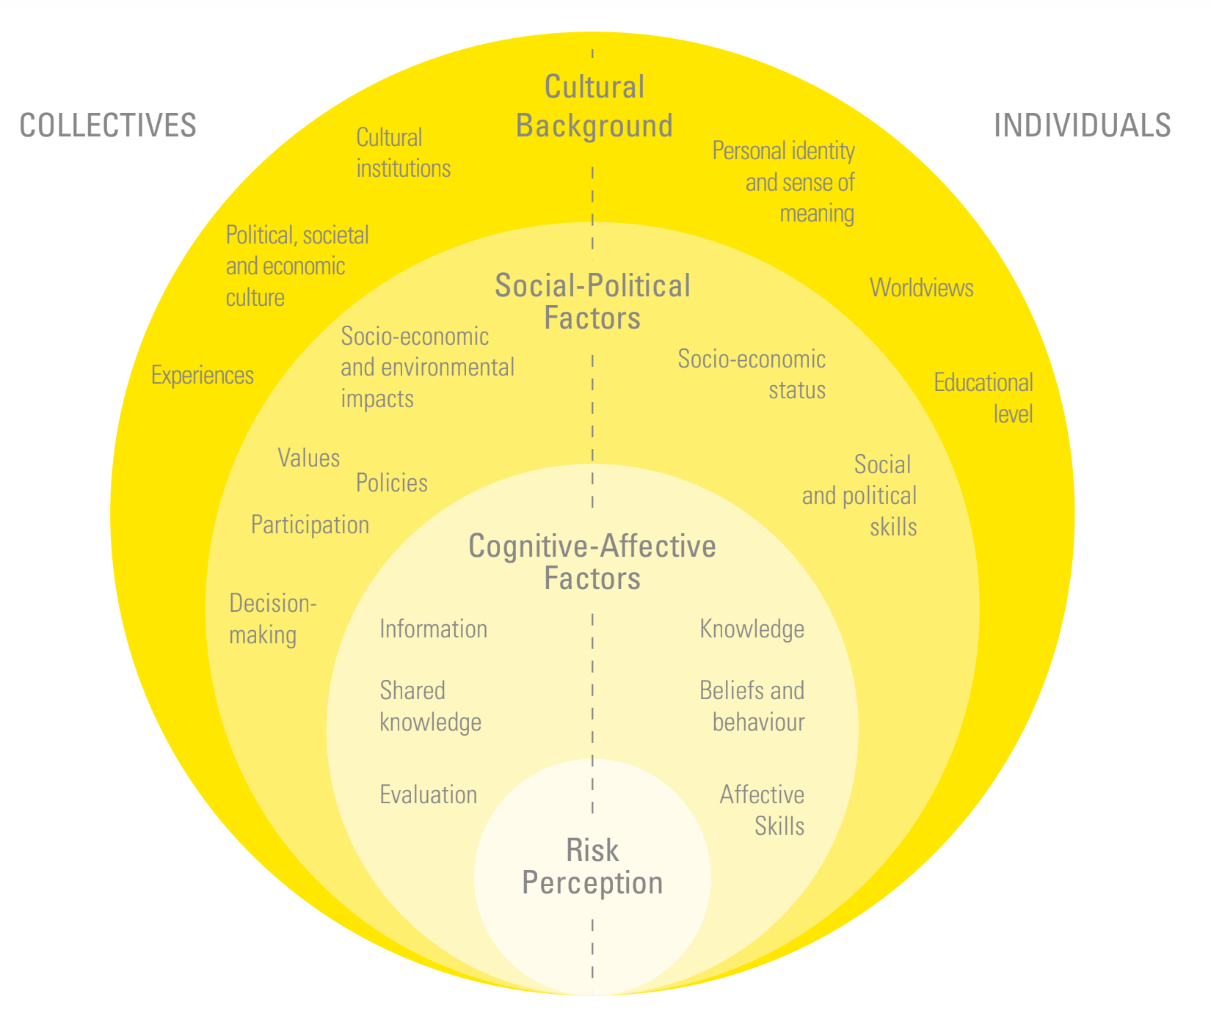
Multi-Level Conceptual Model
(Mañez et al., 2016)
Notes:
This model is more complex than the previous model. Instead of separating factors into two distinct groups, this model uses three layers that build on each other to form a complete picture of risk perception.
The top layer relates to a person’s cultural background, which refers to any factors that are developed over time. For example, a person’s world views, personal identity, and experiences are all things that someone develops as they grow older and mature. Such factors determine a person’s perspective and opinions on many things, including hazards and risks.
The middle layer describes socio-political factors, which refer to factors that relate to and affect a person’s way of life. For example, the governmental policies or social rules that are in place, the values that someone grows up with, and/or a someone’s economic stability can affect the way that a person lives their life.
The lowest layer is associated with cognitive factors, which refer to factors that directly affect a person’s ability to make decisions. For example, a person’s beliefs, evaluation skills, and understanding of the available information can all affect the way that the person makes their decision.

Slide 15
The Levee Effect
Myth: people living in flood zones believe that risk has been eliminated once a barrier (levee, wall) has been constructed.
Reality: risk is never gone, chances of barrier failure exist
More people move into these areas assuming safety
Greater number of people now exposed → higher risk
(Buchecker et al., 2013)
Notes:
The Levee Effect presents an example of how people’s risk perception can change based on their actions, trust, and knowledge.
Some communities may place a physical barrier, such as a wall or levee, to protect from floods. In these communities, it is often widely believed that the risk has been eliminated because the population is no longer vulnerable. This is not true. Yes, risk has been minimized, but it has not gone away completely since people can still be affected. For example, there is a possibility that the barrier will eventually collapse.
As time goes on, more people are likely to learn about the levee and its successes. Nobody believes that the levee may eventually fail because they have never seen that occur yet. As a result, people who have learned about the levee begin to trust the levee and its effectiveness. Such people may also start believing that moving to a levee-protected neighborhood is a good, safe decision that reduces their risk because they are less exposed to a hazard. However, by moving into this area, the overall risk has increased. Now, there are simply a greater number of people that are protected by a levee which may eventually fail. Thus, there is a higher risk involved since a greater number of people are exposed to a potential hazard.
All of this stems from the misconception that a single protective layer like a levee can eliminate risk. The reality is that in almost all situations, risk cannot be eliminated, only reduced.

Slide 16
Why Risk Perception Matters
Understanding risk perception
→ effective risk communication
→ better risk mitigation strategies
(Plapp and Werner, 2006)
Notes:
Why does any of this matters? Well, the purpose of understanding risk is to better improve how we manage risk. Managing risk effectively means protecting people from exposure to hazards.
A key component of protecting people is first understanding what people believe and perceive. By gaining this understanding, more effective messages can be crafted that appeal to those particular people in a way that improves their hazard safety. Thus, we can help people become more aware of certain risks, which improves society’s general readiness for a disaster, and in the more general case, this gives us better risk reduction strategies.

