Slide 1
Vulnerability
A key factor in risk analysis.
Notes:
The purpose of this module is to understand vulnerability, which is a key factor of risk. We will discuss definitions, importance, related concepts, levels of vulnerability, and methods of assessing vulnerability.

Slide 2
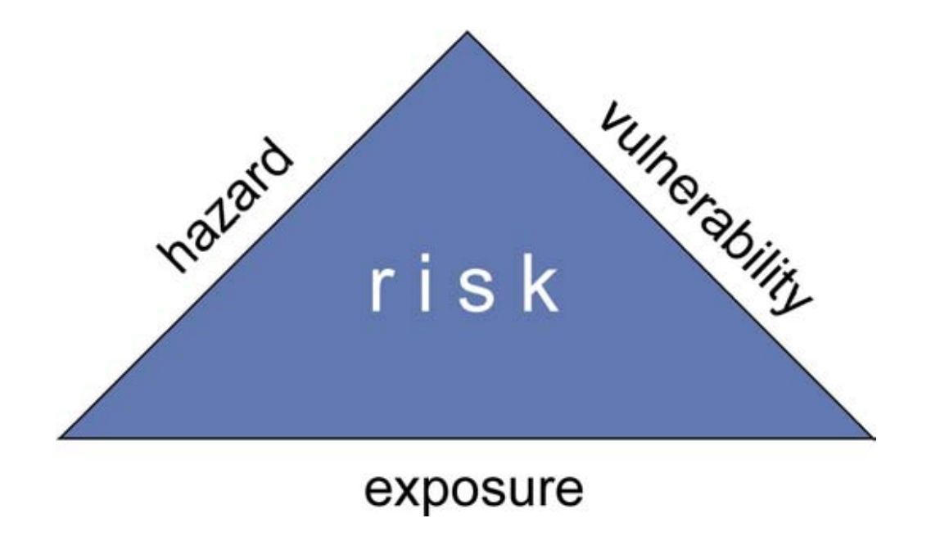
Defining Vulnerability
“Capacity to anticipate, cope with, resist and recover from the impact of a natural or man-made disaster” (Schneiderbauer and Ehrlich, 2004)
Notes:
There are three components of risk: hazard, exposure, and vulnerability. Hazards are dangerous, threatening events. Exposure is used to describe whether any valuable elements are in an area.
Vulnerability defines the degree to which those valuable elements are protected from the hazard. This is tough to quantify. To evaluate the degree of protection, we use our knowledge of the potentially affected elements to consider whether they can “anticipate, cope with, resist and recover from” the hazard and its impacts.

Slide 3
Concept of Vulnerability
Considers resilience
Helps us determine the severity of impacts
  Severity of hazards depends on the type of hazard
  Severity of impacts depends on the vulnerable population
Depends on various factors
  Economic, social, geographic, demographic, culture, governance, environmental
(Cardona et al., 2012)
Notes:
Resilience is an important concept with vulnerability that we will discuss shortly.
The concept of vulnerability sheds light on the idea that people's suffering depends on more than just the impact of the disaster, but also the people's ability to recuperate. Determining vulnerability lets us understand how resilient the population is. This can help us understand how severe the expected damages and other impacts should be.
Vulnerability is dependent on a variety of factors, mostly relating to their socioeconomic circumstances. The level of vulnerability of a person or a group of people is determined by how protected they are. This inherently depends on their social and economic backgrounds, as well as their demographic, culture, and geography. In later slides, you will see how social and economic factors may affect one’s ability to protect themselves from a disaster.

Slide 4
Resilience
“Ability to prepare and plan for, absorb, respond, recover from, and more successfully adapt to adverse events”
Resilience is a factor when thinking about the next potential disaster
Reducing vulnerabilities and risk can improve resilience
(National Research Council, 2012)
Notes:
Vulnerability considers resilience. Resilience defines how well-prepared something is to withstand and bounce back from a hazard. From the definition alone, you can see that it is closely related to vulnerability. By reducing vulnerability, resilience is improved.

Slide 5
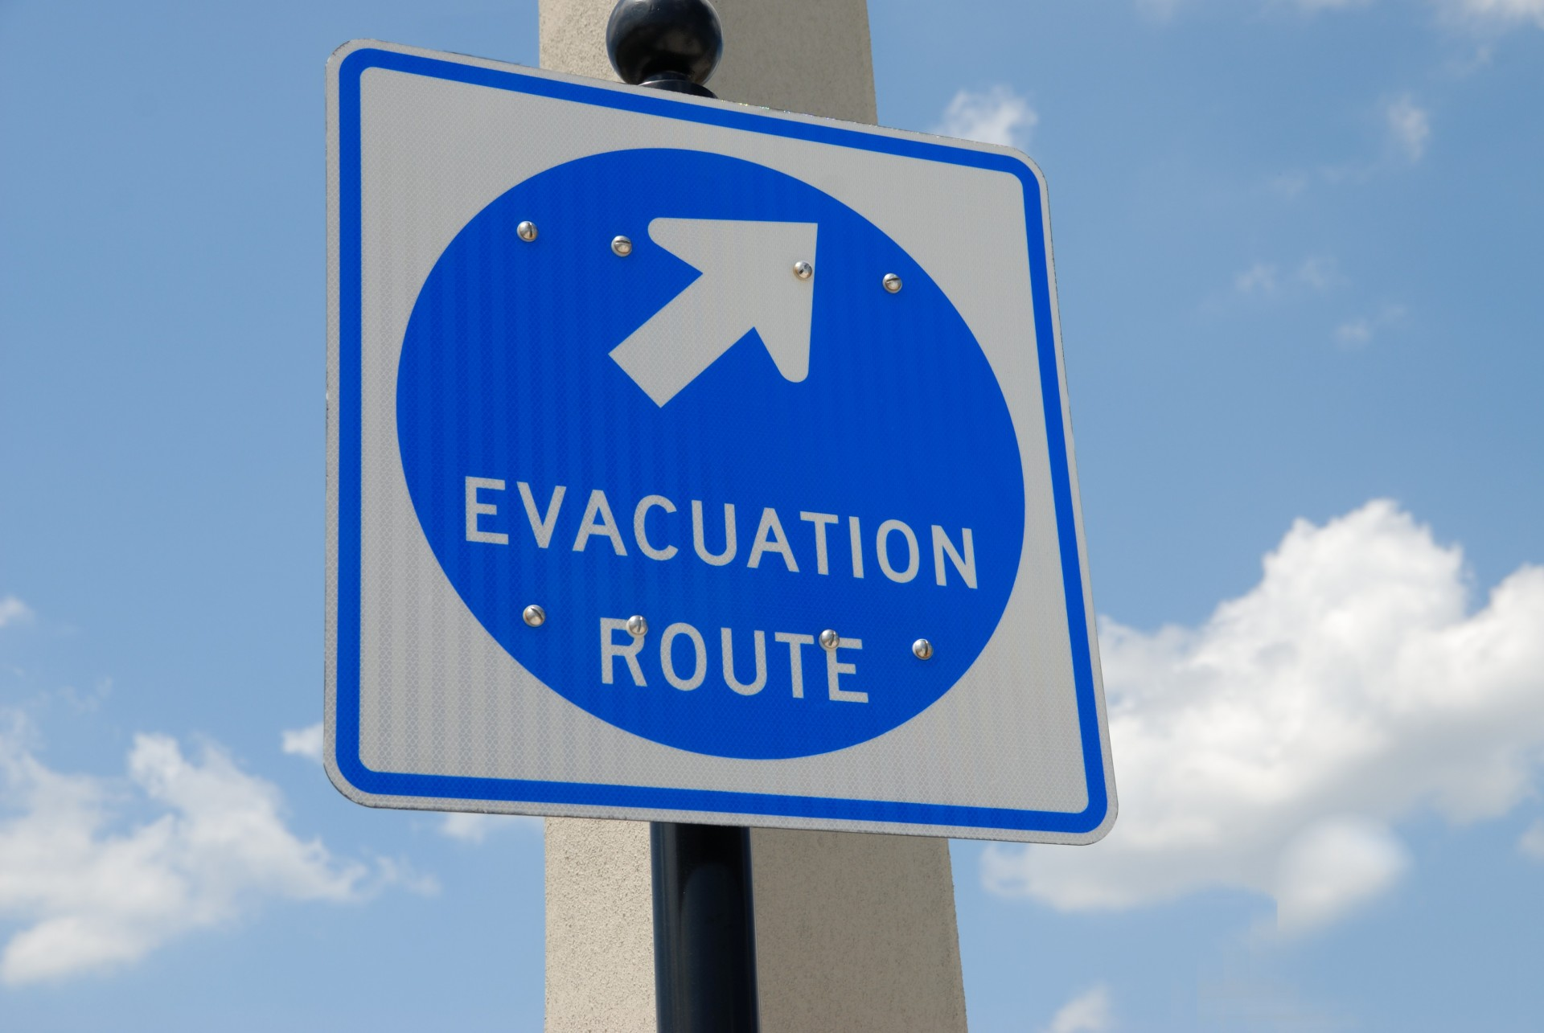
Socioeconomic Trends
Poor societies tend to be more vulnerable
  Fewest resources and opportunities
  Not related to individuals, but overall community status
More developed countries have resources that allow for quicker recovery and/or provide safety
(Schneiderbauer and Ehrlich, 2004)
Notes:
Vulnerability is defined by protection from hazards, which is closely tied to socioeconomic status. A simple way to explain this would be that having more money allows you to buy the things you need to stay safer.
Poorest societies have the fewest resources and opportunities to noticeably reduce vulnerability This is not related to individual income, but the status of the community as a whole (a rich individual in a low-status community would still be vulnerable). For example, if communities or governments do not collectively plan for floods, then even if each individual house is well-protected, communal resources, such as roads, could still be unusable for weeks after the flood, which would affect everyone in that area. Some forms of vulnerability can only be reduced by group effort; thus, we consider the socioeconomic status of entire societies.
Similarly, countries with bigger economies will likely have better resources to sustain and recover from disasters. This is due to their better safety protocols and funds.

Slide 6
Vulnerability is Dynamic
Vulnerability decreases as society develops
Threat of a hazard can cause sudden increase in vulnerability
Developing societies can face hazards that stall development
  Progressive development lessens the effect of each hazard over time
(Schneiderbauer and Ehrlich, 2004)
Notes:
Vulnerability is dynamic, which means that it can change over time, sometimes without much warning. Over time, the population increases, people become better educated, the economy improves, and the quality of living also improves; these are signs of a developing society. In these cases, people are more likely to put more thought into safety and risk as they become better off. Thus, better measures are put in place to reduce vulnerability and risk.
Another reason why vulnerability can change is that hazards may unexpectedly occur. For example, earthquakes are unpredictable. When the threat of an unexpected hazard appears, the society is more vulnerable, thus there is a greater risk.
In some cases, the occurrence of hazards can stall the development of society. If an earthquake destroys all the schools and hospitals in an area, the society must rebuild those components before it can do other things. It is important to recognize that more developed societies would be less affected by the hazard because more developed societies have better measures in place to protect themselves from a disaster. Thus, over time, the effect of any hazard on society decreases. For example, if an earthquake hits an underdeveloped society, its growth will be heavily stunted. However, if after 100 years of development, the same region is hit with an earthquake, the effects and devastations will likely be of a smaller scale because the society had time to develop.

Slide 7
Vulnerability is Dynamic
Hazard events can affect vulnerability to future events
  Large/unpredictable hazards can destroy the community completely
  Smaller/recurring hazards can affect overall vulnerability by changing levels of resources, resilience, and coping capacity
(Cardona et al., 2012)
Notes:
Any hazard can significantly harm a community. This can affect the vulnerability of a community to future events. For example, if a community is significantly hurt by an earthquake that destroys certain infrastructures, it may increase vulnerability to aftershocks or even tsunamis (depending on the geographic location and extent of the earthquake).
If hazards are recurring, this will strongly affect the development of society due to changing resource levels, resiliency, and infrastructure capacity. Thus, even over time, vulnerability would be tough to improve.

Slide 8
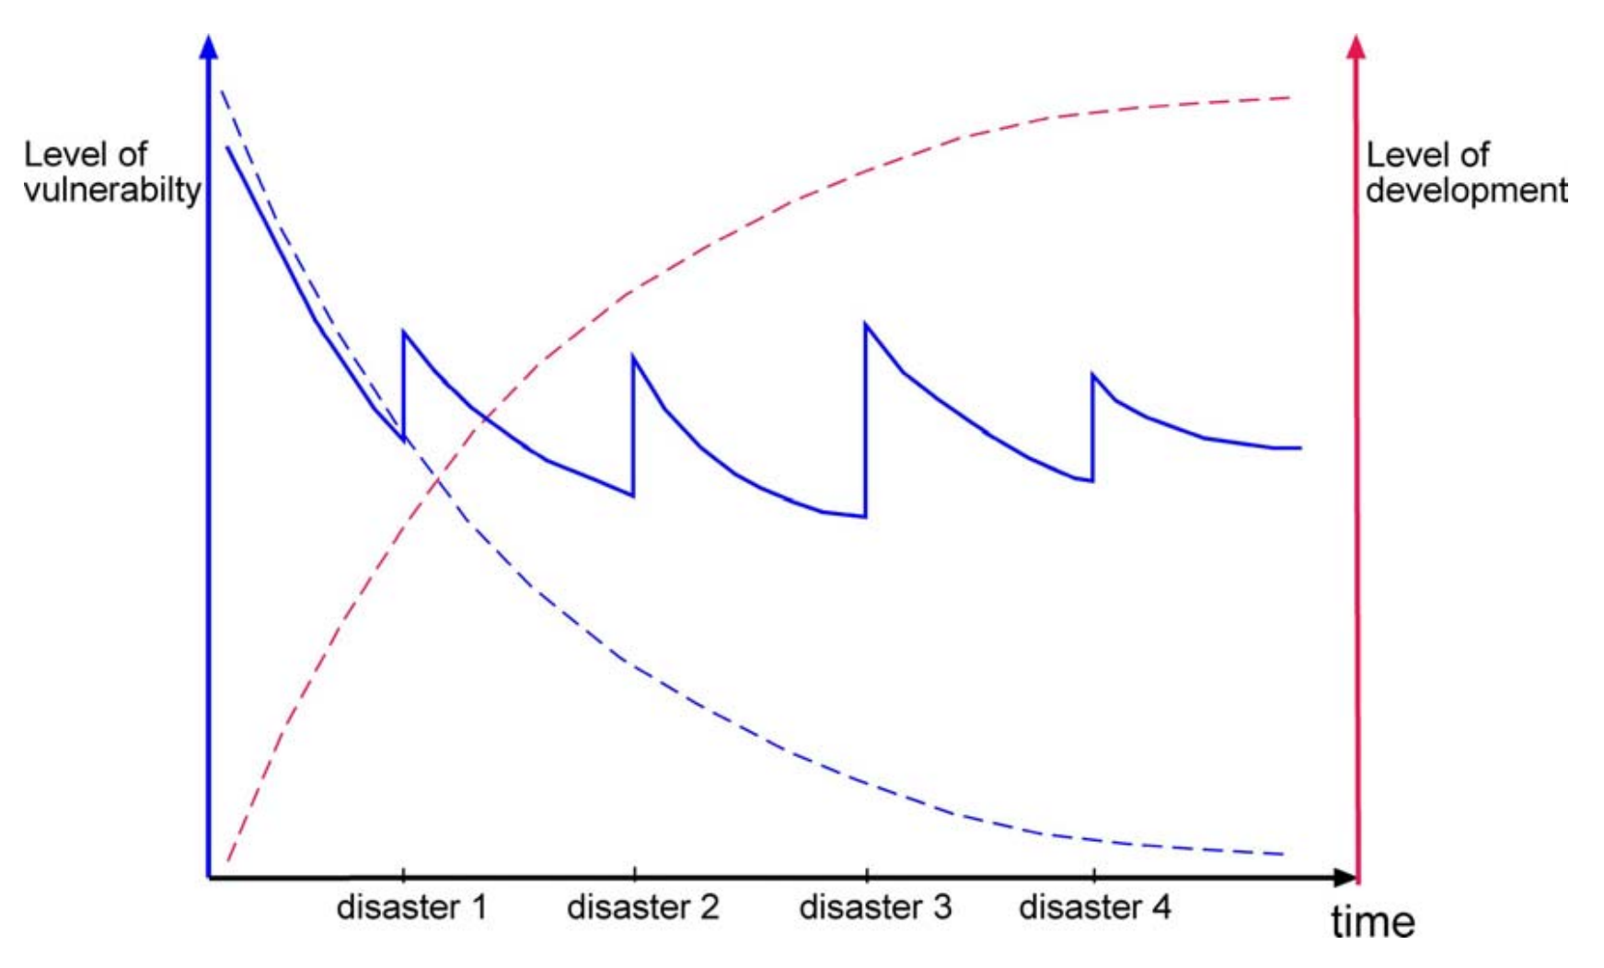
(Schneiderbauer and Ehrlich, 2004)
Notes:
This graph is a visual representation of the last two slides; it shows a hypothetical community’s level of development and vulnerability over time. The levels of vulnerability (blue) and development (red) are shown on the two vertical axes. The horizontal axis shows time and specifically highlights four hypothetical moments at which disasters occur.
The dotted red and blue lines represent an ideal/uncommon scenario in which no disasters strike. In this scenario, the process of development is never interrupted; thus, the level of development continuously increases and eventually reaches a peak, and the level of vulnerability continuously decreases and eventually approaches zero.
The main takeaways from this graph come from examining the level of vulnerability (the solid blue line):
The level of vulnerability decreases as time passes because the community is continuously developing.
Each disaster unexpectedly raises the level of vulnerability, but the community will continue to develop after the disaster, lowering vulnerability once again.
If disasters strike multiple times, each disaster will raise the level of vulnerability by less than the ones that occurred previously (because the development of the community between the disasters would improve the community’s resilience).

Slide 9
Categorizing Vulnerability
Hazard independent: describes the strength of population
  Factors: income, health, education, access to information, existence of mitigation plans
Hazard dependent: describes the strength of population to survive a specific disaster
  Physical factors: construction quality
  Social factors: vaccinated population, preparedness
(Schneiderbauer and Ehrlich, 2004)
Notes:
Vulnerability is a very broad concept, thus there are many ways to decompose it. An example of this is determining whether vulnerability is hazard dependent.
Hazard independent vulnerability suggests that the level of vulnerability does not rely on the type of hazard. Instead of examining the hazard, we examine other factors that determine overall vulnerability, specifically factors that affect the strength of the population. Population strength is dependent on the population’s overall income levels, education, access to information, and the existence of emergency plans – all of which affect the population’s ability to respond to the hazard.
Hazard dependent vulnerability suggests that the level of vulnerability does rely on the type of hazard. This varies for each type of disaster. For example, some buildings are designed to withstand earthquakes. However, that does not affect the building’s vulnerability to other disasters, such as floods. In general, this depends on physical factors like construction quality and geographic features. It can also depend on the population’s general preparedness; for example, if a population is well vaccinated, they are less susceptible to virus/disease-based hazards.

Slide 10

Pre-Disaster
Vulnerability: susceptibility to a disaster
Vulnerability is evaluated by considering physical features
  Current physical assets
  Financial resources
(Schneiderbauer and Ehrlich, 2004)
Notes:
Instead of categorizing vulnerability by hazard, we can also view vulnerability as it stands before and after a disaster.
In pre-disaster situations, we are not concerned about how well a population could bounce back from a hazard, but rather how susceptible and prepared they are to the hazard before it occurs. To evaluate this, we look at current features, specifically current assets and financial resources, that could be used to enhance protection and lower risk.

Slide 11

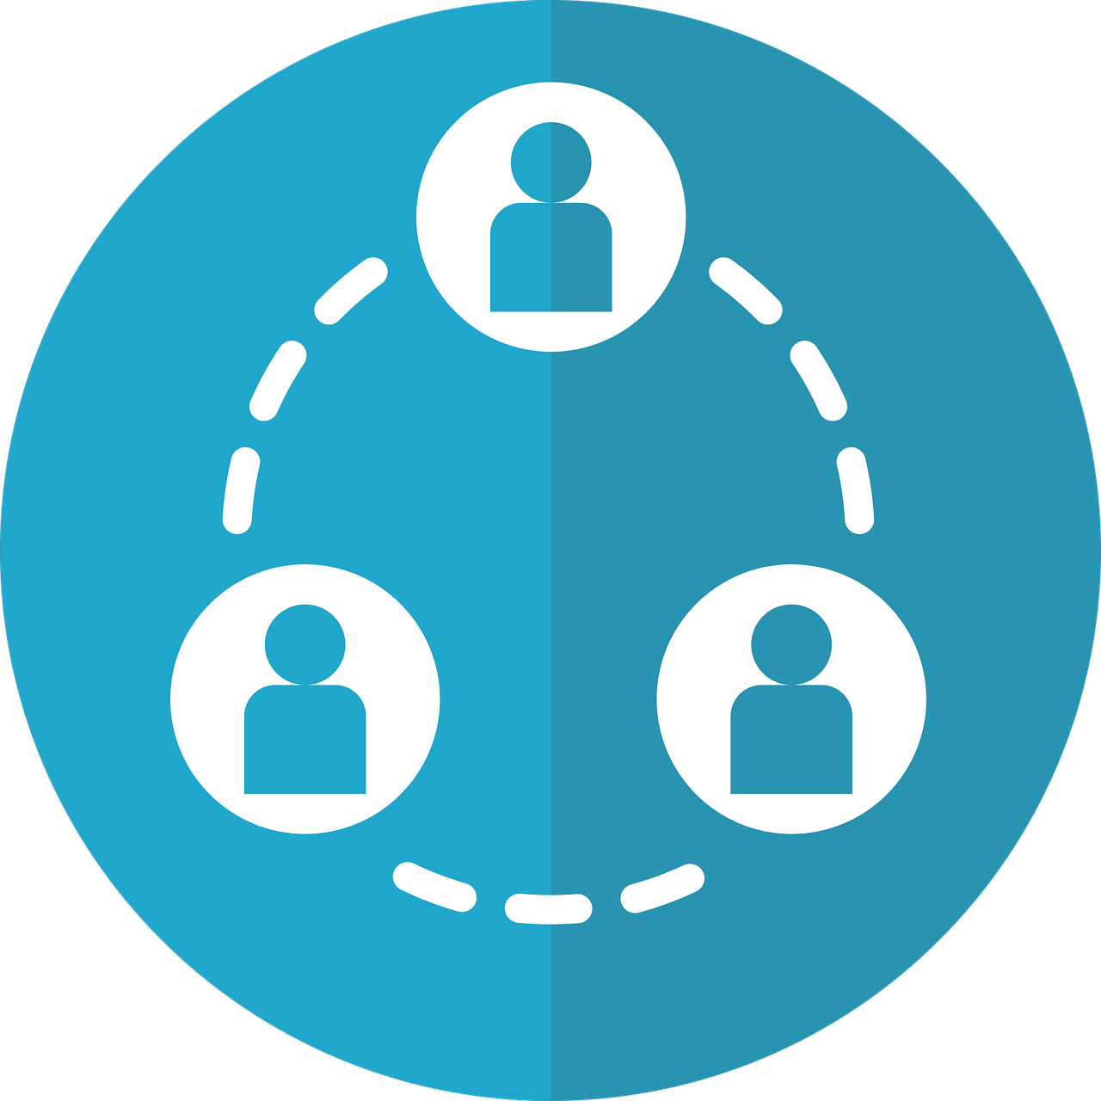
Post-Disaster
Vulnerability: ability to cope and recover from a disaster
Vulnerability is evaluated by considering socioeconomic factors
  Organizational infrastructure
  Social networks
  Quality of services (specifically healthcare)
  Remaining physical assets and financial resources
(Schneiderbauer and Ehrlich, 2004)
Notes:
In pre-disaster situations, we are not concerned about preparedness, but rather how well a population can withstand and bounce back from a hazard. To evaluate this, we look at some of the socioeconomic factors of the society. These include organizational infrastructures (for example, capabilities of businesses/schools/etc. to continue working), social networks, quality of services (such as healthcare and emergency police/fire care), and remaining physical and financial assets.

Slide 12
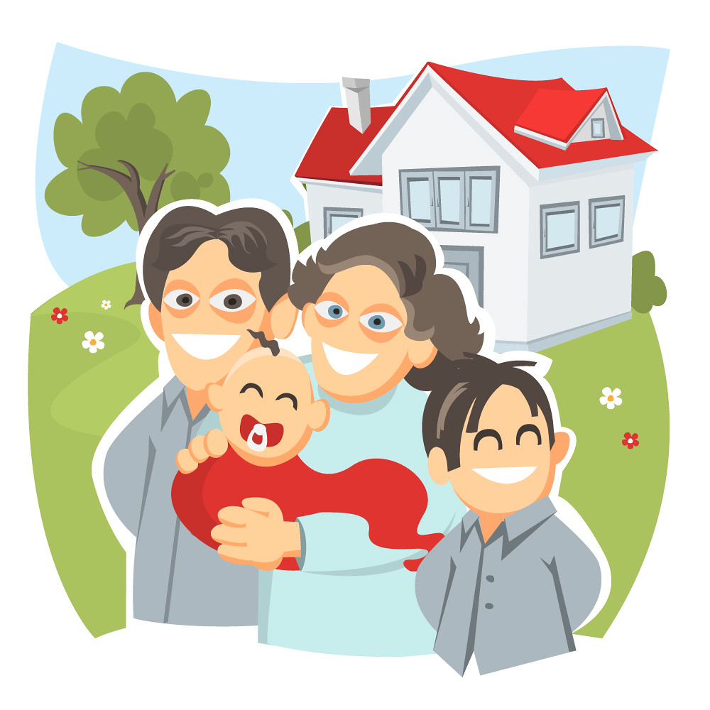
Social Levels of Vulnerability
Average vulnerability level of any individual is dependent on all the social levels that the individual is in.
Individual level: personal income, physical strength, education background
Household level: family insurance, house/property quality
(Schneiderbauer and Ehrlich, 2004)
Notes:
As discussed earlier, socioeconomic status directly affects vulnerability. The vulnerability of an average person is dependent on the social levels that they are in. We will discuss many of these levels.
Individual level: this depends on a single person’s characteristics. For example, personal income, physical strength, and completed education.
Household level: this depends on a person’s direct surroundings. For example, family insurance, property/home, etc.

Slide 13
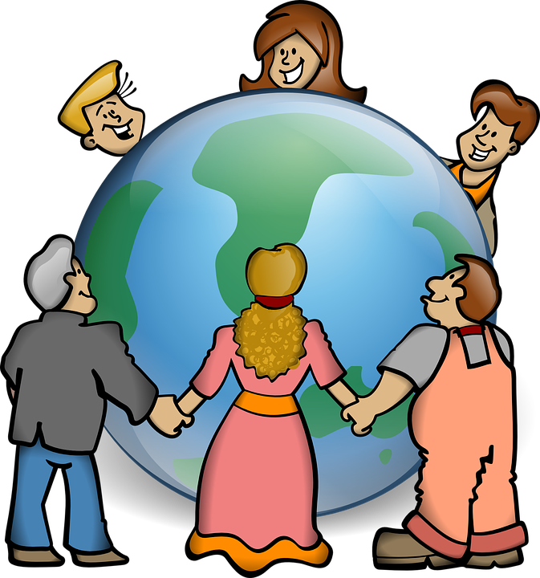

Social Levels of Vulnerability, cont.
Cultural level: coping strategies, risk perception
Administrative level: disaster mitigation measures, civil protection measures
(Schneiderbauer and Ehrlich, 2004)
Notes:
Cultural level: this depends on a person’s cultural background, which could be related to their religion, lineage, etc. Coming from certain cultures can provide risk perceptions or coping strategies for people.
Administrative level: this depends on the government that a person lives under. The government often determines a society’s emergency protocols and disaster preparation protocols.

Slide 14
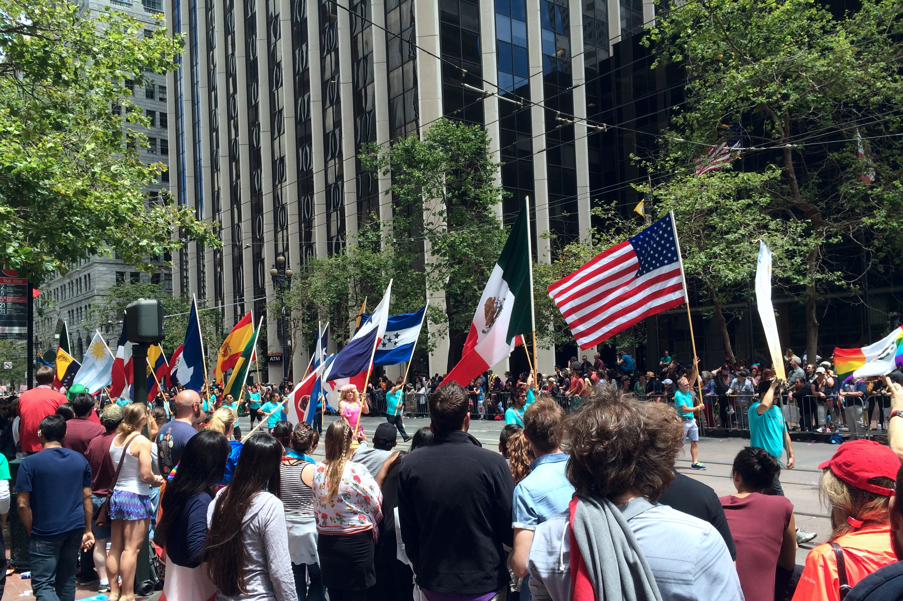

Social Levels of Vulnerability, cont.
Country level: type of government, national disaster management, infrastructure, health care, political relationships
Regional level: climate, geological setting
(Schneiderbauer and Ehrlich, 2004)
Notes:
Country level: the country a person lives in can affect the vulnerability. The country is responsible for the type of government, the departments dedicated to disaster management, health care policies, and more.
Regional level: the region a person lives in determines certain geographical features, such as climate and topography.

Slide 15
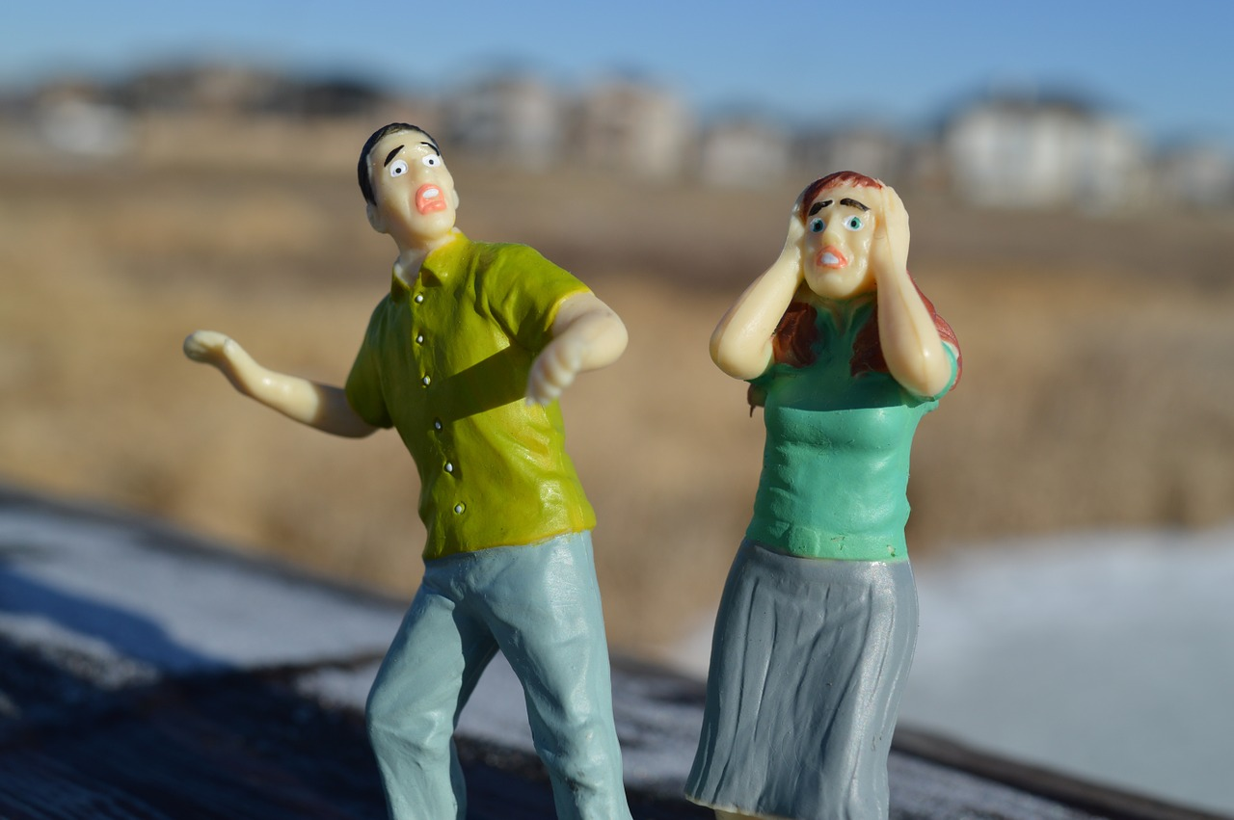
Hazard Vulnerability Assessments (HVA)
Systematic approach to identifying all possible hazards in an area and analysis of the risk of each
Used to determine and prioritize hazard risk by looking at the affected population
(Du et al., 2015)
Notes:
To assess vulnerability, we can use tools called HVAs. These define certain guidelines and provide a systemic approach to identify and analyze possible hazards. This can be used to prioritize hazards based on the level of risk, which ultimately depends on the affected population.

Slide 16
Making HVAs
Developed by a multi-disciplinary team consisting of people from community leadership, safety agencies, defense agencies, medical facilities, etc.
Data (from academic institutions, disaster centers, scientific agencies) is used as main references
  Archives and local residents are secondary sources of information
(Du et al., 2015)
Notes:
HVAs are typically made by a multi-disciplinary team with people that have different backgrounds and job positions from the community. This allows a variety of perspectives to be considered when discussing hazards and risks, such as the perspective of defense workers, medical workers, administrative workers, etc.
HVAs are built using raw data that are supplied from reliable sources, such as academic research facilities, disaster centers, and scientific agencies. Sometimes, perspectives of the general public are also considered, which are usually taken from interviews and surveys.

Slide 17
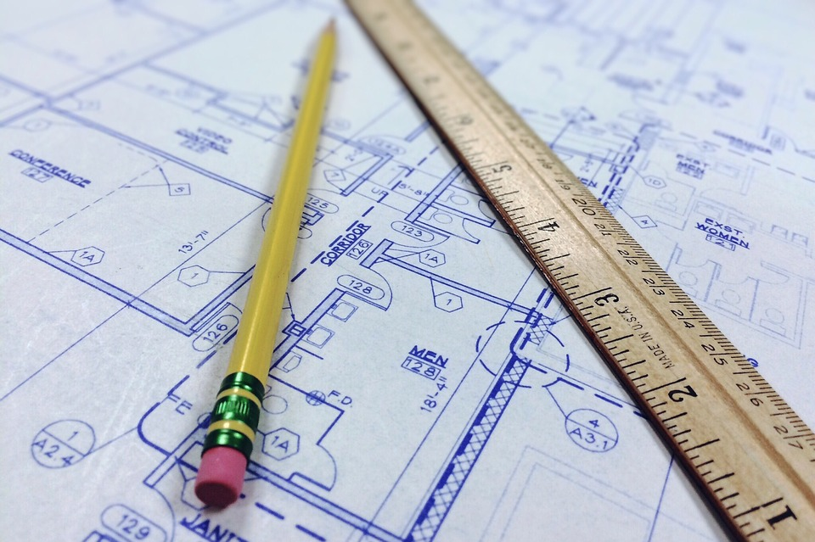
Purpose of HVAs
Outlines essential information
  Most impactful hazards
  Current available resources
Can be used to create mitigation plans
(Du et al., 2015)
Notes:
HVAs are essential to understanding risk. They help us outline the most essential information that is known about all the hazards and the levels of vulnerability.
By determining the most impactful hazards and the current level of protection, we can decide what hazards we should focus on first. Additionally, if we have information about the hazard and the population safety, we can decide how to improve safety.

Slide 18
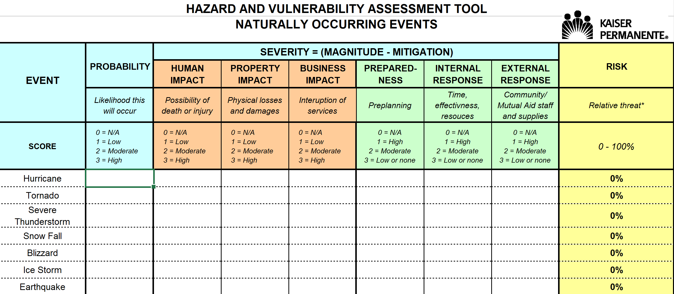
HVA Example
(California Hospital Association)
Notes:
This is an example of an HVA developed by Kaiser Permanente, made available by the California Hospital Association. The link to access this HVA can be found under Module 4 on the website’s References page.
This example considers likelihood, potential damages, preparedness, and response capabilities for a variety of hazards. This particular HVA is specific to natural disasters, and it works by ranking each category/column from 0 (N/A) to 3 (high), and the final risk is calculated by the program as a percentage.

Slide 19
GIS for Emergency Management
GIS: Geographic Information System
Provides socioeconomic and environmental data
Risk maps highlight the impact on communities
Can guide recovery plans and resource allocation
(Du et al., 2015)
Notes:
GIS is another means of vulnerability assessment and analysis that can be used to improve emergency management. GIS can provide data that can determine vulnerability, such as socioeconomic and environmental data. Additionally, GIS can make risk maps that can show how severely communities are impacted. Like HVAs, GIS can help us prioritize certain disasters over others based on how harsh the hazard is and how prepared the population is.

Slide 20
GIS for Resilient Design
GIS: Geographic Information System
Provides historical patterns and demographic information
Encourages data-driven decision-making
Provides methods to spread messages to public and receive feedback
Designs various scenarios to simulate and analyze
(Esri)
Notes:
GIS can also be used to improve resiliency. Certain GIS programs have historical data that show patterns of hazard behavior and provide demographic information. Using a program such as this is extremely beneficial because it is based on hard data, not assumptions. Additionally, the gathered data can be used to create simulations to predict and model the impacts of possible hazards.
GIS systems can also provide methods to spread messages to others and receive feedback. Open, effective communication is crucial when faced with a hazard because it can make more people aware of the hazard and possible means of mitigation.

