Slide 1
What is Risk?
Introduction to terms and concepts related to risk and natural hazards.
Notes:
The goal of this module is to gain a basic understanding of risk. We will start with basic definitions and examples of risk and other related terms, such as hazard, vulnerability, exposure, and disaster. Then, we will move on to ideas that relate to risk evaluation and analysis.

Slide 2
Basic Definition of Risk
“Exposure to the chance of injury or loss; a hazard or dangerous chance” (dictionary.com)
“Possibility or chance of loss, danger or injury” (yourdictionary.com)
Notes:
Let’s start by defining “risk” the way we use it in our everyday lives. The definitions presented on the slide describe how the term "risk" is used in conversational contexts and settings.
By comparing these two basic definitions, we can start understanding some key ideas behind risk: exposure, danger, and chance of loss. Other related themes will be discussed in later slides.

Slide 3



Everyday Examples of Risk
Situations that involve a choice and can result in a loss (emotional, financial, physical, etc.)
Notes:
Do we see risk in our everyday lives? Absolutely.
Whenever we are faced with making a decision that could result in either a gain or a loss, we are inherently thinking about risk. Look at the three images that are on the slide (from left to right):
How do we decide whether we should cross the street? We wait for the traffic signal to turn, look in both directions, see that there are no cars moving towards us, and then walk along the path. In this decision-making process, we are trying to make sure that we don’t get hit by a car. This is an example of minimizing risk, since we are actively trying to reduce our exposure to a dangerous situation that could result in loss.
Many of your favorite athletes have probably been injured at some point in their careers. In fact, you have probably heard of many athletes who had to end their careers due to injury. Competing in sports can result in various kinds of injury. Athletes know that every time they play, they are putting themselves at risk.
Anytime money is loaned or borrowed, there is a risk involved because that money may not be returned on time or at all. If somebody asks to borrow your money, you may not give it to them if you do not trust them. Similarly, a bank only provides loans to people after doing a background check and verifying their payment history.
In all three cases, a choice or decision is involved. With each choice, there is a potential for loss of injury. This implies risk. This is how risk can be seen in your everyday lives.

Slide 4
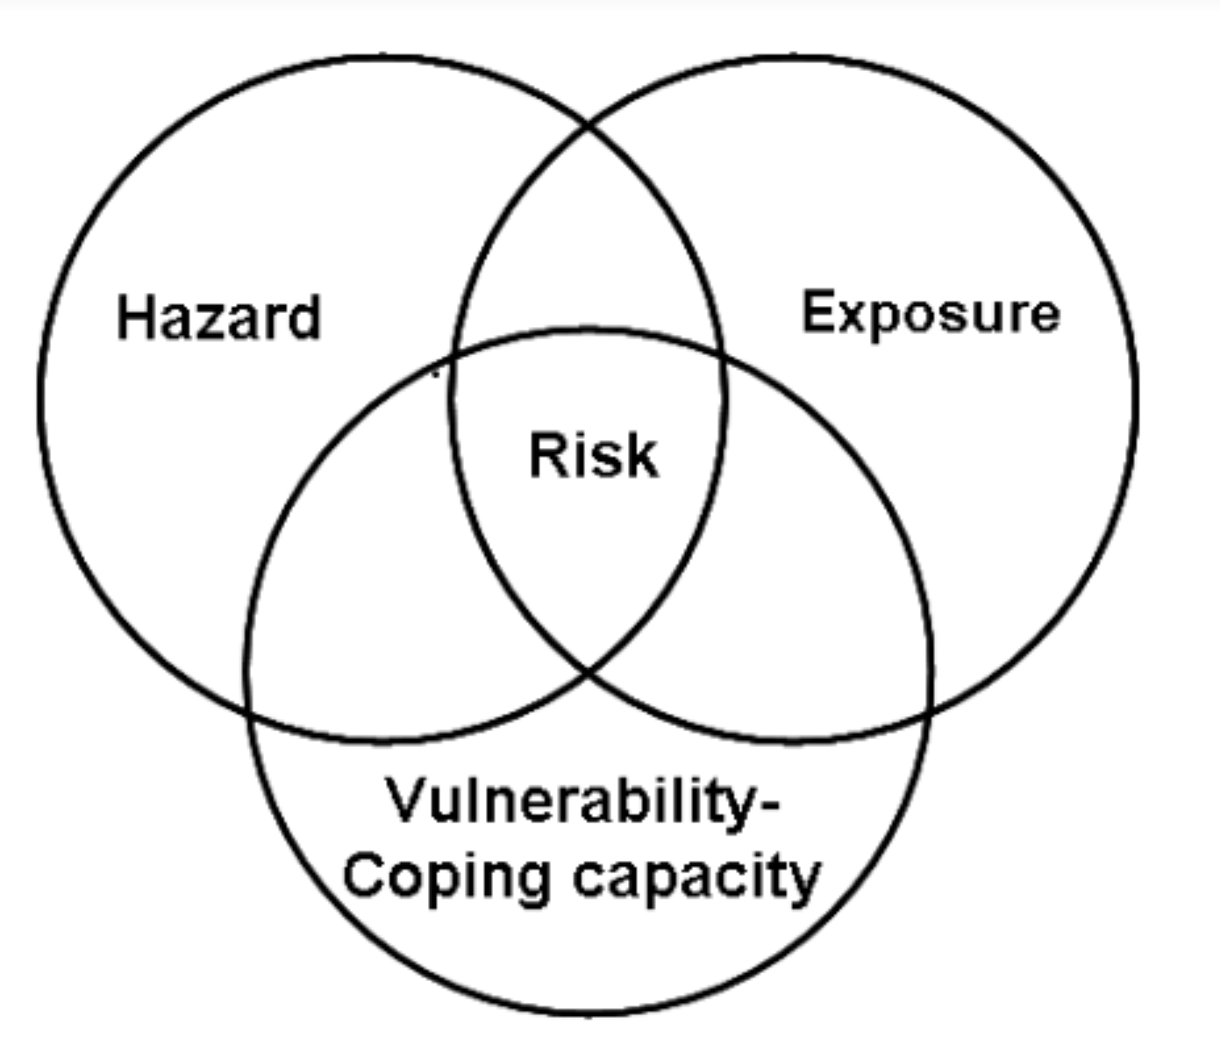
Risk Definition Relating to Hazards
“Risk is a function of the probability of particular hazardous event and the losses each would cause.”
(Dey and Singh, 2006)
Notes:
Now, let’s take another perspective of risk. Like the definitions on previous slides, this textbook definition uses words like “loss” and “hazardous” – furthermore, instead of ”chance,” it uses a synonym, “probability.”
But here, it defines risk as a ”function” which suggests that probability, hazardous events, and losses are all components that directly contribute to risk.
This is also shown in the Venn Diagram on the right, which is from a research paper posted in an academic journal. It shows that risk is composed of three main factors: hazard, exposure, and vulnerability. This brings us to the next slide.

Slide 5
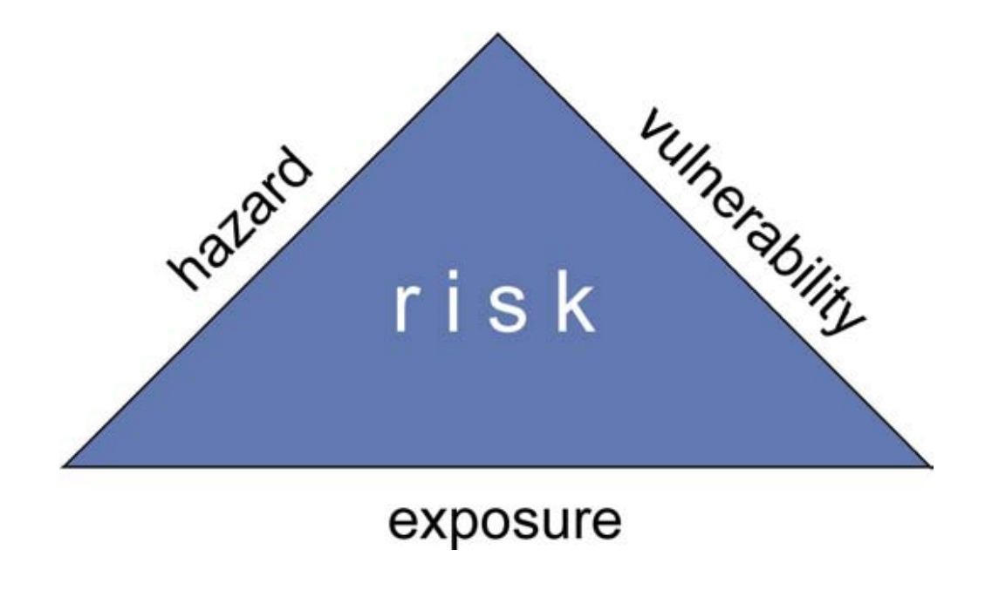
Factors of Risk
“The probability of harmful consequences or expected losses resulting from a given hazard to a given element at danger or peril, over a specified time period.”
(Schneiderbauer and Ehrlich, 2004)
$$Risk=Hazard×Vulnerability×Exposure$$
Notes:
Here is a definition of risk that directly highlights the three main factors of risk, which are also shown in the diagram and the equation.
This definition and the diagram show us that risk is mainly dependent on three things: hazard, vulnerability, and exposure. This means that when we consider risk, we should consider the hazard that is causing the risk, and the potential effect the hazard will have on the community (which includes people, animals, the environment and its resources, property, etc.)
The given equation is representing risk as a product of multiplying hazard, vulnerability, and risk. Although these are difficult to quantify, the purpose of this equation is to show that all three are needed to produce a risk. For example, if we have an extremely dangerous hazard, but nothing valuable is exposed to the hazard, then the ”exposure” element of the risk equation becomes 0, so the overall risk also becomes 0.

Slide 6
What is a Hazard?
“A dangerous condition or event, that threat or have the potential for causing injury to life or damage to property or the environment”
(Dey and Singh, 2006)
Notes:
Now that we know that hazards are a key component to understanding risk, it is vital that we understand what a hazard is.
This is a textbook definition of hazard. Essentially, hazards are any event that presents a potential danger to life, property, or the environment.

Slide 7
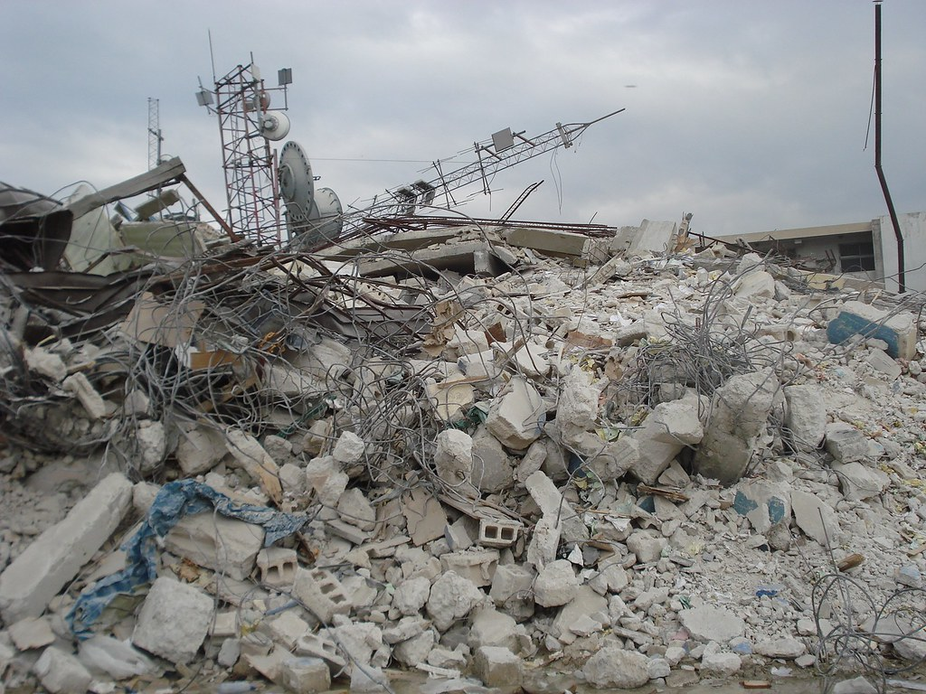
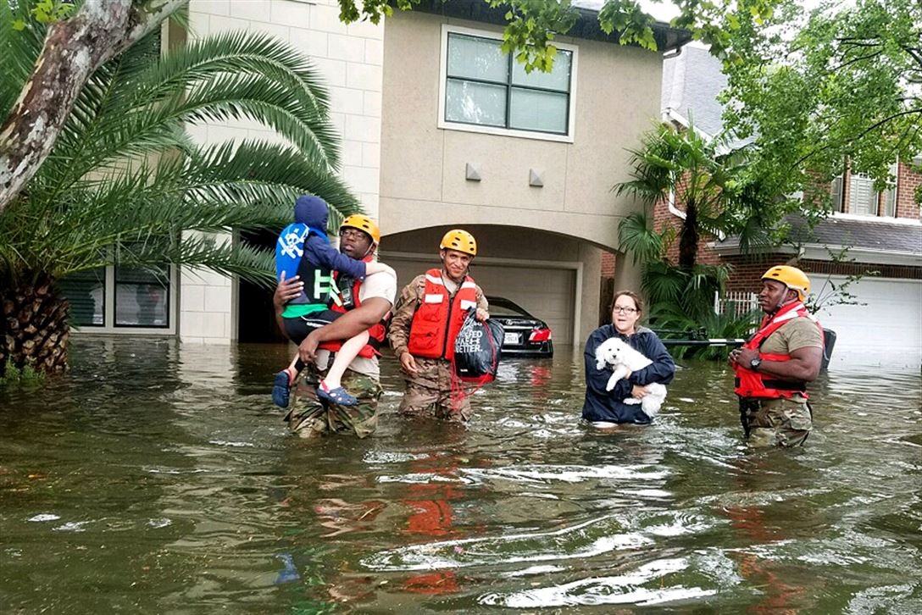
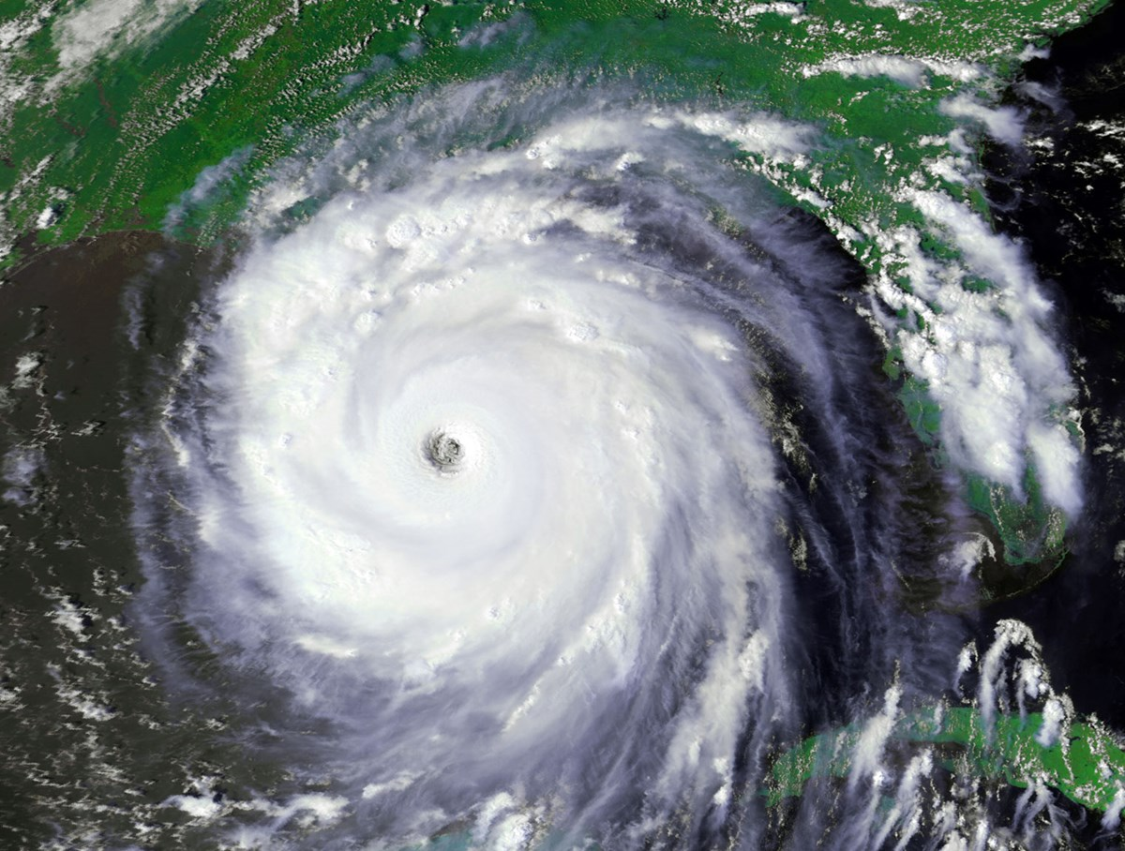
Natural Hazards Examples
Earthquake, tsunami, flood, drought, hurricane, etc.
(Dey and Singh, 2006)
Notes:
Given the definition of hazard on the previous slide, it is easy to understand why many people associate “hazard” with events like earthquakes, floods, and hurricanes. These are events we hear a lot about on the news, and affect individuals, families, and communities in devastating ways all around the world. Such events are labeled as “natural hazards.”
These events are often unpredictable, like earthquakes, but other times we can see them coming and have a few days to prepare, like floods or hurricanes.

Slide 8
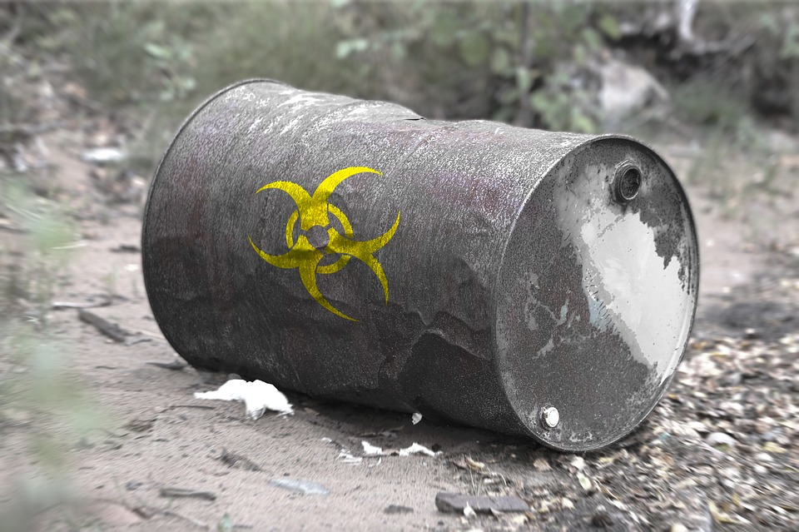
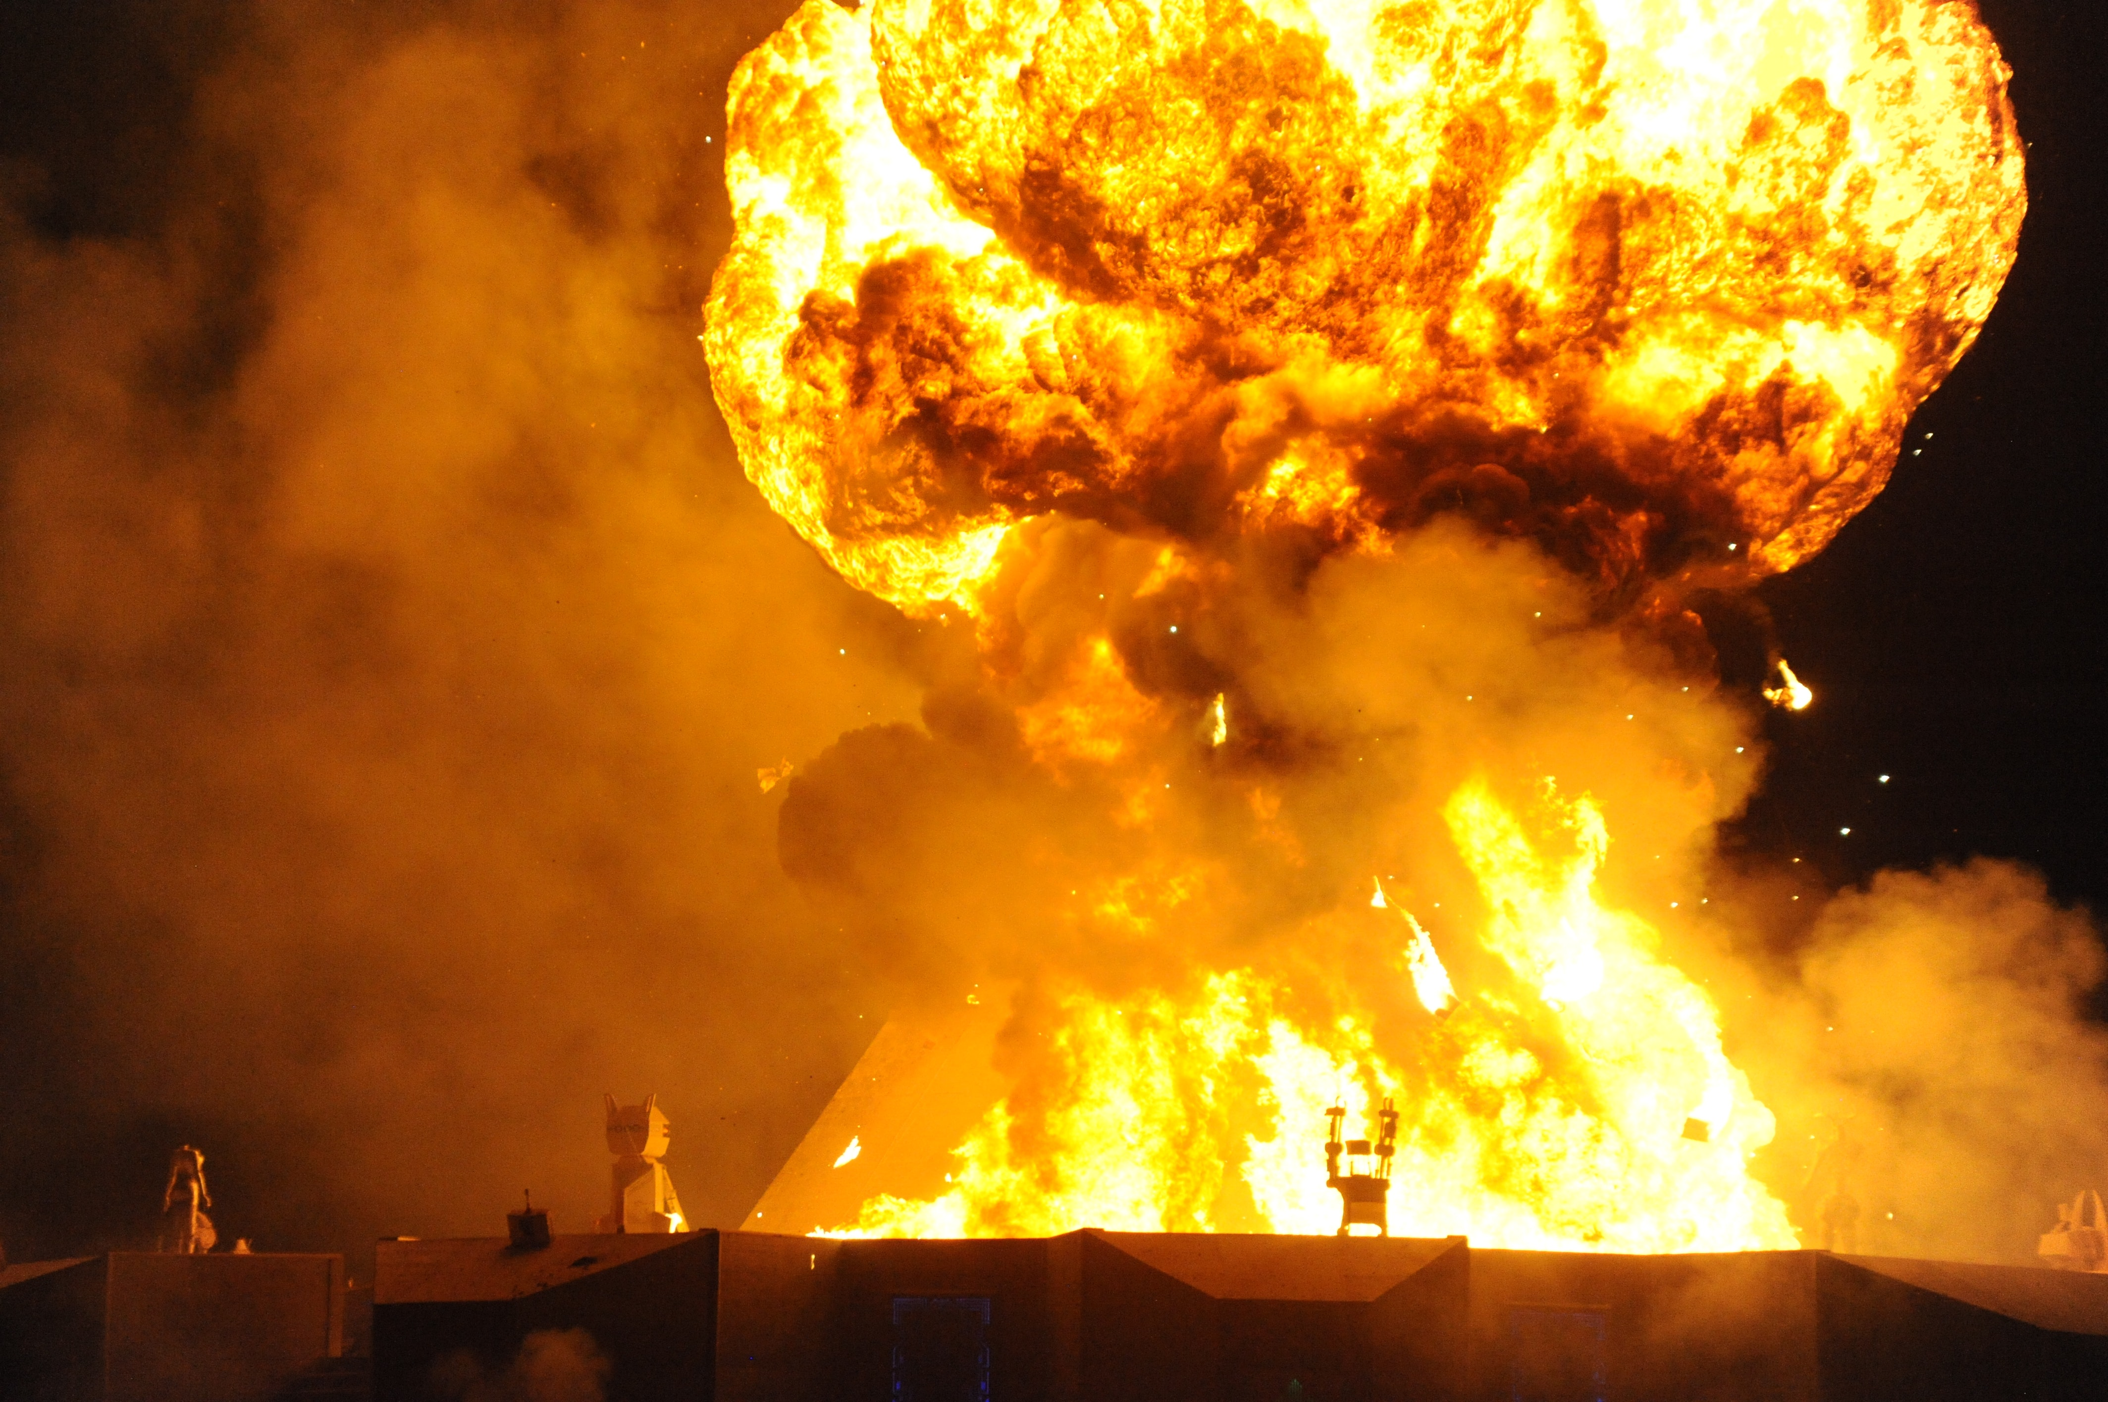
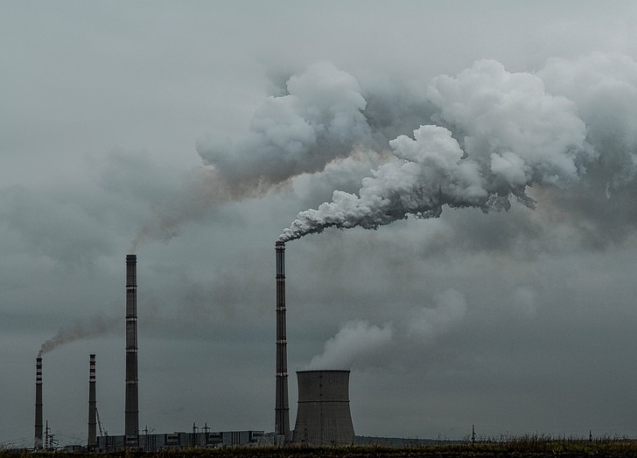
Anthropogenic Hazards Examples
Explosions, toxic waste leaks, pollution, collapses, wars, etc.
(Dey and Singh, 2006)
Notes:
Natural hazards are not the only type of hazards. Anthropogenic hazards can be caused by human activity, as well – this is also known as man-made disasters.
Many events fit under this category. The key question that should be discussed when considering whether a man-made event is considered a hazard is: “does this event affect humans or the environment?” In cases like toxic spills or pollution, the environment is greatly affected since water or air is contaminated. In cases like wars, explosions, or engineering failures such as bridge collapses, human lives are usually lost – thus, it is also a hazard.

Slide 9
Exposure and Disaster
Exposure: “Inventory of elements in an area in which hazard events may occur”
(Cardona et al., 2012)
Disaster: hazards in which something of value has been exposed and is at risk
(Dey and Singh, 2006)
Notes:
Often times, ”hazard” and “disaster” are used interchangeably. However, they are not the same.
The key idea that separates a disaster from a hazard is exposure. The definition of exposure given on the slide describes as elements, which are people, houses, pets, trees, etc. (essentially anything that is valuable), in an area where hazards may hit.
When discussing the risk equation, we noted that if a hazard occurs, it is possible that nothing is at risk. Perhaps, the hazard has occurred in a deserted area, or in an empty ocean, where nothing of value is under threat. In other words, nothing was exposed.
However, “disaster” is used to describe a scenario in which a hazard occurs in an area where something valuable is threatened and in danger. In other words, a disaster directly implies that something or someone was exposed to and threatened by a hazard.
Simply put, all disasters are hazards, but not all hazards are disasters. The important factor to separate the two is exposure.

Slide 10
Vulnerability
“Capacity to anticipate, cope with, resist and recover from the impact of a natural or man-made disaster” (Schneiderbauer and Ehrlich, 2004)
Notes:
We’ve discussed hazards and exposure. The third element of risk is vulnerability.
Whereas exposure is used to describe whether any valuable elements are in an area, vulnerability defines the degree to which those valuable elements are protected from the hazard. Again, this is tough to quantify. To evaluate the degree of protection, we use our knowledge of the potentially affected elements to consider whether they can “anticipate, cope with, resist and recover from” the hazard and its impacts.
For example, if we know a flood will soon hit Tennessee, we can see determine how vulnerable Tennessee’s population and environment are by looking at the government’s plans for floods, the effectiveness of the drainage systems, the insurance that people have, the percentage of people with physical barriers to protect their homes, etc. All of this can help us answer: “if this flood hits, how will people react? How safe will they be? How quickly will they recover?”
Similar to a previous discussion, it is possible, but extremely unlikely, that there is no risk even though there is a hazard and there are exposed elements. Perhaps there are extremely effective measures in place to handle a flood such that no property is damaged, and no lives are lost. This is ideal, but impractical and unachievable, since floods are destructive. Thus, we try to minimize the risk by using some of the measures discussed earlier to reduce vulnerability: detailed planning, effective drainage, insurance, barriers, etc.

Slide 11
Risk Concept
Risk can be handled as three components
Risk analysis
Risk evaluation
Risk management (mitigation strategies)
(Bründl et al., 2009)
Notes:
We now know what factors determine risk. But, the concept of risk can be broken down into three different components.
Risk analysis is the process of determining: “what can happen?” – what are possible scenarios could occur and how those would affect exposed elements
Risk evaluation is the process of determining: “what is the result?” – what are the consequences of the likely scenarios
Risk management is the process of determining: “what can be done?” – what steps must be taken to prepare

Slide 12
Risk Analysis
Societal risk analysis
    - Risk to a group of people in a specified area
Hazard analysis
    - Consider geographical features, determine impacts
    Exposure analysis
    - Identify people/assets of value and their level of exposure
(Bründl et al., 2009)
Notes:
Let’s start with risk analysis. When considering “what can happen,” we should consider what could happen to the different types of exposed elements. Thus, risk analysis must be broken down further.
First is societal analysis, which focuses on people and objects in a specified area. Here, we consider the injuries and fatalities that are expected due to the hazard. We can numerically calculate this by quantifying the expected damage and the frequency/likelihood of the scenario and multiplying the two.
Next is hazard analysis, which focuses on geographical features. Here, we consider the damages to physical features. This can be done with terrain analysis, analyses of topographic and geological maps, aerial photographs, satellite images, and/or historical chronicles. The actual physical impacts once the hazard occurs can be anticipated by physical modeling, and the result of hazard analyses can be displayed in intensity maps for each hazard scenario. Intensity maps indicate at which location a certain physical impact is to be expected during a reference period.
Finally, there is exposure analysis, which focuses on all assets in general. Here, we identify people and assets of value and determine the level of their exposure. The level of exposure varies with types of objects. For example, permanent objects (ex: buildings) in areas are more exposed than mobile objects (ex: people, cars) which can be moved away from those areas.

Slide 13
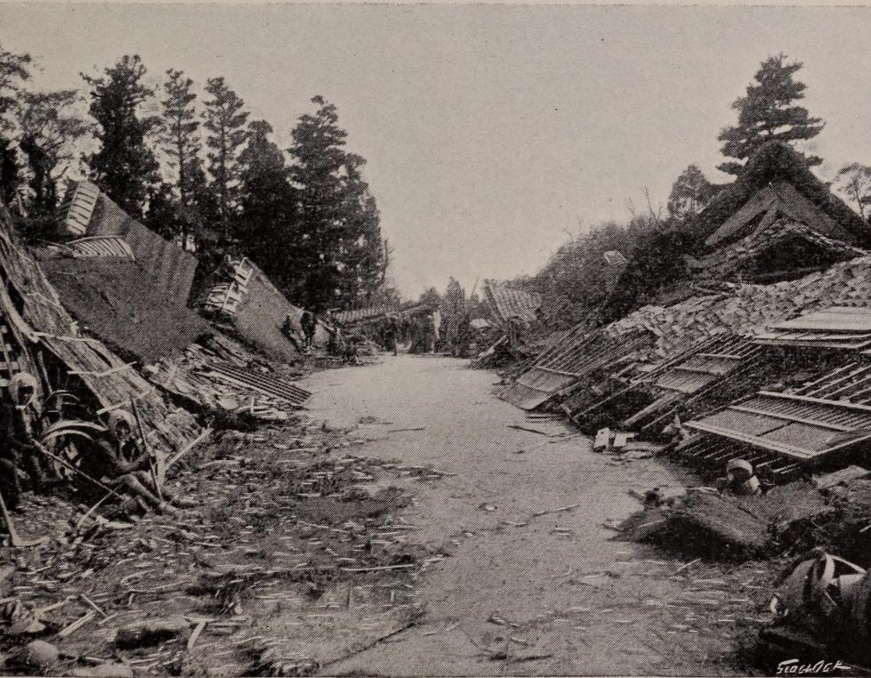
Risk Evaluation
Consequence analysis
- Combine hazard and exposure analyses
- Determine expected damage/loss of all scenarios
(Bründl et al., 2009)
Notes:
The second component of the risk concept is risk evaluation. Here, we can analyze the consequences of each hazard scenario to determine what is likely to happen as a result and what to prepare for. This combines hazard and exposure analyses from risk analysis. By doing so, we can determine the expected damage or loss for all considered scenarios.
To determine this mathematically, we must quantify the expected for every individual at-risk object in each scenario. The total expected loss for a given scenario is then determined by summing all individual losses.

Slide 14
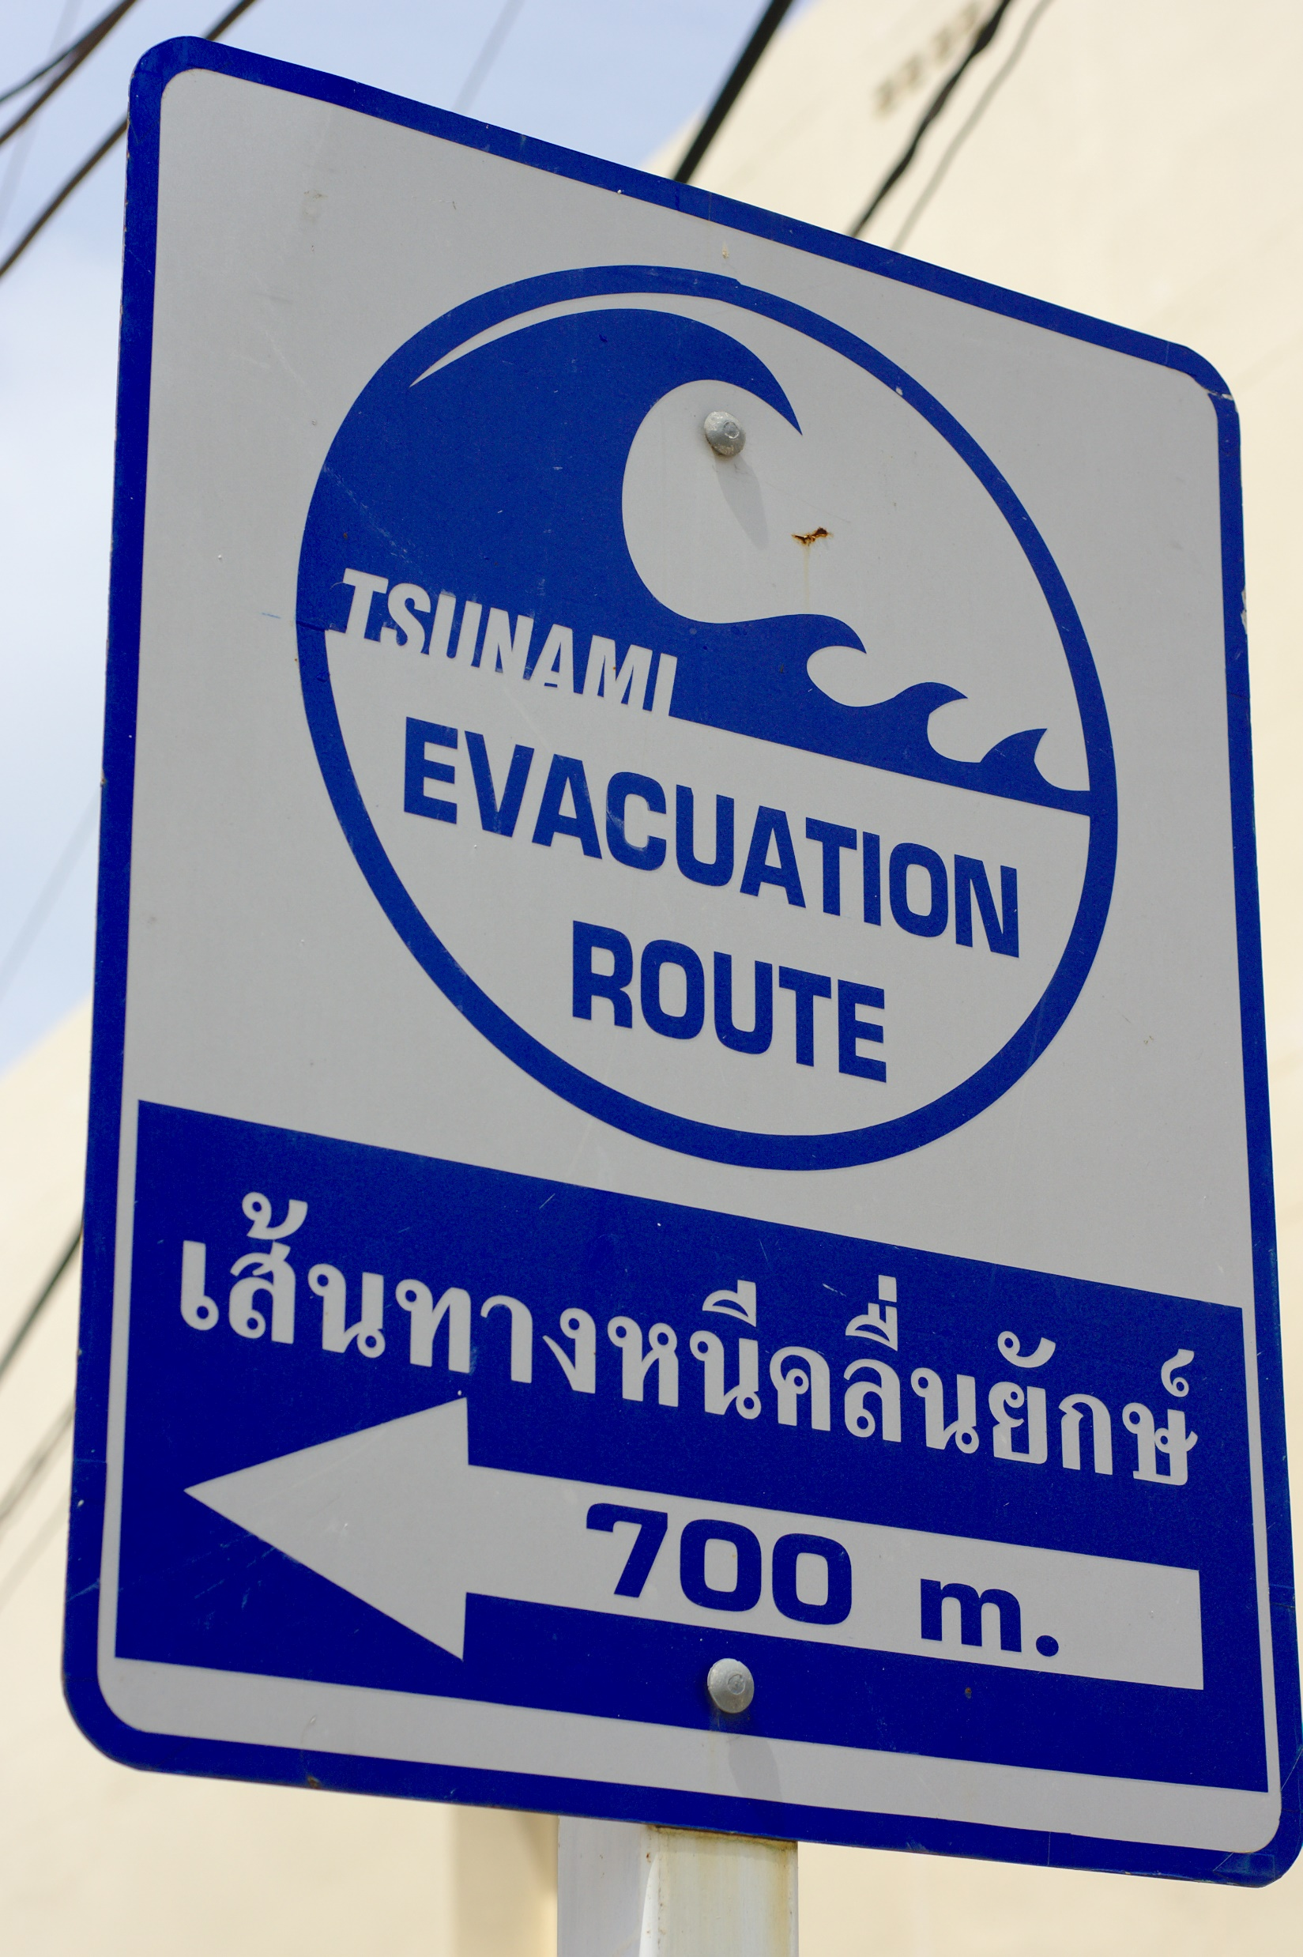
Risk Mitigation
Mitigation: process of reducing risk.
Hazards cannot be controlled, but risk can be reduced
Lower vulnerability and/or exposure to reduce total risk
(Bründl et al., 2009)
$$Risk=Hazard×Vulnerability×Exposure$$
Notes:
The final component is risk mitigation. The purpose of this is to reduce the level of risk for exposed elements.
Although we often cannot control the strength and severity of hazards, we can reduce the level of damage it does to us. We do this by lowering our exposure and/or lowering our vulnerability. More on this on the next slide.

Slide 15
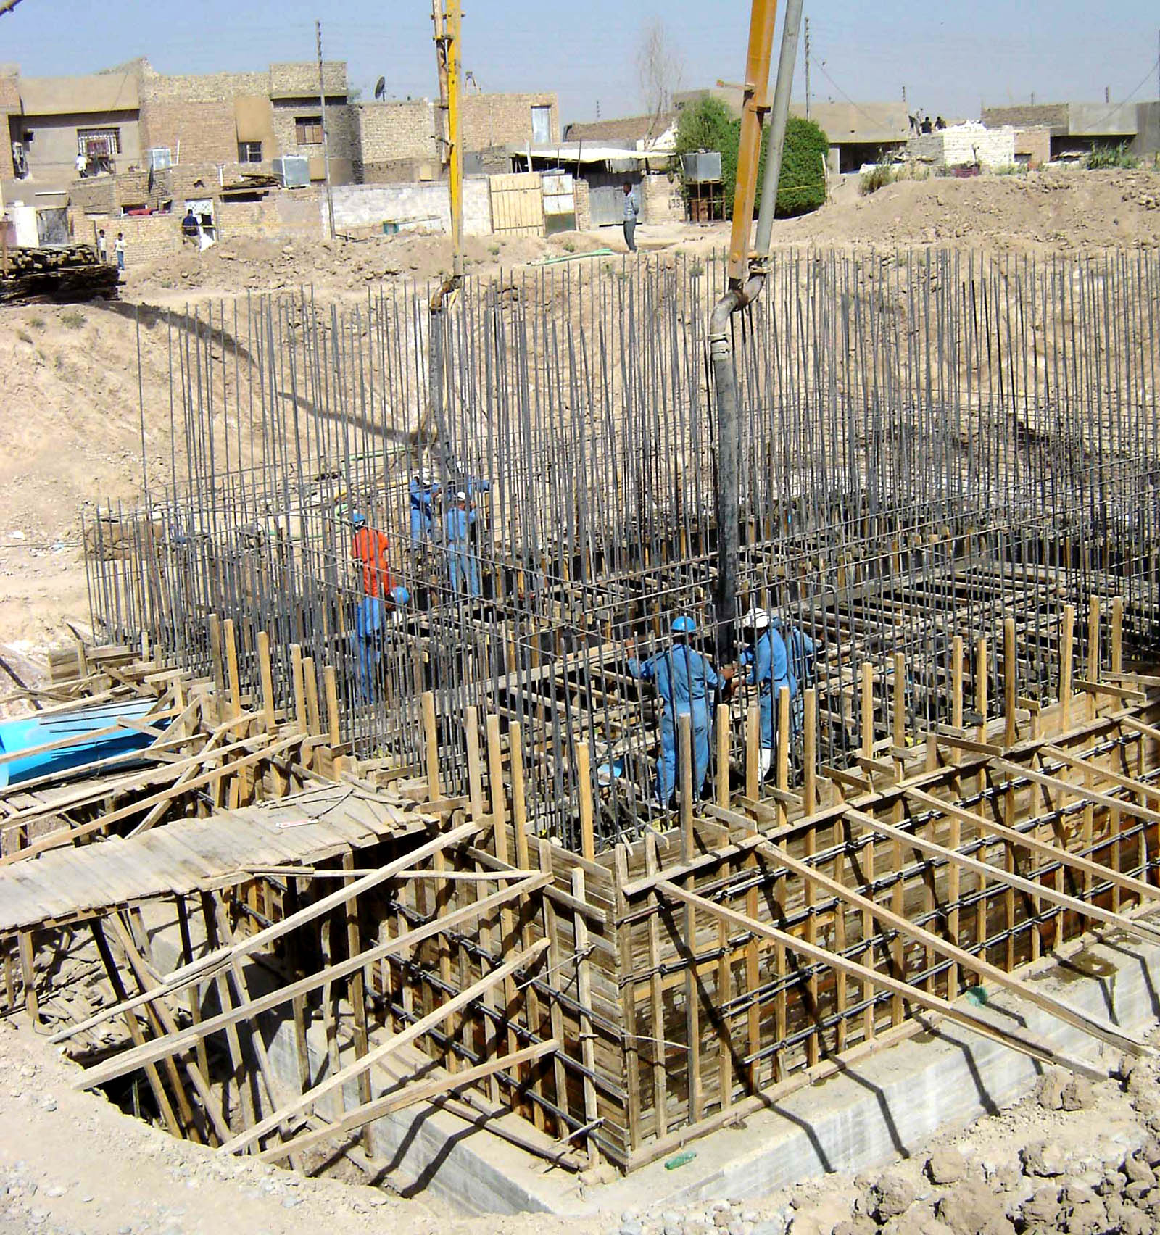
Reducing Exposure or Vulnerability
Evacuating danger areas
Reinforcing buildings
Spreading awareness about common hazards
Preparing emergency plans
(Bründl et al., 2009)
Notes:
Reducing exposure can happen by moving out of potentially affected areas. Reducing vulnerability can happen by adding more measures that protect lives, property, or the environment. This could be by making buildings safer, making people more aware, and preparing emergency plans.

Slide 16
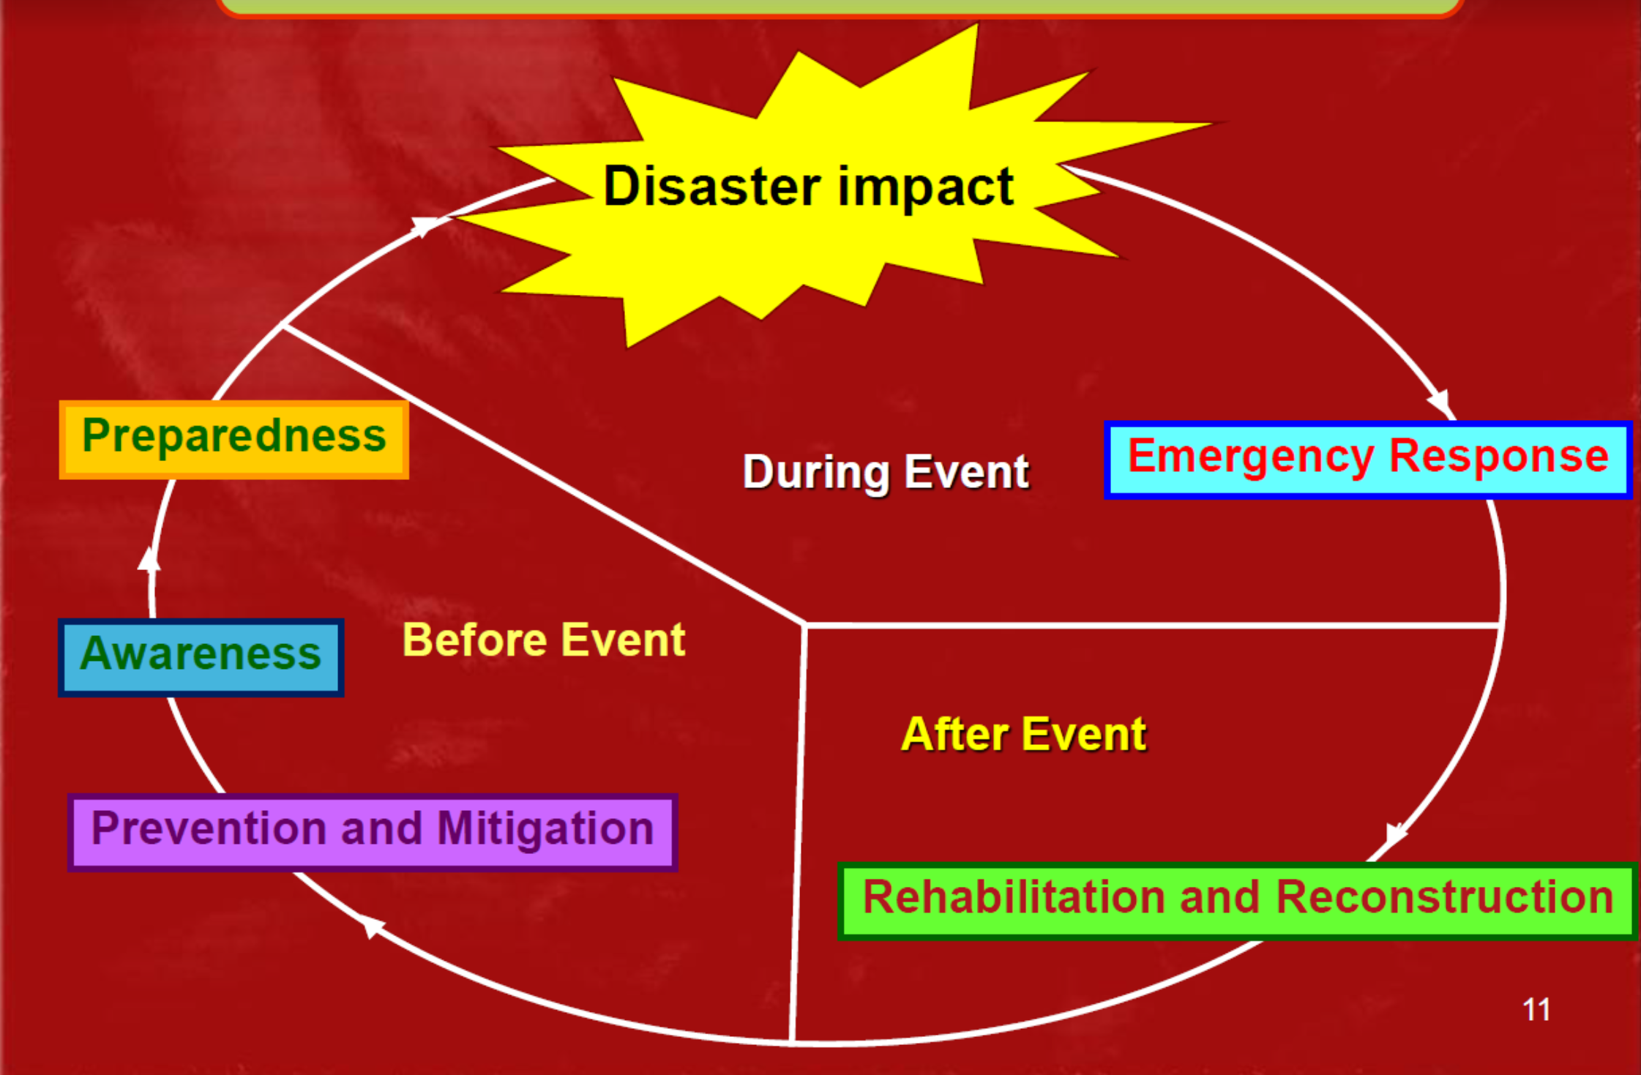
Risk Management Cycle
(Thailand Disaster Management Flow Chart)
Notes:
This diagram sums up the entire hazard and risk process.
The left side explains activities (raising awareness, investing in mitigation, increasing preparedness) that are done pre-disaster and used to reduce risk to a population. The top of the cycle is when the hazard occurs, during which, emergency protocols are used to respond. The bottom right represents post-disaster activities, such as reconstruction, that can restore the community.

