Slide 1
Mitigation and Adaptation
Methods to reduce risk.
Notes:
The goal of this module is to gain an understanding of risk mitigation, how certain measures can reduce risk, and why some people choose not to invest in mitigation. We will start with basic definitions of mitigation and other related concepts (such as tolerance and appetite) and provide everyday examples of mitigation measures. We will then explain the role of insurance because it is a common form of risk mitigation. Finally, will we conclude with a discussion on another effective means of mitigation: education.

Slide 2
Defining Mitigation
“The process of making something less severe or less intense” (yourdictionary.com)
“Lessening the force or intensity of something unpleasant, as wrath, pain, grief, or extreme circumstances” (dictionary.com)
Notes:
Let’s start by defining “mitigation” the way we use it in our everyday lives. The definitions presented on the slide describe how the term is used in conversational contexts and settings.
By comparing these two basic definitions, we can understand the key idea behind mitigation: lessening the intensity of something. Other related themes will be discussed in later slides.

Slide 3
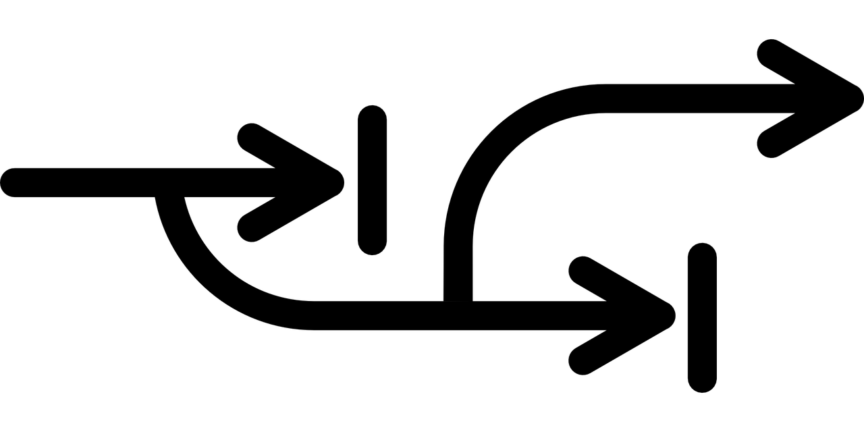
Defining Adaptation
“A change or adjustment to improve something, or to make it suitable to a different situation” (yourdictionary.com)
“Adjustment” (dictionary.com)
Notes:
Now, let’s define “adaptation” the way we use it in our everyday lives. The definitions presented on the slide describe how the term is used in conversational contexts and settings.
By comparing these two basic definitions, we can understand the key idea behind adaptation: adjustment to a situation.

Slide 4
Other Basic Terms
Risk appetite: amount and type of risk someone is willing to take in an effort to meet their goals
  Dependent on culture, financial resources, goals, etc.
Risk avoidance: process of taking action to avoid risk
  Withdrawing from an activity to shield from the risk that comes with that activity
Risk tolerance: expressing that the perceived risk is or is not tolerable
  Not how much risk is accepted, but how much can be handled
  (Society for Risk Analysis, 2015)
Notes:
Here are some other basic terms that are helpful when considering risk mitigation.
Risk appetite refers to the willingness to absorb risk in order to meet certain goals. You may have heard the phrase “high risk, high reward” – how high a person is willing to go is their risk appetite. This depends on many things, including the level of current financial resources, the commitment to the goals (ex: is it worth it?), and size of the reward.
Risk avoidance refers to the process of taking action to reduce risk. This could be as simple as leaving a risky situation/activity and pursuing something else.
Risk tolerance defines how much risk someone can handle. This is similar, but not the same, to risk appetite. The difference here is that risk tolerance defines the absolute threshold of risk that cannot be crossed, whereas risk appetite is about how much someone is willing to take in. Think about this as the difference between want and need. We want to stay under our maximum level of risk appetite, whereas we need to stay under the maximum level of risk tolerance.

Slide 5
Appetite, Avoidance, Tolerance
These terms can help develop a plan for what to do.
Provide better understanding of risk exposure and potential tradeoffs
Effectively understand and communicate the boundaries related to any/overall risk
Guide decision-making processes
Guide resource allocation
Notes:
Risk appetite, avoidance, and tolerance are three concepts that can be used in decision-making. The terms are usually used for an internal reference: “How far am I willing to go? How can I make sure that I avoid too much? How much can I handle?”
These questions help us gain a basis for further decisions by giving us a better understanding of the amount of risk that we are exposed to.
These questions can also be used to guide risk management. In consideration of the questions, we understand and explain our own situation, decide the most effective plans, and allocate our resources accordingly.

Slide 6
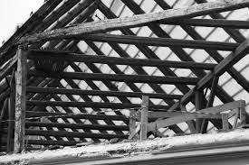
Mitigation Measures
Actions carried out pre-disaster to reduce the level of risk
Improve the stability of the house/building/community
  Reinforcing walls, improving foundation, constructing levies, etc.
Typically require large, upfront investment
  Investment doesn’t prove its worth until disaster strikes
(Kunreuther, 1996)
Notes:
What actions can we take to reduce the severity of hazards? Or more simply: how can we mitigate the risk?
Recall that risk is determined by three main factors: hazard, exposure, and vulnerability.
Most natural hazards affect infrastructure or property, such as houses, buildings, and communities. Therefore, a common way to reduce risk is to improve the protection of these properties by reinforcing walls, improving the strength of the foundation, or placing protective barriers such as levies. Such protection lowers the vulnerability to the hazard, thus the overall risk is reduced.
In general, all forms of mitigation require large, upfront costs. Reinforcing walls requires the purchasing of new/better material, construction equipment, and/or workers. Such investment doesn’t pay off until an actual disaster strikes – and even then, sometimes it isn’t enough.

Slide 7



Common Examples of Mitigation
Life-jackets
Helmets
Shin guards
Knee/elbow pads
Notes:
Some common, every-day example of how we reduce our vulnerability towards certain risks. Can you explain how each of these measures protects someone and/or something?

Slide 8

Why People Don’t Invest in Mitigation
Cost of investment could exceed the perceived future cost of damages
For short-term purchases, mitigation may seem impractical
Underestimation of probability
  People don’t believe that they are in a position of risk
  People may have a threshold limit of risk
(Kunreuther, 1996)
Notes:
Investment in mitigation can be significant and may not be realized immediately or in the near future.
Many people believe that those large costs are not worth it. They believe that the cost of investment is too high, and any costs of damages that they will pay in the future will amount to less than consistent payments to insurance companies. Specifically for short-term purchases, like renting a car or home for a couple of months, those mitigation costs seem impractical.
Often people do not invest in mitigation because they believe the chance of disaster is too low. This belief can be risky and expensive. Effective mitigation can ensure that even with a remote possibility, mitigation can reduce the impact of a disaster.

Slide 9
Examples of Insurance
Flood insurance (FEMA offers national insurance program)
Earthquake insurance
Car insurance
Home insurance
Renter’s insurance
Life insurance
Notes:
Insurance is an extremely common form of mitigation.
This list is a small sample of some types of insurance – there are many more. But what exactly does insurance do?

Slide 10
Role of Insurance
Two factors considered by insurance companies: likelihood of disaster and expected damages
Insurance is cheaper for people at less risk/danger
  Encourages risk mitigation on a household/individual level
Provides financial assistance if hazard strikes
  The insurance provider takes the responsibility of the risk onto themselves in cases of disasters
Notes:
Companies that provide the insurance set prices by considering two factors: the probability of a disaster occurring, and the level of damages expected.
Given these two factors, it follows that insurance is cheaper for those who are less at risk. This is because either it is less likely for the disaster to strike or there is adequate protection already in place. Since the likelihood and/or the amount of assistance is lower, the cost of the assistance is also lower. This pricing encourages households to do some level of risk mitigation on their own. By investing in more protective measures, the cost of insurance is lowered. By then buying insurance, the household then covers itself from any damages that the protective measures cannot handle.
Insurance companies provide financial assistance if hazard strikes. In the case of a disaster for which you are insured, the insurance provider takes the responsibility of your risk onto itself – this means that it will pay for most damages and costs. In return, by buying insurance, you agree to some sort of payment towards the company for accepting the burden of the risk. This payment must occur, even though the disaster may not.

Slide 11
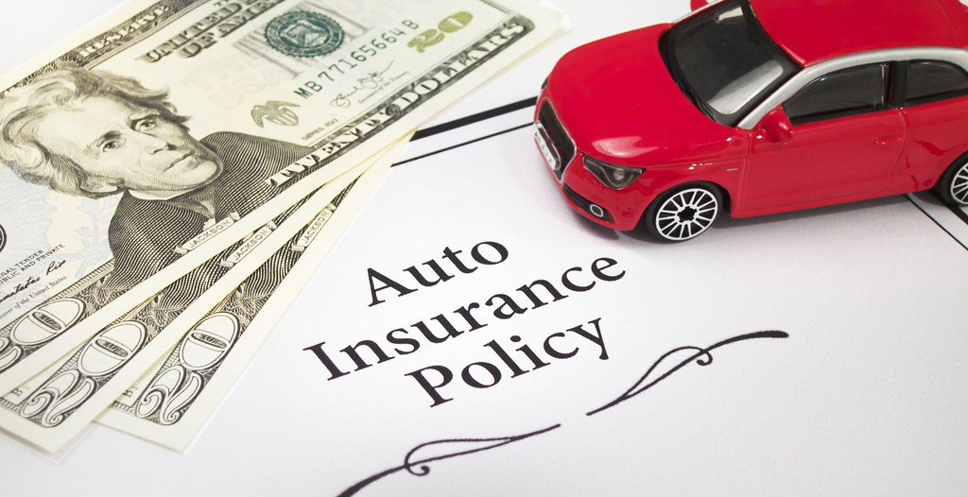
Cons of Insurance
Premium: amount paid to purchase insurance (can be high)
Insurance can only be purchased for a limited amount of time (6 months, 1 year, etc.), can be renewed each time
  Any expected benefits are only valid if they fall within that time
  Mitigation measures are more long-term
(Kunreuther, 1996)
Notes:
In return for insurance protection, you pay a premium. Premiums can be high, especially in areas with high risk tendencies.
Insurance policies are often for a limited amount of time and require a renewal. Therefore you must continually invest and keep up with your policy. This means that you may not be committed to the same policy for too long. Compared to insurance, other mitigation measures are more long-term. For example, if you add more protective measures to your house, such as reinforced walls or stronger windows, those will likely protect you for longer than one year and still reduce your level of risk.
Insurance only covers accidents or hazards that occur during the policy period. If you purchase car insurance for one year but do not get into an accident in that time period, you don't gain any benefit from your premium payments. The benefit comes only if you get into an accident and need coverage from your insurance provider.
The cons discussed above arise when considering a financial perspective. However, insurance can also be considered through the lens of risk. When an insurance policy is purchased, the provider is assuming the risk. The insured receives the reassurance that they are covered in case of an accident and will not be financially burdened. Therefore, even if you don’t need financial support from your provider to cover an accident, you do receive the security and reassurance of coverage.

Slide 12
Why People Don’t Buy Insurance
If risk is perceived to be low, consequences seem harmless
Myth: people expect government aid and don’t buy insurance
  Reality: people use personal financing and/or loans to recover
People who buy insurance tend to cancel instead of renew, especially if nothing harms them while covered
(Kunreuther, 1996)
Notes:
What are some reasons people do not purchase insurance?
Let’s assume that you buy car insurance for six months and no accident occurs. You renew your insurance, but still, no accident occurs for the next six months. This process continues for years and years. Eventually, you may get frustrated thinking that you pay a big premium every six months and never get any monetary payback. So, you finally cancel your insurance. This is a common case – when people buy insurance but then do not face any harm, they cancel instead of renewing.
People may also choose not to buy insurance if the perceived risk is low and/or the consequences don’t seem too bad. For example, if a flood is approaching, a homeowner may be confident that the protective measures can handle the strength of this flood. This means that the homeowner believes that they are not vulnerable because they are well protected or that the hazard’s impacts are not severe; in either case, the risk is perceived as low. Thus, the homeowner may choose not to purchase insurance for the house.
It is a common perception that in the case of a disaster, the government will step in to help everybody. However, this is often not the case. Although some people are eligible for government aid, the reality is that most people rely on their own personal financing or take on some form of debt to recover from a disaster.

Slide 13

Why People Don’t Buy Insurance
Insurance providers charge more for ambiguous, uncertain, and unpredictable cases because the risk is hard to estimate
  For extreme disasters, providers will need to spend more to finance recovery
Insurance providers don’t always advertise/promote
  Having too many clients can be dangerous
  If high impact disaster strikes, providers are at risk of going insolvent due to the heavy financing required for recovery
(Kunreuther, 1996)
Notes:
For risks that are highly uncommon, unpredictable, and/or uncertain, the premiums tend to be much higher. This is because the burden of risk taken on by the insurance provider is difficult to estimate. Think about it this way: given the unpredictable nature of the risk, it is possible that the impacts of the disaster are quite extreme. This means that if an extreme disaster strikes, the recovery from the disaster would be very expensive. Therefore, the insurance provider will require a larger premium upfront to finance the recovery in the future.
Lastly, not all insurance providers advertise or promote themselves in the public eye. The job of an insurance provider is to step in when a disaster strikes. But what happens if too many people rely on the same provider? If a disaster strikes that affects too many people and/or heavily affects one specific area, then the insurance provider could go bankrupt trying to financially help everyone. Thus, having too many clients can be dangerous for an insurance provider. So, some providers choose to stay out of the spotlight, and as a result, fewer people buy insurance.

Slide 14
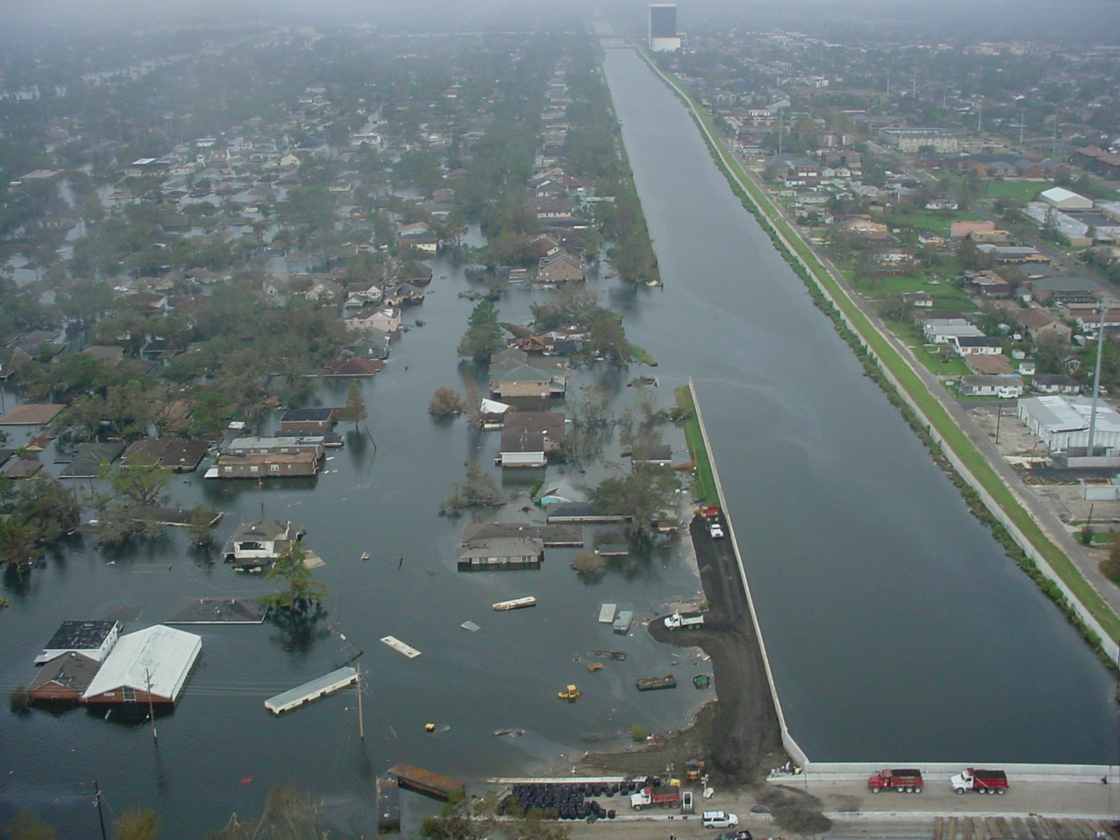
Is Insurance/Mitigation Worth It?
Floods are the most common, destructive, and costly disaster
Recovering from weak flood damages in an average home costs roughly $27,000
Average cost of flood insurance is $700 per year, but varies greatly depending on the region
(Pogol, 2020)
(Federal Emergency Management Agency, 2017)
Notes:
Is insurance worth it? To answer this, let’s look at floods. The data and information on this slide are taken from the Federal Emergency Management Agency (FEMA). Floods are a special form of disaster because, according to historical data, they are the most common, most destructive, and most costly disaster.
Financing personal recovery from a weak flood can cost an average of $27,000. By contrast, the average cost of flood insurance is $700 per year. This cost of insurance varies greatly depending on the region (since the likelihood of flood also varies by region) and must be renewed for long-term coverage.
Let’s run through an example. Assume I live in an area where the averages for both numbers are met; flood insurance costs me $700 a year and without insurance, recovery from damages would cost me $27,000 per disaster. With these numbers, one uninsured damage is more expensive than paying for 38 years of insurance. In those 38 years, let’s assume that there were only three floods. Having an insurance plan would save me a lot of money and effort because a total of about $27,000 is paid over 39 years for coverage of multiple floods, instead of paying around $27,000 each time a flood occurs.
This example had three floods in 38 years. In areas where floods are common, they would occur at least once a year – here, flood insurance would cost slightly more, but will likely stay below the cost of uninsured damages. And of course, where there are more floods, there is a greater chance for damages. Thus, whenever disasters are more common, insurance seems more and more worth it. But even in the example above, where floods are uncommon (only once a decade), the insurance was still a good option because it covered three floods over 38 years at the same price for one uninsured damage. Thus, insurance is only not worth it if other forms of mitigation (like protective barriers) can be placed that would be sturdy and more long-term and/or disasters are very, very unlikely.

Slide 15

Mitigation + Insurance Example
FEMA’s Community Rating System (CRS) identifies communities that have (or have not) invested in flood mitigation
Flood insurance rates can go down by 45% for properly mitigated regions
(Federal Emergency Management Agency, 2020)
Notes:
Earlier, it was discussed how the prices of insurance policies reflect the level of mitigation. When a disaster occurs, insurance providers cover for the damages done. When more protective measures are in place, there are fewer damages and less paid by insurance providers. This lowers the cost of insurance for those that are already more protected. Thus, insurance encourages mitigation.
FEMA has a rating system that identifies communities with more protective measures. In those areas, flood insurance is much cheaper. In fact, flood insurance rates can go down by as much as 45% for well-mitigated areas.

Slide 16
Education for Risk Reduction
Raise awareness for potential risks and risk reduction
Campaigns, public messages/advertisements, workshops could all be used for educational purposes
Curriculums designed specifically for exposed and/or vulnerable populations can reduce future damages
Can encourage local governments to bring policy changes that address risk that people are concerned about
(Asharose et al., 2015)
Notes:
Another common form of risk mitigation is education. By making people aware about potential risks, or even the concepts behind risk, they can make decisions about how to reduce the risks that they face.
Risk and hazards can be taught in various ways. Public advertisements, campaigns, and workshops can all be used to educate. Schools can adopt curriculums that focus on hazard safety to the younger generation. Regardless of the way risk is taught, it is extremely important because people must understand risk in order to effectively mitigate it. Education can be the first step towards lowering exposure, improving protection, and reducing future damages.
Additionally, if enough people believe they are threatened by a hazard, they can encourage local governments to adopt new policies. Such action can be used to make the entire local population safer.

Slide 17

Education for Risk Reduction
Direct education: taught in classrooms, included in syllabus
Indirect education: extra-curricular activities (clubs), games, competitions, student-led discussions
Focusing on younger generation leads to more long-term safety
(Asharose et al., 2015)
Notes:
How can we educate?
There are two basic approaches to education: direct and indirect. Direct education is used when referring to classrooms; so this method involves a syllabus, lectures, teachers, etc. Indirect education refers to all other forms of education: extracurricular activities, games, competitions, discussion groups, etc. The two methods are often used together to make educating a more well-rounded, information, and fun experience.
Why is education important?
Education instills values in the next generation. By starting early with risk education, the information is better remembered and can have a long-term impact. Members of the younger generation grow to become leaders in their community; for example, they may become the decision-maker of a household, run a business, and/or work in government. At that time, they can utilize their childhood education to help make a safer population.

