Slide 1

VUH Pressure Injury Prevention Champion Class

Slide 2


Objectives
Define the role and responsibilities of the unit-based Pressure Injury Prevention Champion
1
Discuss the pathophysiology of a pressure injury, recognize potential causes, and identify patient populations at risk for developing a PI
2
Discuss best practice for pressure injury prevention related to pressure and shear/friction reduction, moisture management, and surface pressure redistribution
3
Demonstrate and/or verbalize appropriate pressure injury prevention strategies based on the patient’s risk factors
5
Discuss pressure injury risk assessment and prevention documentation requirements
4

Slide 3
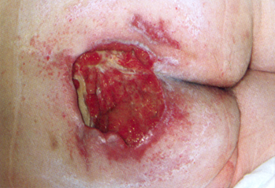
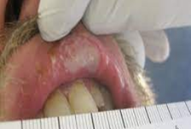
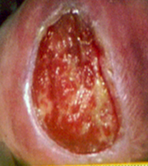
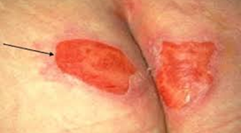
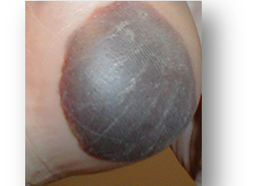
Purpose
Prevent patient harm
Pain
Delayed recover
Longer hospital stay
Patients who develop a HAPI are 2.8 times more likely to die during their hospital stay and 1.69 times to die within 30 days of discharge.
Cost of PI to hospital 11 billion aggregate cost annually (https://europepmc.org/article/nbk/nbk54557)
Notes:
-in 2008 law passed that hospitals will not be reimbursed for HAPI's, potentially costing the hospital millions of dollars

Slide 4

Skin Champion Remodeling
The role of the “Skin Champion” is shifting from when it was originally introduced at VUH, based on findings from a Failure Modes and Effect Analysis (FMEA) that was conducted on the VUH Pressure Injury Prevention and Identification Program
The goals is for Champions to be focused more on prevention
The “Skin Champion” title will change to “Pressure Injury Prevention Champion” as these champion are trained on PI prevention strategies.
Notes:
Be clear to staff how to let them know they are their PIPS Champion -> Identify yourself at huddle as PIP Champion and on visual management board
Participate in monthly PIPS meetings or if can not attend review meeting minutes
- Quarterly meeting for PIP champions to discuss ideas/collaborate?
- Placeholder in agenda for PIP committee for report outs from PIP champions

Slide 5

Pressure Injury Prevention (PIP) Champion Roles and Responsibilities
Provide at the elbow support to bedside staff for pressure injury prevention by:
Participating in 50% monthly/quarterly PI surveys (6 out of 12) and use findings to drive unit-based interventions
Or complete PI prevention related activities in partnership with unit leadership, such as K-Card rounding, repositioning audits, etc.
PI prevention monthly education (flyer, presenting info/data at unit board/staff meeting, rounding, etc.)
Acting as liaison between bedside staff, manager, CNS, Nursing Education Specialist, and Wound Experts
Encourage participation in the VUH Pressure Injury Prevention (PIP) Committee Meeting
Notes:
Be clear to staff how to let them know they are their PIPS Champion -> Identify yourself at huddle as PIP Champion and on visual management board
Participate in monthly PIPS meetings or if can not attend review meeting minutes
- Quarterly meeting for PIP champions to discuss ideas/collaborate?
- Placeholder in agenda for PIP committee for report outs from PIP champions

Slide 6

PIP Champion Competency
PIP Champions must:
Complete initial training
Pre-existing Skin Champions will need to go through PIP Champion Training to be trained on prevention strategies
Annual competency must be completed to maintain PIP Champion status
The competency will align with the roles and responsibility of the PIP Champion.

Slide 7


What is a Pressure Injury
Localized damage to the skin and underlying soft tissue
Open or intact skin
Multiple factors can lead to PI development
Nursing Sensitive Indicator
Cone-shape distribution
The visible injury may be just the “tip of the iceberg”
Notes:
Localized Damage –
usually over a bony prominence or related to a medical or other device. The injury can present as intact skin or an open ulcer and may be painful.
When the skin and tissues are compressed, blood cannot circulate causing a lack of oxygen and nutrients to the tissue cells.
Pressure compresses tissue and blood vessels impairs flow of oxygen and nutrients, leading to tissue hypoxia, injury and death.
Nursing Sensitive Indicator –
Influenced by nursing care and in collaboration and coordination with interdisciplinary partners (providers, care partners, nutrition, PT/OT, respiratory therapy, etc.)
Cone-shaped Distribution
Pressure over a bony prominence tends to result in a cone-shaped distribution with the most affected tissues located deep, adjacent to the bone-muscle interface.

Slide 8
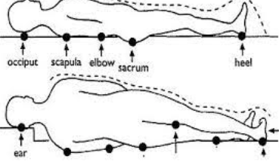
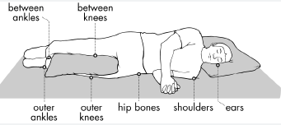
BONY PROMINENCES

Slide 9
Skin Assessment Reminders
Skin Assessment
Complete a head-to-toe skin assessment, assessing all pressure points including those underneath preventive foam dressings and around medical devices.
Skin Assessment Frequency
Complete a head-to-toe skin assessment assessing all pressure points:
Braden Risk Scale
Complete a Braden Risk Scale:
Within 8 hours of admission; Every shift; AND With significant change in the patient’s condition
Within 8 hours of admission; Every shift; AND With significant change in the patient’s condition

Slide 10
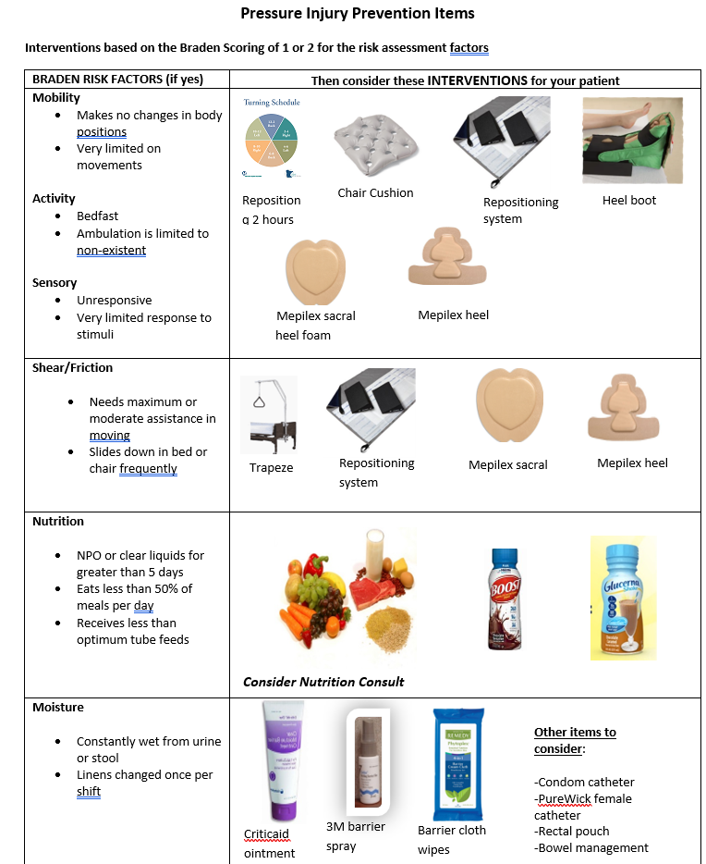
Braden PI Risk Score
Braden PI risk score = 18 or less
Additional Considerations:
If a patient has an existing PI, they should be considered “at risk” regardless of Braden
Interventions to reduce PI risk target the Braden sub-scores is located on the PIPs website
Sub-score definitions and suggestions for intervention items are also found in e-Star sidebar

Slide 11
Braden Scale for Risk Assessment Tool
Sensory Perception
Moisture
Activity
Mobility
Nutrition
Friction & Shear
Notes:
Sensory Perception
The ability to detect and respond to discomfort or pain; The ability to sense pain itself plays into this category, as does the level of consciousness of a patient and therefore their ability to cognitively react to pressure-related discomfort.
Moisture
Excessive and continuous skin moisture can pose a risk to compromise the integrity of the skin by causing the skin tissue to become macerated and therefore be at risk for erosion.
Activity
This category looks at a patient's level of physical activity since very little or no activity can encourage atrophy of muscles and breakdown of tissue.
Mobility
This category looks at the capability of a patient to adjust their body position independently. This assesses the physical competency to move and can involve the patient’s willingness to move.
Nutrition
Eating only portions of meals or having imbalanced nutrition can indicate a high risk in this category.
Friction & Shear
Friction-resistance between two surfaces moving against each other Shear is the opposing motion of two surfaces

Slide 12
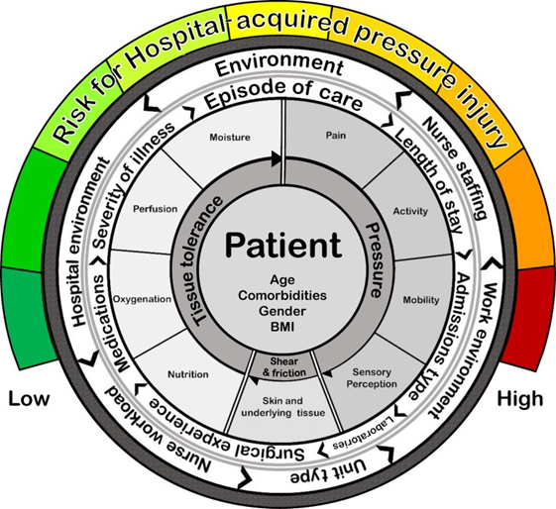
Additional PI Risk Factors
Higher glucose, BUN and creatinine levels
Low Albumin and Hemoglobin levels
Chronic conditions
Extreme BMIs (morbid obesity or underweight)
Extreme temperatures (hypothermia and fever)
Patients with an admit to ICU or surgical unit
Low bed turnover
Nurse staffing (hours per day)
Nursing skill mix
Expertise of staff
Medical device = 2.4x risk
Oxygen support = 5x risk
Vasopressor use = 8x risk
Length of Stay greater than x risk days = 7.5x risk

Slide 13
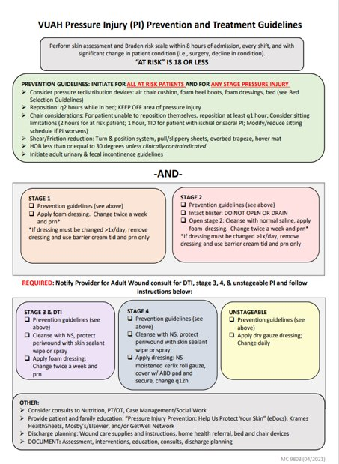
You can ask the patient’s primary team for a consult to the Adult Wound Team with concerns for ANY pressure injury

Slide 14
Five-Layer Foam Dressings
Sacral
Heel
4x4 Square
Notes:
5-layer foam dressings have been proven to prevent Pis
Sacral Dressing
Position the bottom of the dressing in the gluteal cleft
4X4 Square Dressing
Can be used in many locations, such as elbows or other small areas
Foam Bordered Dressing
Can be used to pad devices but should not be cut

Slide 15
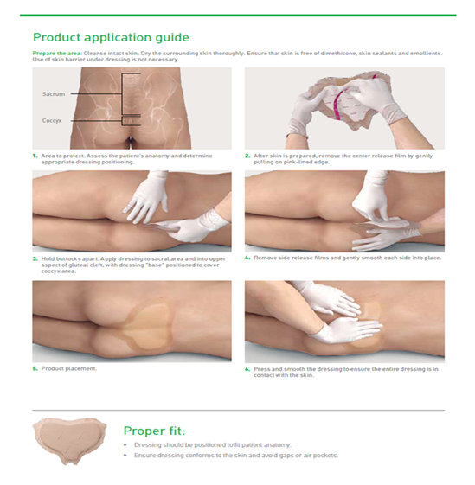
5 Layer Foam Sacral Dressing Application

Slide 16
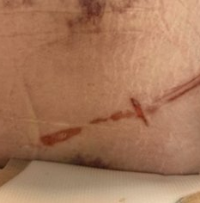
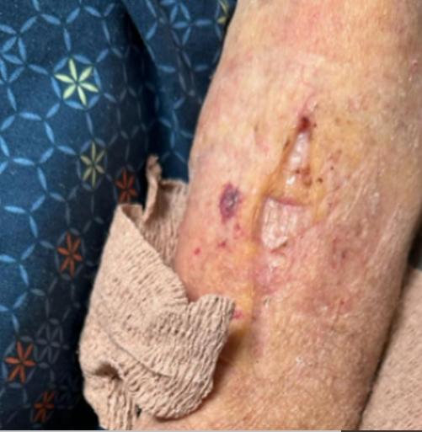
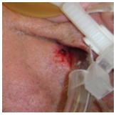
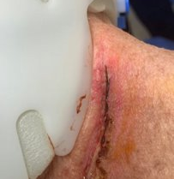
Device Related Pressure Injuries

Slide 17
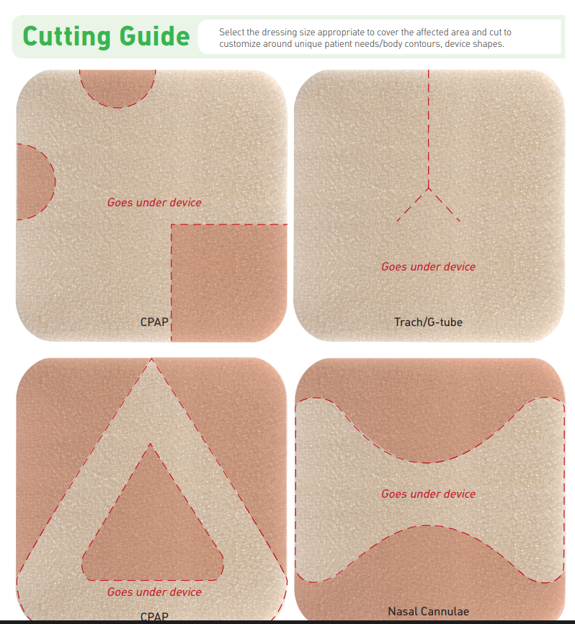
Lite Foam Dressing - Device Related Prevention
Notes:
Lite foam dressings can be cut to shape around medical devices

Slide 18
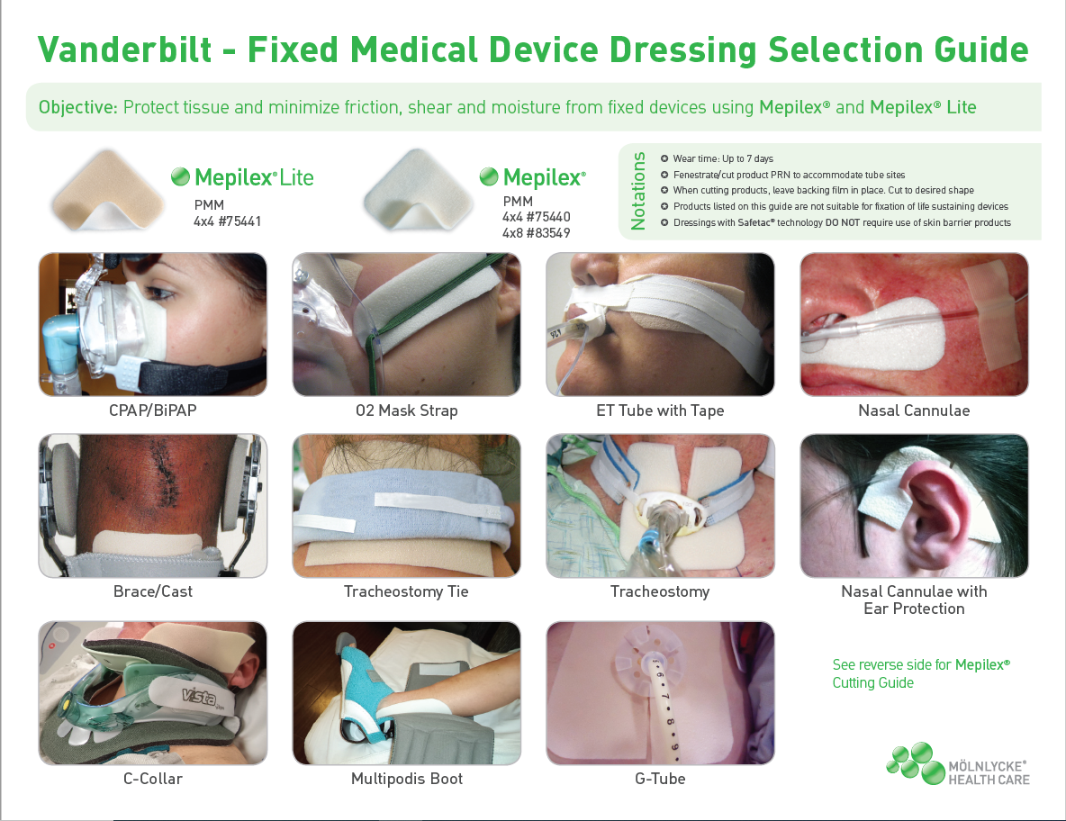

Slide 19
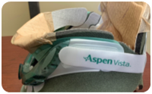
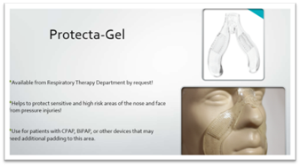
Devices & PI Development
The presence of a medical device more than doubles risk of HAPI formation
Tubes, lines, and drains
Trach plates and sutures
Padding devices
Apply protective dressings beneath BiPap masks if use is greater than 4hrs.
Notes:
Monitor trach plates and sutures, alert team if breakdown suspected.

Slide 20
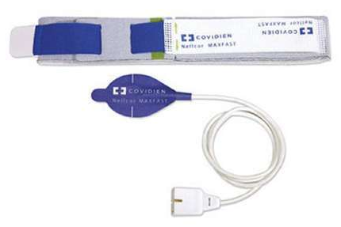
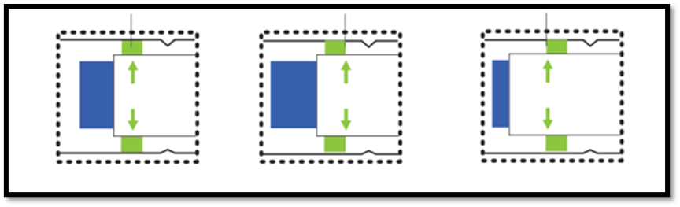
Forehead SpO2 Monitor
Rotate pulse ox site every 4 hours and PRN
Adjust the forehead band tension to align green arrows with indictors
Green arrow to green bar – do not overtighten
Do not add anything between the probe and skin
Attempt to transition back to a finger probe every once per shift

Slide 21
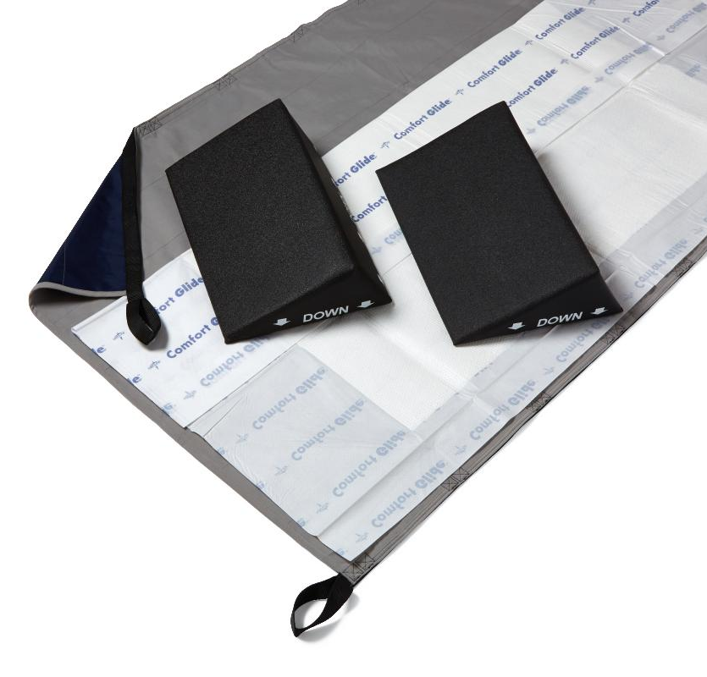
Repositioning Sheet with Wedges
Positioning Supplies
Wedges
Slick sheet
Hover mat
***Frequent/adequate repositioning is the most important intervention of all!!***
Notes:
Technically Chux are for moisture, not repositioning

Slide 22
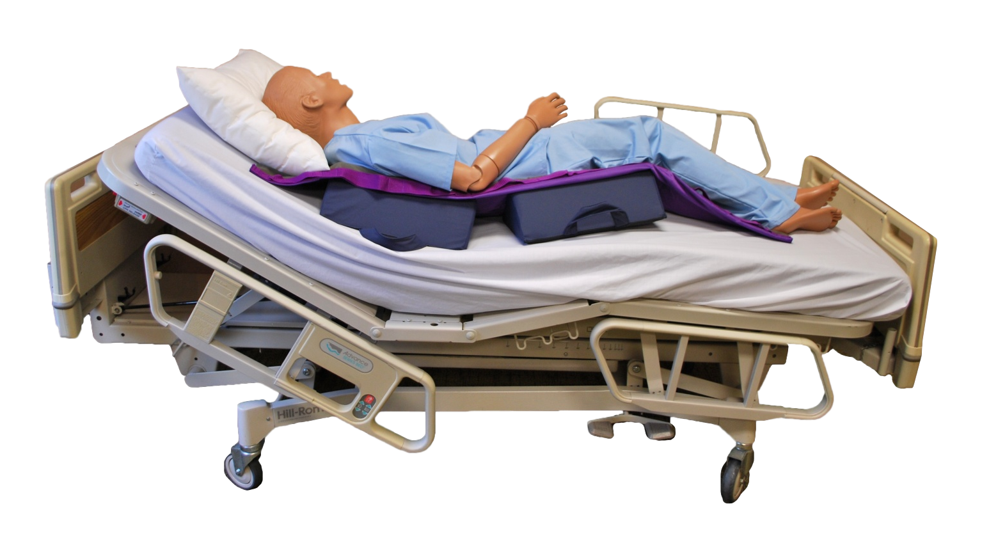
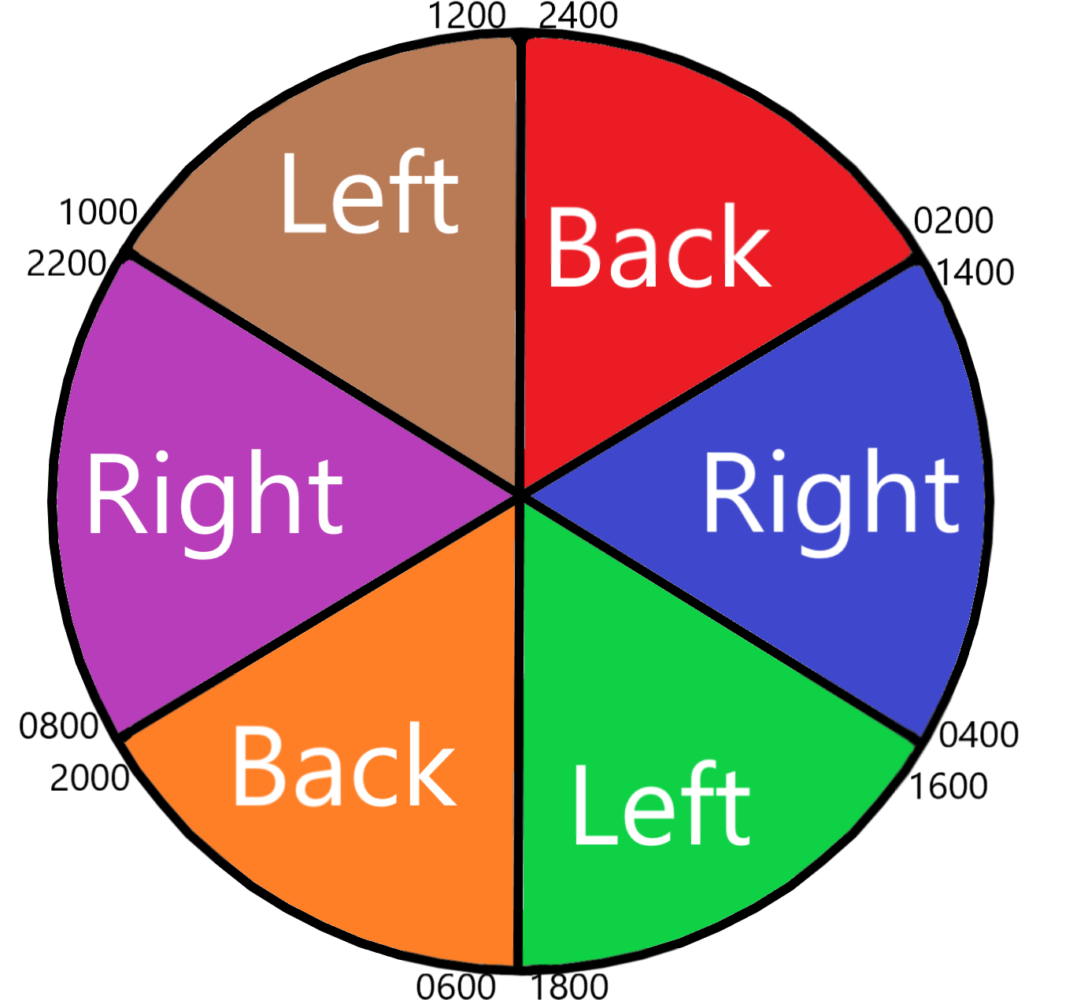
Effective Repositioning in the Bed
Patients should be repositioned every 2 hours
Wedges create an adequate 30-degree turn
HOB < 30 degrees if not clinically contraindicated
Mind the Gap
Notes:
-float heels
-right, back, left, right, back, left … not right, back, left, back, right, back, left, back because then patient is on their back 50% of the time
-hand check

Slide 23
Chair Considerations
If a patient is sitting at the bedside chair, consider the following time limits:
2 hours max in chair for at risk patient​​
1-hour TID for patient with ischial or sacral pressure injury​​
Patients should shift their weight in the chair every 15 minutes​​
If the patient is unable to shift their weight, reposition them in the chair every hour

Slide 24
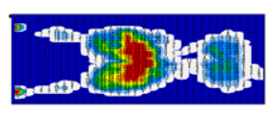
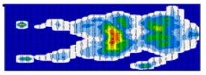
Pressure Injury (PI) Prevention and Sitting
In sitting positions, the pressure is higher than in lying postures.
The risk of pressure injury is greatly increased during sitting periods.
Pressure map in supine position
Pressure map in sitting position

Slide 25
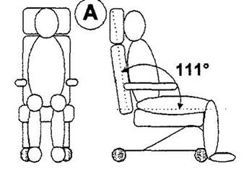

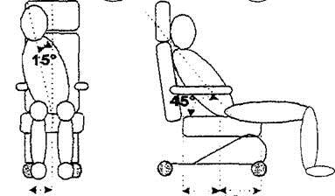
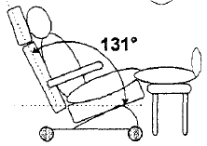
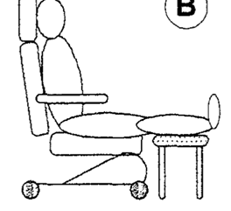
YES
NO
If chair does not recline, sit patient upright with feet on the ground.
Maintain proper position and alignment in chair.
Slouched or slid-down postures create significant increases in pressure.
YES
NO
If chair reclines, lean patient back and elevate legs on a rest.
Preferred chair position if patient has an ischial PI.
Do not sit patient upright with feet elevated

Slide 26
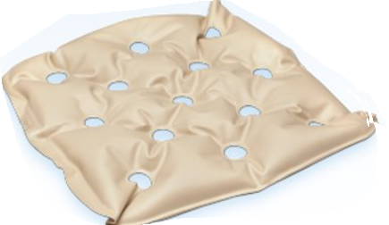
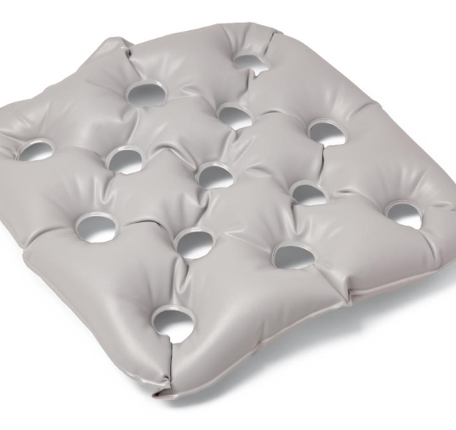
Chair Cushion Reminders
Standard vs Bariatric Chair Cushions
Micro-turns in the bed
Pillows are NOT adequate offloading devices for chair
Notes:
Any chair (e.g., recliner, neuro-chair, size-wise chair, etc.)
This can begin occurring when greater than 32mmHg of pressure is applied. Laying in a typical hospital mattress can generate 150mmHg and sitting can cause greater than 300mmHg of pressure.
Chair cushion is intentionally not fully inflated​
Bariatric chair cushion available (pt weighing 250 lbs or greater)
If PT/OT uses or recommends a pillow to elevated the patient in the chair, place the pillow in the chair first then the chair cushion. The patient’s skin must be touching the chair cushion vs pillow

Slide 27
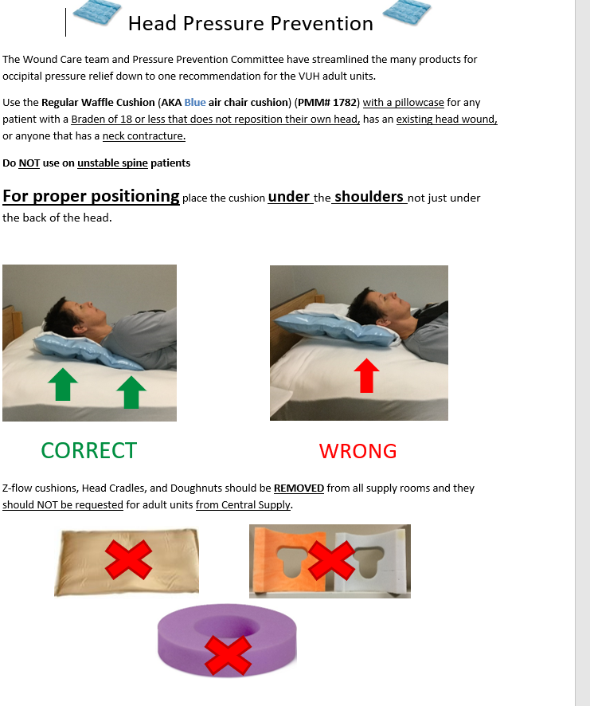


Head and Occipital PI Prevention Strategies
Position cushion under shoulders, not just head
Indications:
Patients with Braden 18 or less that does not reposition their own head
Existing head wound or PI
Neck contracture
Contraindications:
Unstable spine patients
Notes:
Throw away donuts under patients head after surgery
Place a chair cushion in a pillowcase

Slide 28
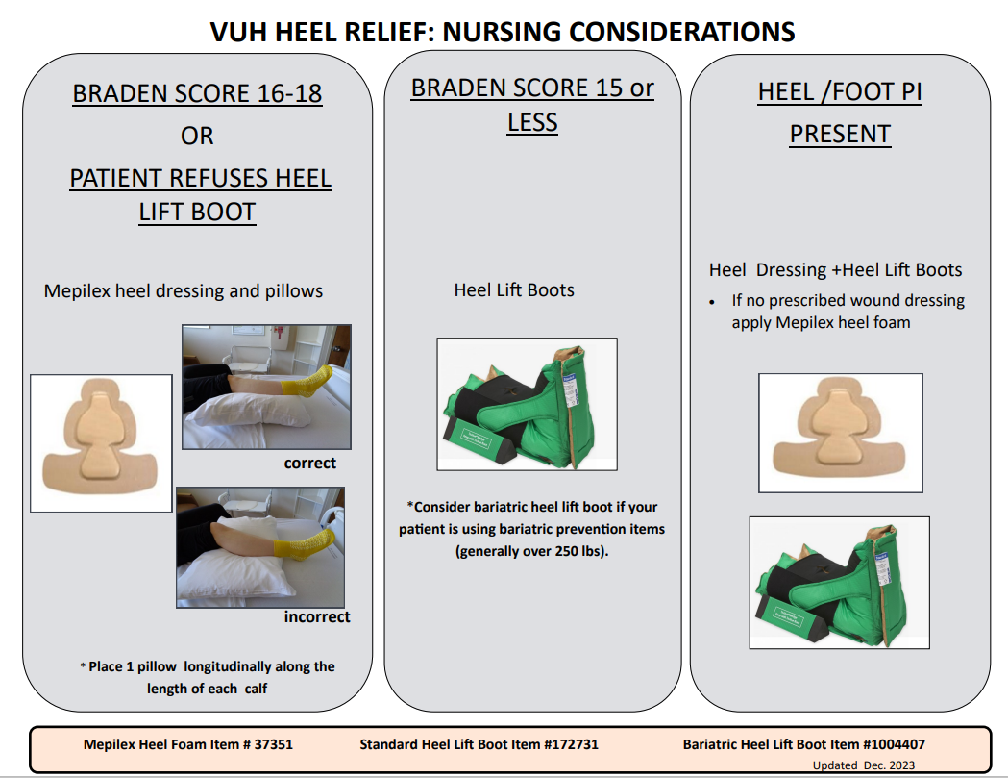
Notes:
Feel for proper placement, heel should be offloaded.
Bariatric boots available.

Slide 29
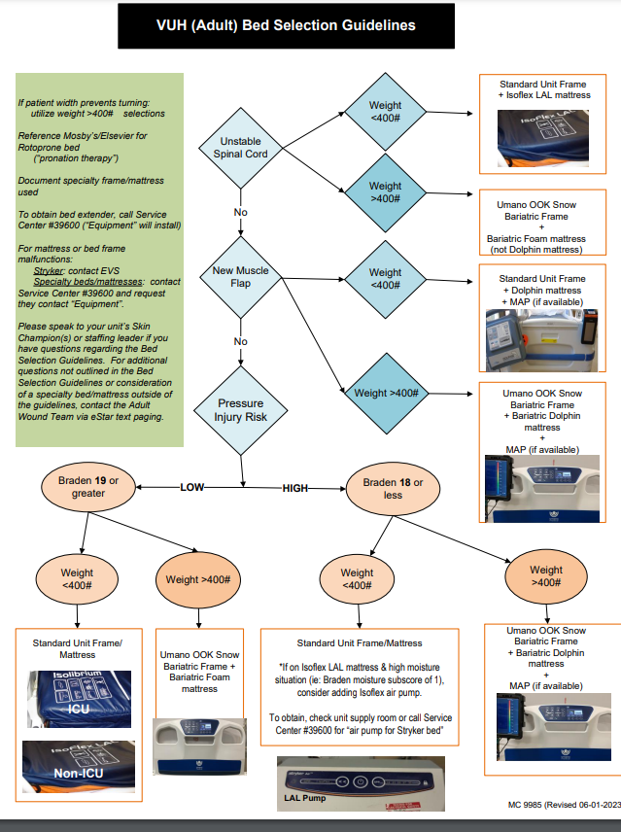
Beds at VUH
Most units have specific beds and mattresses for their typical patient population.
Isolibrium
Isoflex LAL
Low air loss pump – high moisture
Specialty Beds
Dolphin Bed
Bariatric dolphin bed
Notes:
ALL beds at VUH are pressure reduction beds
Isoflex beds has Low Air Loss built in
Isolibrium has an option to add the Low Air Loss pump
Review the reason Dolphin beds are not for all patients with low Braden
Bed extenders
Low air loss pump – does not add pressure relief

Slide 30
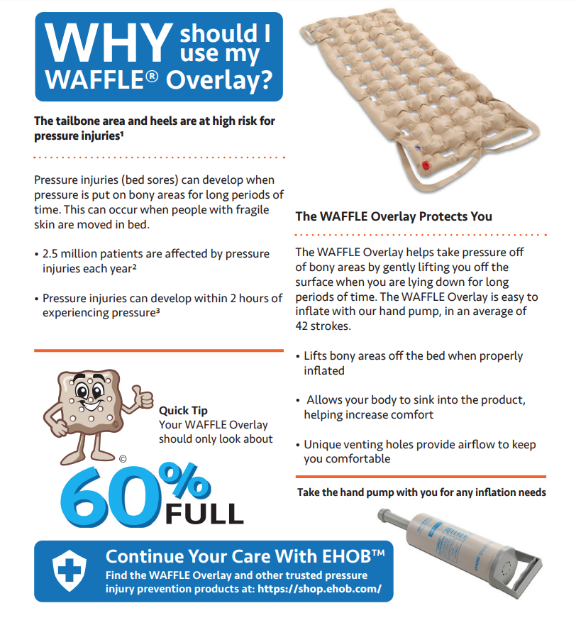
ED Waffle Overlay
For stretchers in the Emergency Department only
Always place a sheet on top of overlay
Contraindications:
Unstable spine/spinal precautions
Recent sacral flap or graft surgery
Patient with suicide precautions
Please remove when patient is transferred to an inpatient bed!
Notes:
Remove overlay when patient received on inpatient unit and give pt/family information sheet and explain reasoning why they are not to be used on inpatient beds

Slide 31
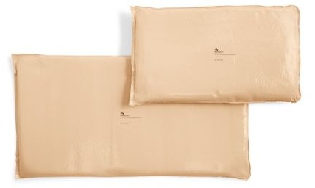
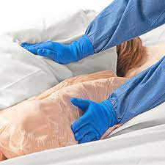
Fluidized Positioner
Only approved on certain inpatient units
Notes:
Current approved units (Dec 2023): 8CCT, 8N, 8MCE, 5N, 5S, 7N

Slide 32


Incontinence and Risk for PI Development
Adult patients with urinary incontinence are 3.7 times more likely to develop a PI
Adult patients with urinary incontinence and formed fecal incontinence have a 3.8 times greater risk of developing a PI
Adult patients with urinary and liquid fecal incontinence have up to a 22 times greater risk of developing a PI

Slide 33
Incontinence Management Devices
Chux Pad
Rectal Pouch
Stool Management System
Provider order required
External Catheters
Notes:
Only use one layer of chux pads, as more layers increase chances of developing a PI

Slide 34
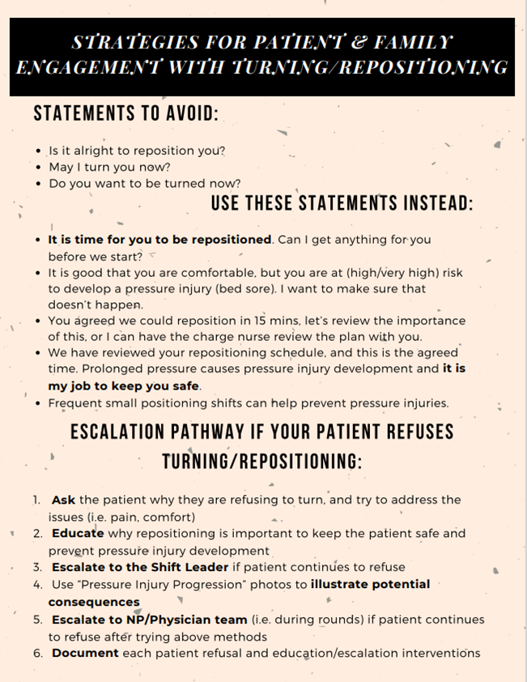
Additional Considerations
Patient should not be lying on an existing PI
Turn patient's head with their body
Ensure patients who can reposition themselves are doing so and frequently
Page provider if patient refuses turning and document patient refusal

Slide 35
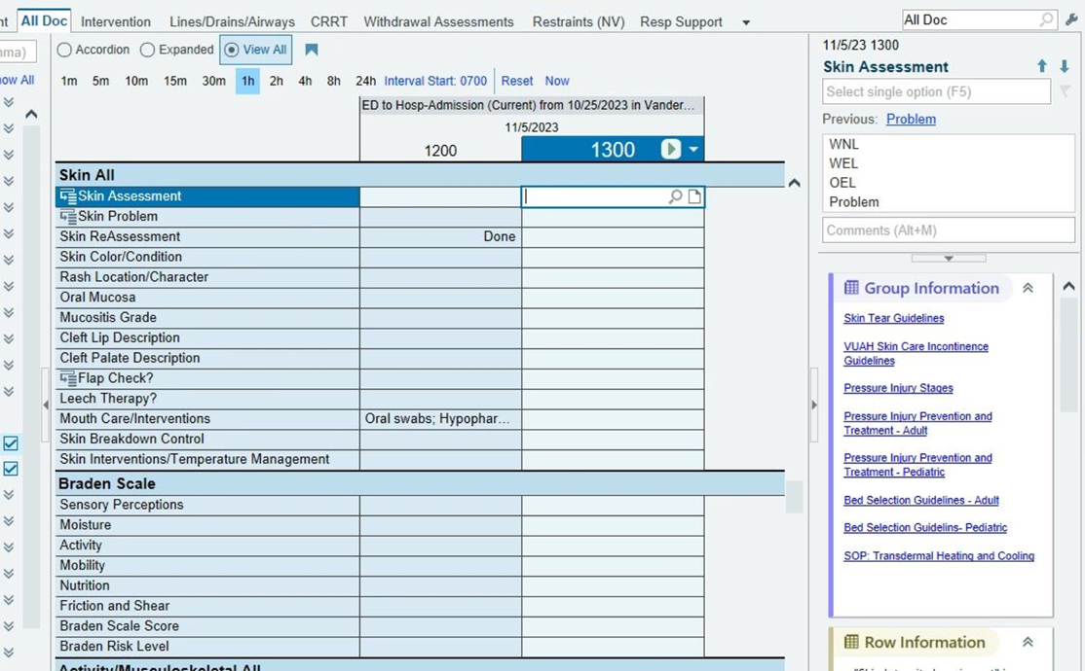
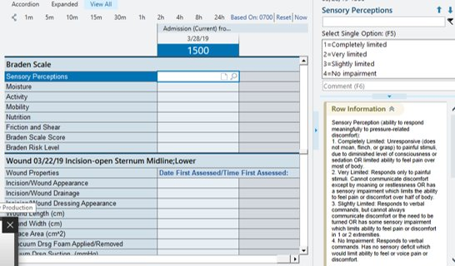
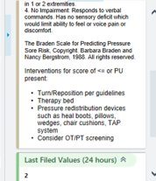
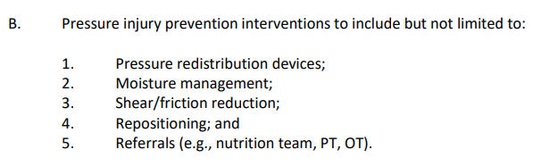
eStar Documentation and Resources
Notes:
Sidebar links in Estar for guideline resources as well as Braden subset intervention 'ticklers'.

Slide 36
Consulting the Adult Wound Team
A consult to the Adult Wound Team is required for patients with a Stage 3,4, unstageable, or DTI pressure injury
You are encouraged to consult the adult wound team for ANY PI, especially if you are unsure of the stage
Page the patient’s primary team asking for a consult to the Adult Wound Team
For any questions, you may directly contact the Adult Wound Team via eStar Paging

Slide 37
Resources
PolicyTech
Pressure Injury Prevention SOP
Wound Photography SOP
VUMC Pressure Injury Prevention Website
Bed Selection Guideline
VUH PI Prevention and Treatment Guidelines
PIP Product Tip Sheet
VUH Heel Considerations
Adult Incontinence Skin Care Guidelines

