Slide 1
Transforming Healthcare to Whole Health:
Why, What and How
Tracy Gaudet, MD
Former Executive Director, Whole Health Institute
Former Executive Director, Office of Patient-Centered Care and Cultural Transformation,
Veterans Health Administration

Slide 2
Learning Objectives
Delineate the core drivers for the transformation of health care.
Define the critical elements of a health care system that is designed to empower and equip people to optimize their health and well-being.
Describe examples of current demonstrations of this approach and the relevant data and research outcomes.

Slide 3
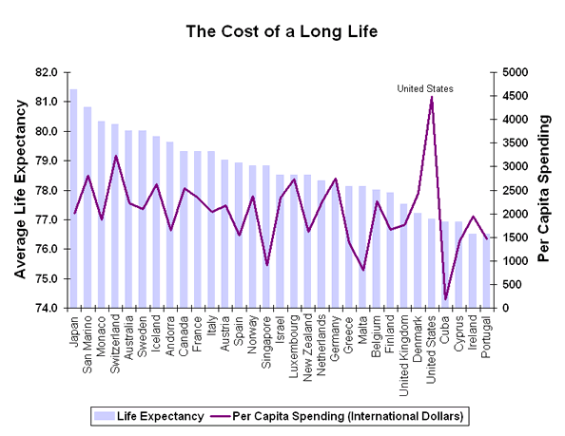
The Global Economics and Outcomes
UC Project for Global Inequality

Slide 4
The Healthcare Crisis Facing the U.S.
Healthcare consumed 19.7% of our GDP in 2020 and costs continue to rise, with unsatisfactory results.
Life expectancy decreased to 77 years in 2020 and 76 years in 2021 representing the biggest two-year decline since 1921-1923.
Chronic conditions consume more than 75% of health care costs, are largely affected by people’s choices and behaviors.
The current health care model doesn’t work because we do not have a core competency in engaging people in optimizing self-care and well-being.
The Opioid Crisis is clear demonstration of the limitations of a “find-it, fix-it” reductionistic paradigm.

Slide 5
Doing more of the same
will not
fix this problem.

Slide 6
“Problems cannot be solved
by the same level of thinking that created them."
Albert Einstein

Slide 7
The primary purpose
of the current healthcare system is to
diagnose and treat disease,
cure it when possible,
manage it when not.

Slide 8
The purpose of Whole Health is to
empower and equip people
to take charge
of their physical, mental and spiritual health
to live a full and meaningful life.

Slide 9
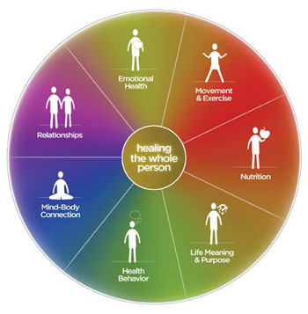
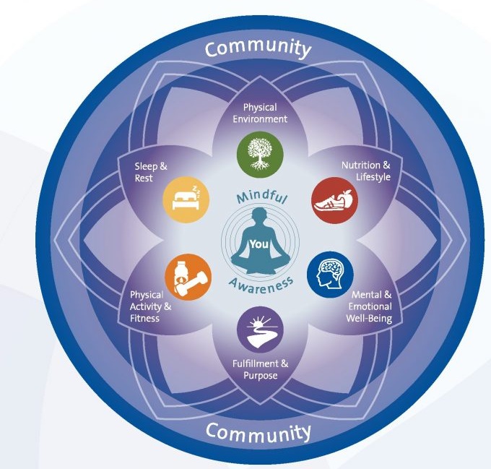
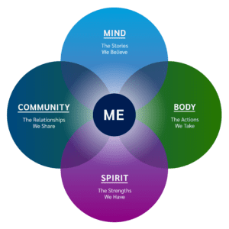
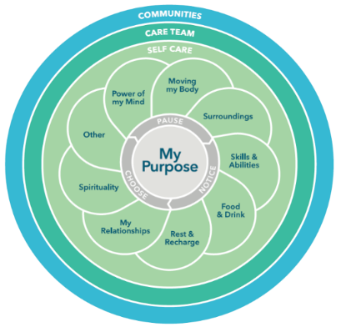
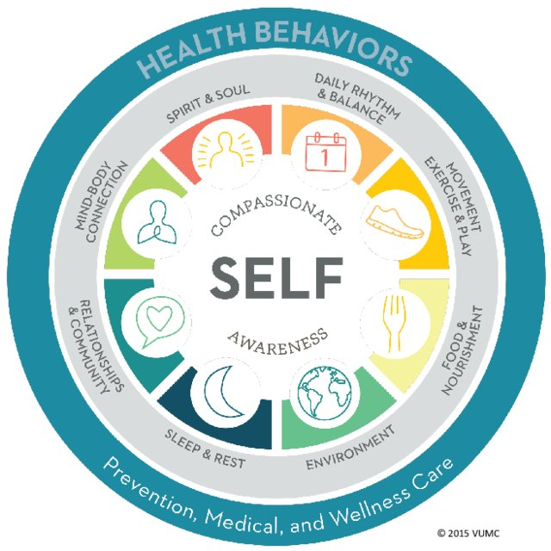
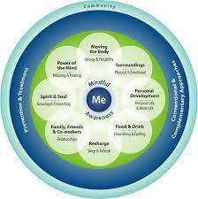
Whole Health Models
Notes:
Tracy will share for 15 minutes

Slide 10
As Is | Will Be
Focused on disease | Focused on the person and their purpose
Problem based | Aspiration based
Physician-directed | Partnership with team
Disease management | Health optimization
Find it, fix it | Identify risk, minimize it
Reactive | Proactive
Sporadic | Lifelong planning
Biomedical interventions | Whole person approaches
Individual left to enact | Skill building and support in the workplace and community

Slide 11
The VA Journey as a Case Study Lessons Learned

Slide 12
Veterans Health Administration (VA)
VA is the largest integrated health care system in the United States
171 VA Medical Centers, 1,298 sites of care (inpatient and outpatient)
Serving over 9 million Veterans, More than 371,000 employees
Nation’s largest provider of graduate medical education
Major contributor to medical and scientific research
Annual budget of approximately $68 billion
In 2010 VA committed to large system change to transform the culture to become more patient centered, From that charge, our team envisioned, created, and implemented Whole Health.

Slide 13
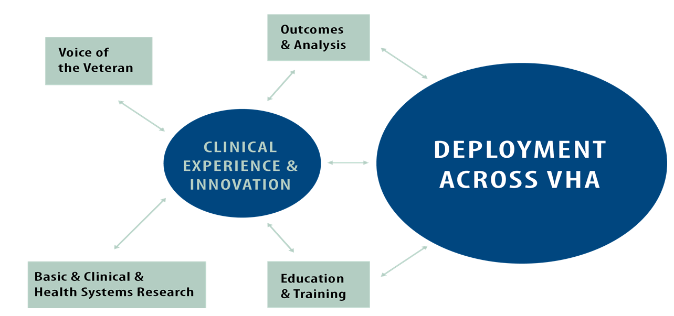
Innovation Engine Model

Slide 14

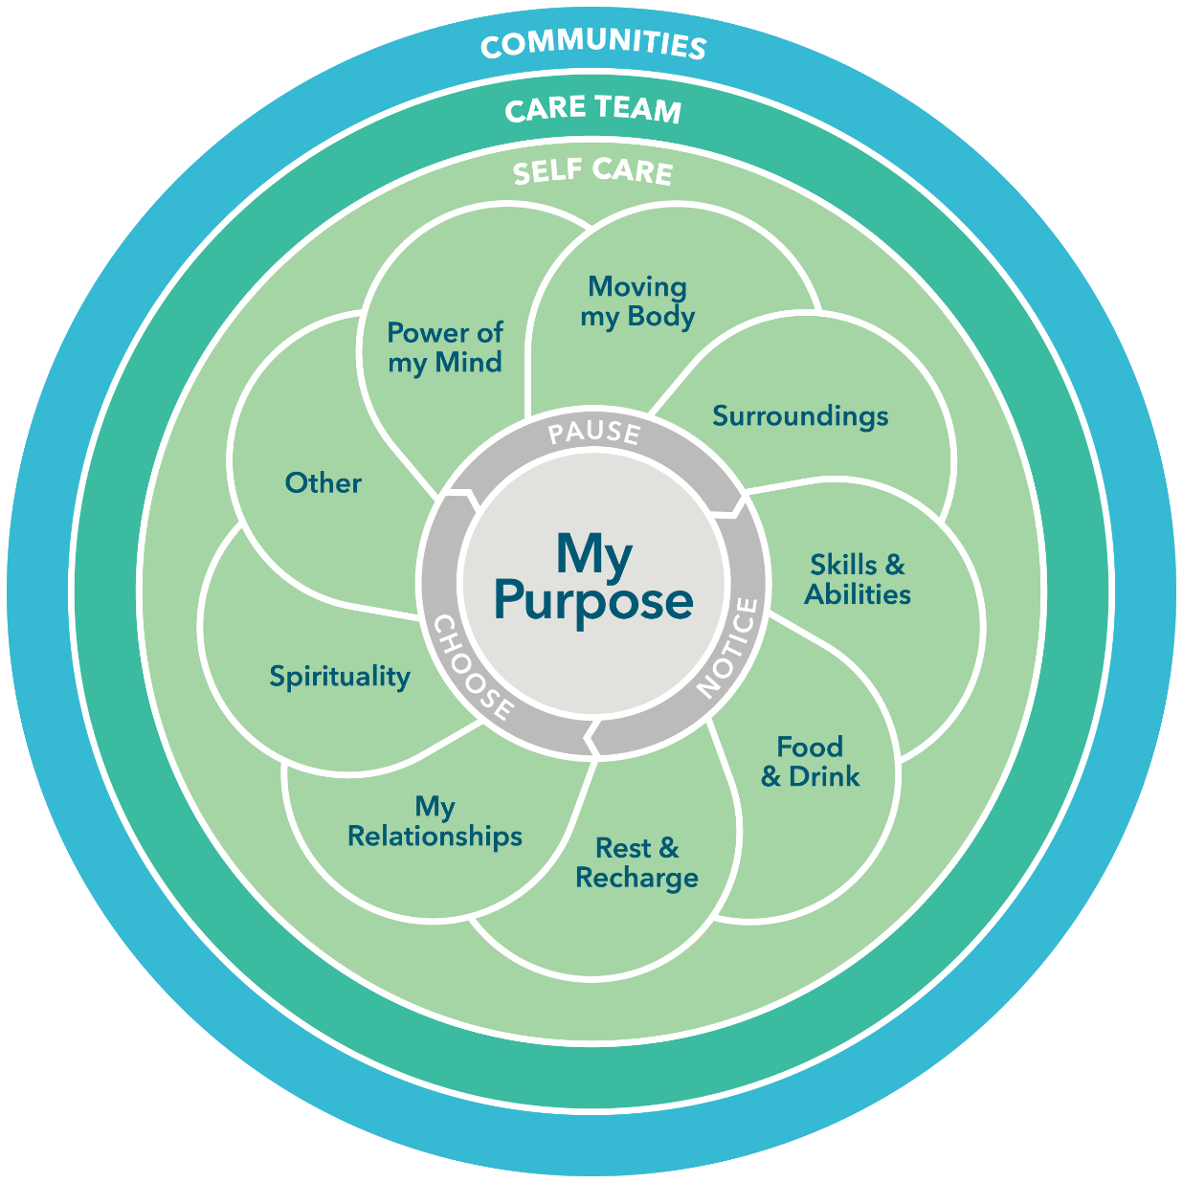

Slide 15

What does a healthcare system look like if it is designed to deliver this?

Slide 16
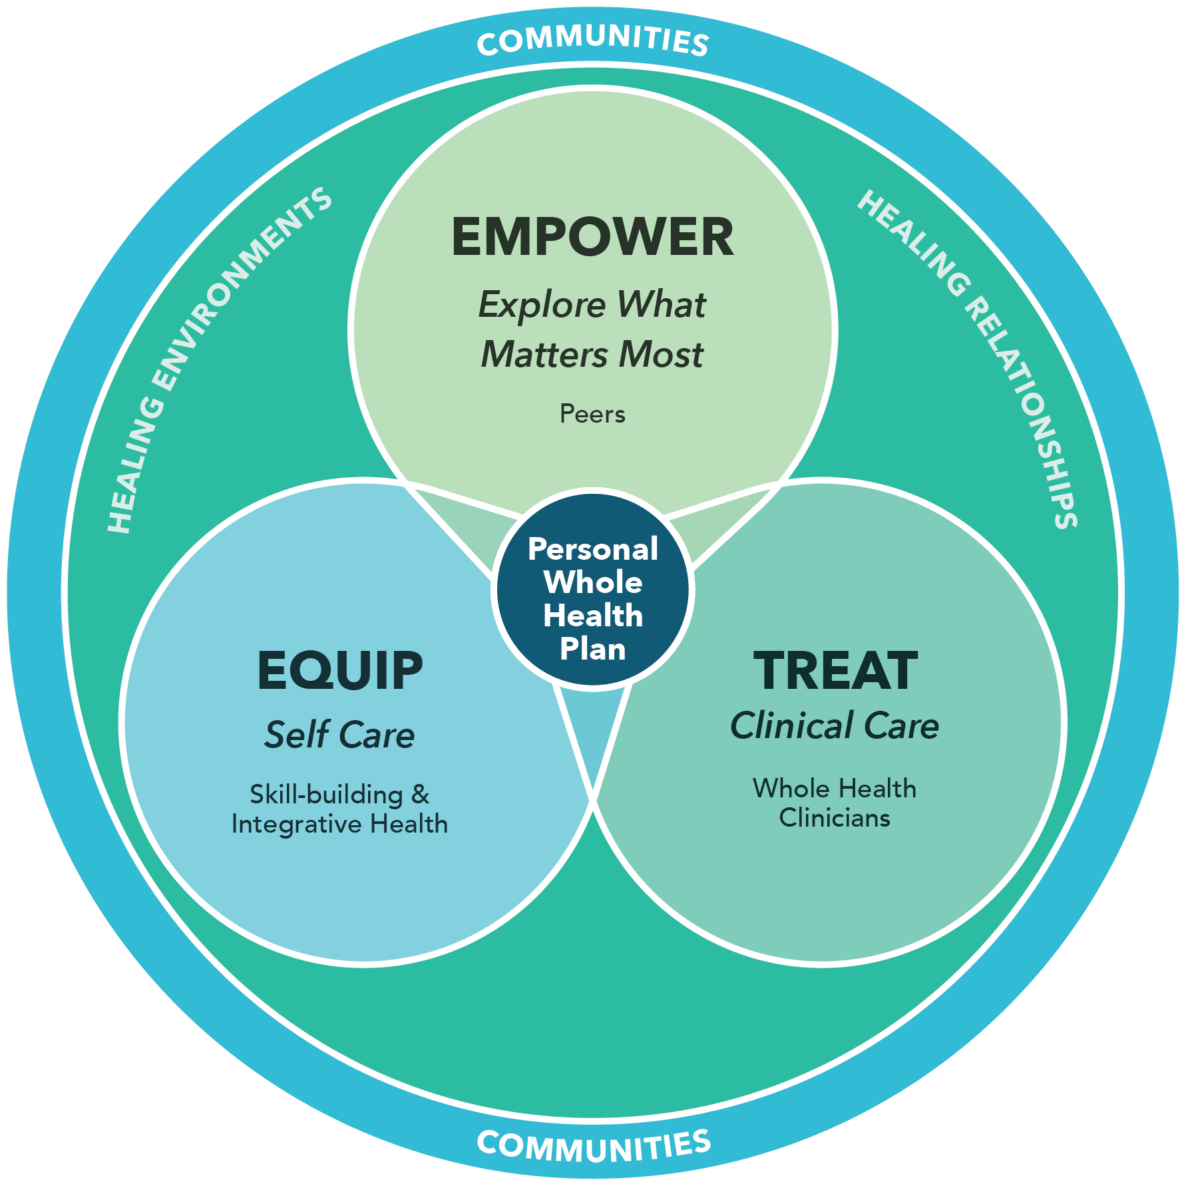
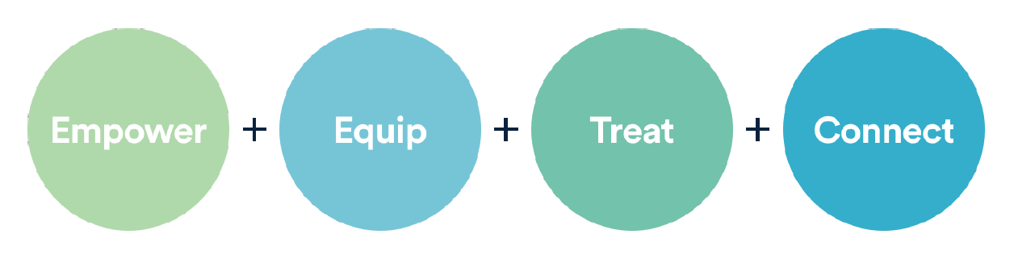
The
Transformed Health
System

Slide 17
Empower – Finding Your Purpose
Led By Peers
An opportunity for self-exploration around purpose, meaning and what matters most, and sharing through storytelling
Introduction to Whole Health classes and Taking Charge of my Life and Health program to empower individuals and their families

Slide 18
Equip – Self Care
Led by Instructors & Coaches
Well-Being focused activities, skill building classes and support, Whole Health coaching, providing experiences around the Circle of Health
Power of the Mind; Moving the Body; Surroundings; Skills and Abilities; Food & Drink; Rest and Recharge; Relationships; Spirituality; Other

Slide 19
Treat – Clinical Care
Led by Clinicians, trained in Whole Health
Whole Health Shared Medical Appointments (SMA) focus on optimizing health and well-being and co-creating a personal health plan (PHP) which serves as their overarching plan
Providers aligned with Whole Health - MD, DO, ND, NP, Lifestyle Medicine, Integrative/functional nutritionists, mental health professionals, coaches, others

Slide 20
Community – Connect
Led by ALL
Where we live, learn and work
Support and belonging
Our interdependence
Well-Being is rooted in and sustained by community

Slide 21
Can it be Implemented and
Does it Work?

Slide 22
To drive system change, you must address bottom up and top down strategies simultaneously.

Slide 23
Timeline of the VA’s Transformation to Whole Health
2012: New Directions Design Summit (national thought leaders), 8 Centers of Innovation (COI’s) established and more than 200 Innovation Grants awarded
2014: COI’s and Innovation grants evolve the model
2016: 25 Whole Health Design Sites launched; Comprehensive Addiction and Recovery Act signed into law; delivery model refined; aligned with Opioid Safety, Suicide Prevention, and Employee Health
2017: Whole Health and CIH services included in the Medical Benefits package and reimbursement system. Directive requiring all facilities to offer appropriate CIH

Slide 24
Timeline of the VA’s Transformation to Whole Health
2018: 18 Health Systems launch the implementation of all aspects of the Whole Health Delivery System, total of 140 facilities advancing aspects of Whole Health
2019: Designation Model System developed and deployed. Next 36 sites funded for full-implementation
2020: Initial research outcomes from the 18 flagship health systems released.
2022: Research outcomes published, national implementation continues.

Slide 25
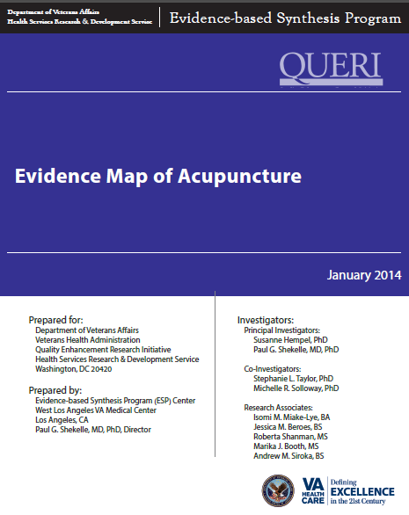
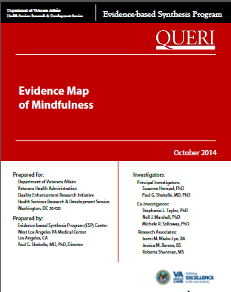


Providing Evidence Maps Maps

Slide 26
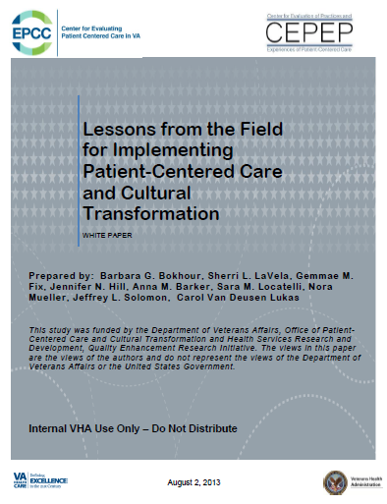

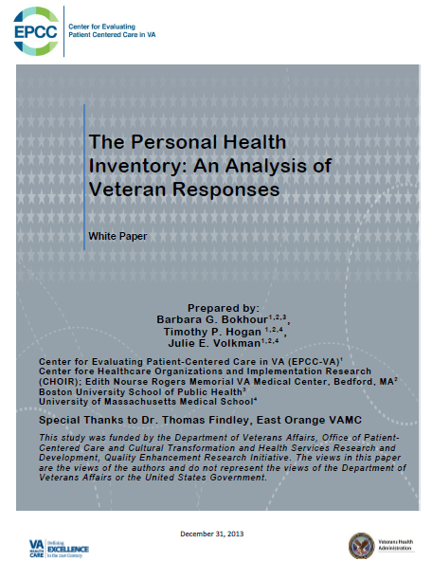
Supporting Research & Evaluation
Lessons from the Field for Implementing PCC
Compendium of VHA research related to PCC
Personal Health Inventory Analysis
Whole Health Education Level 3&4 Evaluation
Integrative Health Implementation
Interactive Patient Care Evaluation
PCC Metrics Project
PRIMIER
All Employee Survey
Evaluation Toolkit

Slide 27
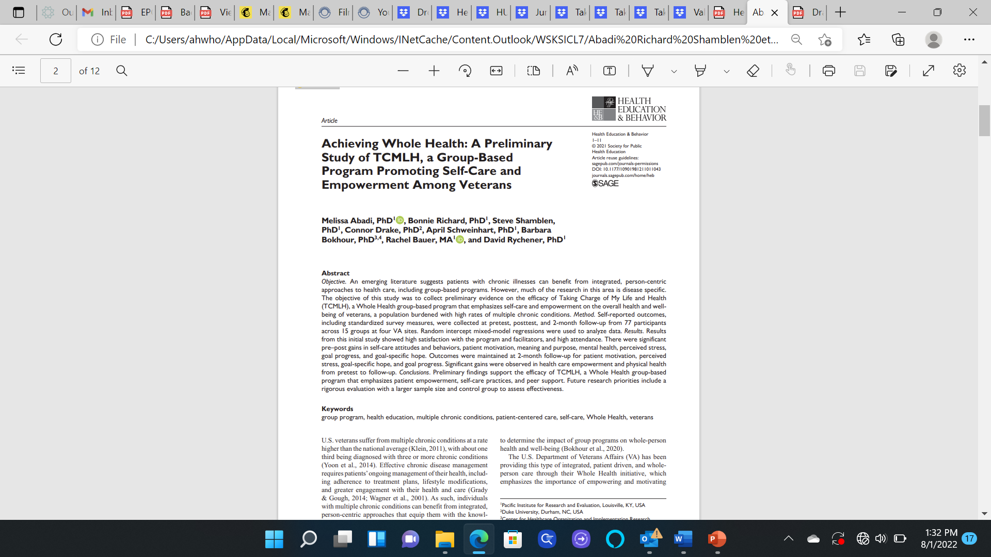
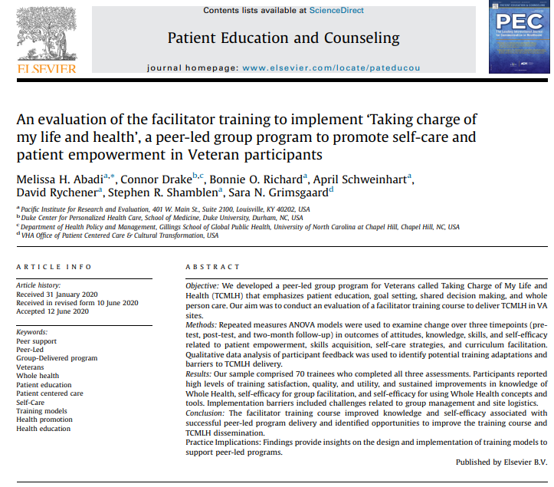
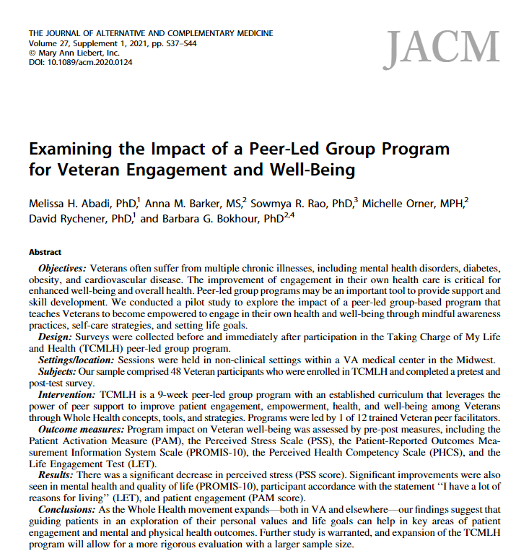
Research on Peer Programs
Notes:
There were significant pre–post gains in self-care attitudes and behaviors, patient motivation, meaning and purpose, mental health, perceived stress, goal progress, and goal-specific hope. Outcomes were maintained at 2-month follow-up for patient motivation, perceived stress, goal-specific hope, and goal progress. Significant gains were observed in health care empowerment and physical health from pretest to follow-up
Significant gains in mental health and quality of life, participant accordance with the statement ‘I have a lot of reasons for living, and patient engagements
Training – created competencies- both knowledge and self-efficacy- in group facilitation. And they enjoyed and found meaning in the training

Slide 28
18 Flagship Health Systems: Four Research Teams for Whole Health Evaluation
Implementation
Progress towards system transformation and Lessons learned
Patient Outcomes
Patient-Reported Health Outcomes; Clinical Outcomes; Veteran Satisfaction
Healthcare Workforce
Engagement and Burnout
Cost & Utilization

Slide 29
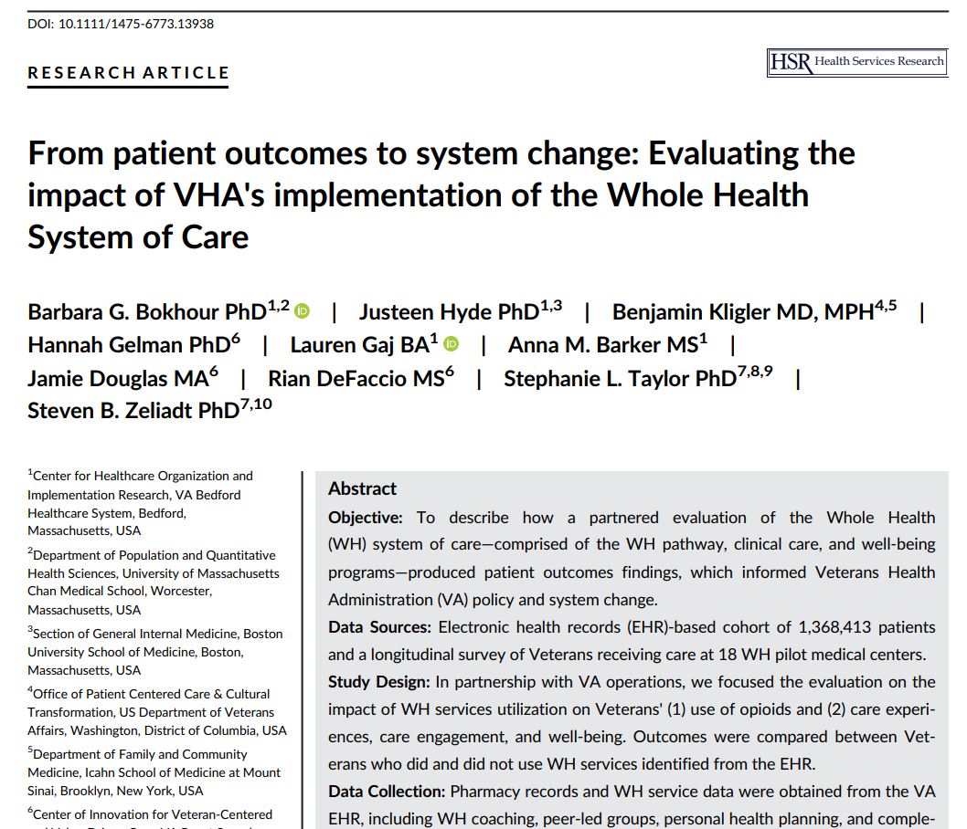

Slide 30
Categories of Whole Health Services Use
Whole Health Service Category | Services included
Complementary and Integrative Health (List 1: covered by Medical Benefits) | Chiropractic care Massage Whole body acupuncture & Battlefield acupuncture Yoga Tai Chi Meditation Biofeedback Guided Imagery Hypnosis
Core Whole Health | Personal Health Planning Peer-led Whole Health Groups Whole Health Pathway (peer) services Whole Health Coaching Whole Health Educational Groups
Bokhour, B., Hyde, J. et al., From patient outcomes to system change: Evaluating the impact of VHA’s implementation of the Whole Health System of Care. Health Serv. Res. 2022: 1-13.
Notes:
A key goal of the Flagship WHS Pilot is to determine the feasibility of incorporating complementary and integrative health and Core Whole Health services to the system of pain management and other health care services for Veterans.
CIH and Core Whole Health Services for this study are defined in this table
For the purpose of utilization this table shows the definitions of WH services. It incorporates well-being and pathway, does not include WH CC consults, but includes encounters with a note title and health factors associated with any clinical care service (e.g. primary care, social work etc.)
This component of the evaluation focuses on assessing how the 18 pilot flagship sites expanded WHS services, and how those services were used by Veterans with chronic pain.

Slide 31
Research Groups
No Use: No Whole Health (WH) services
Single Use: 1 WH service
Any 2+ Use: More than 2 WH services
CIH Intensive: More than 4 CIH services; any peer or coaching services
Core WH Intensive: More than 4 peer or coaching services, any CIH service
Comprehensive WH: More than 8 WH services – 2 or more peer or coaching services AND 2 or more CIH services
Bokhour, B., Hyde, J. et al., From patient outcomes to system change: Evaluating the impact of VHA’s implementation of the Whole Health System of Care. Health Serv. Res. 2022: 1-13.
Notes:
Key summary points:
WH had a + impact on reducing opioid use
3 fold reduction in opioid use among Veterans with chronic pain who use WHS services compared to those who did not
Overall opioid use decreasing amongst Veterans; however comprehensive WH users decreased opioid use by 38% compared to 11% decrease amongst Veterans with no WH use
Veteran reported outcomes
Gathered from the Veteran Health & Life Survey conducted at flagship sites to learn about Veteran perceived changes in health and well-being when receiving WH services.
Survey assesses range of patient reported outcomes(Veteran experiences of care, engagement, meaning and purpose, pain and physical and mental health)
Veterans surveyed at baseline, 6 month and 12 month timepoints. Findings for 12 month time point not available (As of Jan 2020)
N=3266 Veterans completed baseline and 6 month survey. Survey is ongoing with anticipated participation of 10,000 Veterans across 18 flagship sites
Compared to Veterans who did not use WH services, Veterans who used WH services reported:
Greater improvements in perceptions of the care received as being more patient-centered.
Greater improvements in engagement in healthcare and self-care.
Greater improvements in engagement in life indicating improvements in mission, aspiration and purpose.
Greater improvements in perceived stress indicating improvements in overall well-being.

Slide 32
Implementation
Progress towards implementation
All 18 health systems made progress along the implementation continuum
CIH and well-being services were furthest along, clinical care was slowest to progress
Key facilitators to implementation include:
Strong leadership including tangible support for WH
An organizational culture in which being a learning organization is valued
Key barriers to implementation include:
Infrastructure constraints
Perceptions of WH as a program rather than an approach
Misalignment of clinical and facility level incentives
Bokhour, B., Hyde, J. et al., From patient outcomes to system change: Evaluating the impact of VHA’s implementation of the Whole Health System of Care. Health Serv. Res. 2022: 1-13.
Notes:
Key Summary points:
all 18 sites have made progress along an implementation continuum
Variation amongst sites in implementation of the different WHS components-
CIH and well-being service implementation is furthest along
WH Clinical Care implementation is slowest to progress
Strong leadership facilitates implementation
includes tangible support (e.g. addressing barriers to hiring staff, allowing key staff protected time to work on implementation activities, assistance with addressing challenges, requiring staff to participate in WH trainings) for WH
Executive leaders see WH as a strategy for meeting VA priorities rather than being in competition with them were furthest along
An organizational culture in which being a learning organization is of value facilitates implementation. Sites further along with implementation encourage staff to engage in continuous quality improvement efforts and share thoughtful change management approaches.
Perceptions of WH as a program rather than approach, infrastructure constraints and mis-alignment of clinical and facility level incentives are barriers to implementation

Slide 33
Patient Outcomes
Whole Health had a positive impact on reducing opioid use
There was a threefold reduction in opioid use among Veterans with chronic pain who used WHS services compared to those who did not (38% decrease vs 11%)
Preliminary, WH Veterans demonstrate trends towards improvements in patient-reported health and well-being outcomes (over a 6-month period)
WH Veterans compared to non-users reported greater improvements in:
Perceptions of the care received as being more patient-centered
Engagement in healthcare and self-care
Engagement in life indicating improvements in mission and purpose
Perceived stress indicating improvements in overall well-being
Bokhour, B., Hyde, J. et al., From patient outcomes to system change: Evaluating the impact of VHA’s implementation of the Whole Health System of Care. Health Serv. Res. 2022: 1-13.
Notes:
Key summary points:
WH had a + impact on reducing opioid use
3 fold reduction in opioid use among Veterans with chronic pain who use WHS services compared to those who did not
Overall opioid use decreasing amongst Veterans; however comprehensive WH users decreased opioid use by 38% compared to 11% decrease amongst Veterans with no WH use
Veteran reported outcomes
Gathered from the Veteran Health & Life Survey conducted at flagship sites to learn about Veteran perceived changes in health and well-being when receiving WH services.
Survey assesses range of patient reported outcomes(Veteran experiences of care, engagement, meaning and purpose, pain and physical and mental health)
Veterans surveyed at baseline, 6 month and 12 month timepoints. Findings for 12 month time point not available (As of Jan 2020)
N=3266 Veterans completed baseline and 6 month survey. Survey is ongoing with anticipated participation of 10,000 Veterans across 18 flagship sites
Compared to Veterans who did not use WH services, Veterans who used WH services reported:
Greater improvements in perceptions of the care received as being more patient-centered.
Greater improvements in engagement in healthcare and self-care.
Greater improvements in engagement in life indicating improvements in mission, aspiration and purpose.
Greater improvements in perceived stress indicating improvements in overall well-being.

Slide 34
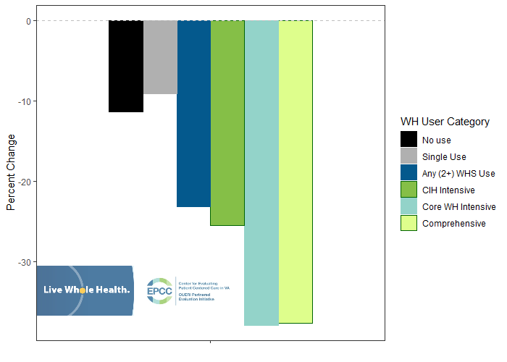
Opioid Utilization
Change in opioid use by WH user category for Veterans with chronic pain (n=11,4357)
Data Source: EPCC – Department of Veteran Affairs
Notes:
Veterans with chronic pain who started using WHS Services in QTR 3 FY 18 had a larger overall decrease in the average morphine equivalent dose of opioids compared to similar Veterans who did not use WHS services or used only a single WHS service.
Key notes:
these are new WH service users
Study compared opioid dose costs for new Veteran users of WH prior to using WH services (qtr.. 1 and 2 FY 18) and their dose 1 year later (qtr. 1 and 2 FY 19)

Slide 35
Facility Impact and Costs
For the Whole Health Facilities:
Increased hospital performance
Increased ratings for patient-centered care
Significantly less increase in outpatient pharmacy costs:
Patients with chronic conditions 4.3% increase vs 15.8%
Patients with mental health conditions 3.5% increase vs 12.5%
Bokhour BG, Hyde JK, Zeliadt S, Mohr DC. Whole Health System of Care Evaluation- A Progress Report on
Outcomes of the WHS Pilot at 18 Flagship Sites. 2020. Veterans Health Administration, Center for Evaluating
Patient-Centered Care in VA (EPCC-VA). Available at: https://www.va.gov/WHOLEHEALTH/professional-resources/clinician-tools/Evidence-Based-Research.asp.

Slide 36
Employee Outcomes
Employee involvement in provision of WH expanded from 2018-2019 in all sites.
Greatest uptake in primary care, mental health, rehabilitation, home/community care
Employees who reported involvement with WH also reported:
Their facility as a ‘best place to work’
Lower burnout
Greater motivation
Reduction in resignations
Facilities with higher employee involvement had:
Higher ratings on hospital performance
Higher ratings from Veterans on receiving patient-centered care
Data Source: EPCC – Department of Veteran Affairs
Notes:
Key Talking Point:
Caveat for employee involvement in WH and SAIL and SHEP ratings-preliminary analyses does not reflect cause and effect, rather it reflects only correlation.

Slide 37
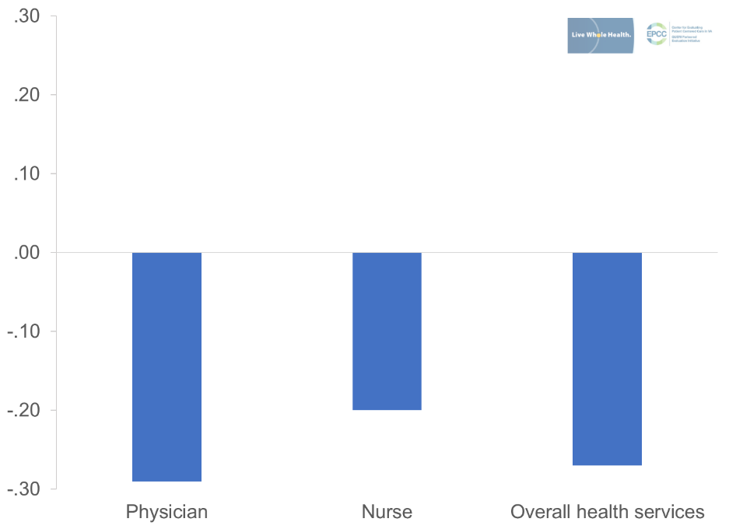
Resignation Rates
Relationship between WH Involvement and resignation rates by occupation.
Spearman rank-order correlations. Values of 0 suggest no association; while 1 indicate perfect association.
Data Source: EPCC – Department of Veteran Affairs
Notes:
This graph shows the relationship between WH Involvement and resignation rates by occupation
Clinical staff who are more involved with WH were also less likely to resign.
Looking within occupations, greater involvement in Whole Health negatively related to resignation rates at sites. Physicians, registered nurses, and health services employees showed similar patterns.

Slide 38
A Relevant Example in
Driving Large System Transformation
The VA is taking a systems approach – addressing each of the following efforts synergistically:
Created a new model of healthcare
Developed detailed implementation guide and dashboard
Provided experiences and education for the workforce
Researched the implementation and the outcomes
Changed the Veterans benefits package
Aligned how leadership is evaluated

Slide 39
“Whole Health began my journey to joy, I am a changed person. I no longer need my cane. The Whole Health group has become my family. My neurologist says he doesn’t need to see me anymore!”
“I have lost 33 pounds. I go to FIT class, nutrition class, Battle-field acupuncture, and regular acupuncture. My wife says I have a positive attitude now! And my diabetes is under control, blood pressure down and lipids good. I see my primary care doctor much less”
52 year old Male
71 year old Male
“I used to drive over the Mississippi River Bridge, to Jefferson Barracks VA, and think about jumping every time. The whole health system has helped me explore my purpose, find ways to use nutrition to reduce my pain, and use iRest and Tai Chi to get moving again. Now I drive over that bridge and think about tomorrow…. I have hope”
37 year old Female

Slide 40
“We’ve been wrong about what our job is in medicine.
We think our job is to ensure health and survival.
But really it is larger than that.
It is to enable well-being.
And well-being is about the reasons one wishes to be alive.
Those reasons matter not just at the end of life,
or when disability comes,
but all along the way.”
Atul Gawande

Slide 41
And oh, by the way, clinical outcomes improve and costs decrease.

Slide 42
My Reflections for Your Consideration

Slide 43
Lesson 1:
This is a
CULTURAL
TRANSFORMATION

Slide 44
What is transformation?
It is NOT continuous improvement
of the existing paradigm.
It IS changing the PURPOSE of a System.

Slide 45
What is Culture and how do we Drive it?
Culture is individual and collective behavior based in experience and incentives.

Slide 46
Lesson 2:
Your strategies must address both
EXPERIENCE
and
INCENTIVES

Slide 47
What are the Challenges and Opportunities for You?
Given that you have a mature and very successful Osher Center for Integrative Health,
You can lead the way in demonstrating how a center can help drive system transformation.

Slide 48
How might you approach that?
A bottom-up strategy providing experiences that bring this to life:
In addition to your core program, create a pilot with peer groups focused on selfcare, overseen by non-clinical coaches.
This reaches a broader population and is scalable and can be evolved from existing work.

Slide 49
How might you approach that?
A top-down strategy aligning incentives:
Begin to pilot and demonstrate aligning what you measure, value, and reward.
Use the Osher Center as a Living Laboratory for this system change.

Slide 50
“The greatest barrier to discovery is not ignorance,
but the illusion of knowledge.”
David Borstein

Slide 51
Imagine a day when ...

Slide 52
Imagine a day when ...
The job of healthcare is to help people explore their sense of meaning and purpose and address all aspects of their health and well-being so that they can live their most meaningful lives

Slide 53
Imagine a day when ...
Healthcare uses the best that
medical science and the art of healing
have to offer, and is not limited by reductionistic thinking

Slide 54
Imagine a day when ...
Healthcare systems are reimbursed for
improving well-being

Slide 55
Imagine a day when ...
Well–Being Centers focused on skill building and support
are the center of healthcare; clinics and hospitals assist them in advancing and sustaining well-being

Slide 56
Imagine a day when ...
Peer groups that support people in living
Whole Health are present in every community

Slide 57
Imagine a day when ...
Whole Health is integrated into neighborhood life, schools, and workplaces

Slide 58
Imagine a day when …
The cost of healthcare is significantly reduced and
is no longer crippling our nation

Slide 59
Imagine a day when ...
People’s sense of meaning and purpose,
their mutuality, interdependence, compassion, and awareness of a collective humanity is profoundly altered

Slide 60
Imagine a day when ...
This transformation in social consciousness
results in a quantum leap in health and well-being

