Slide 1
Pressure Injury Prevention Products
Vanderbilt University Hospital

Slide 2
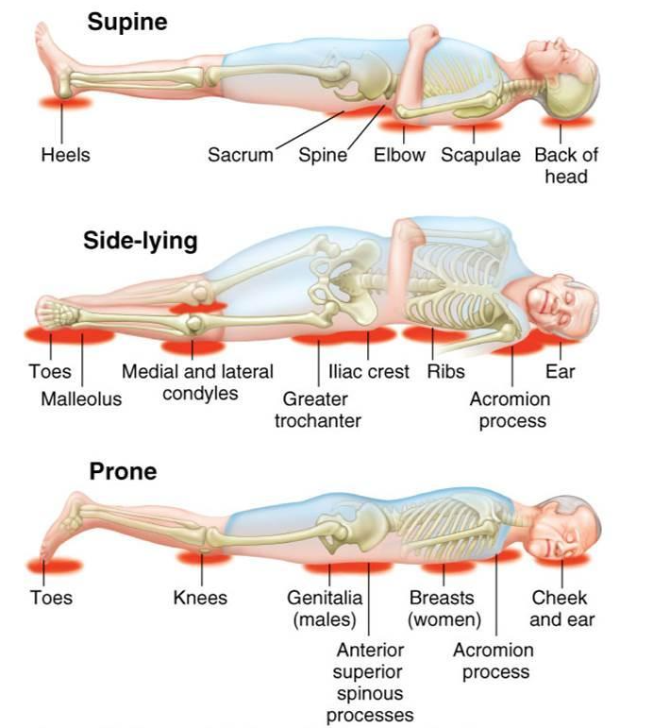
Typical areas for Pressure Injury development

Slide 3
Foam Dressings
Foam dressings are used for prevention AND treatment of pressure injuries (PIs) throughout the care continuum.
You do NOT need an order to apply these items for prevention!

Slide 4

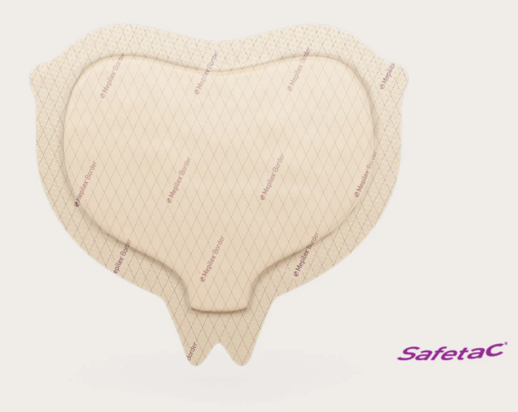
Sacral Mepilex
#84549
5-layer foam dressing
Should NOT be used if consistently soiled by incontinence.
Can be used ANYWHERE on the body for prevention from pressure or devices!
NOT designed to be cut.

Slide 5
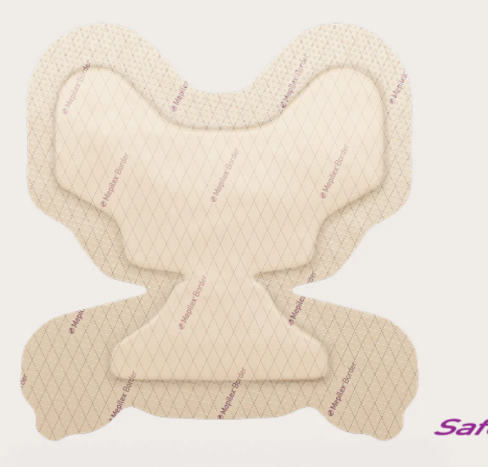
Heel Mepilex
#137351
5-layer foam dressing.
Does NOT take the place of offloading boots or floating heels with pillows!
Can be used for Heels, Elbows, Knees, or any other place for prevention.
NOT designed to be cut.

Slide 6
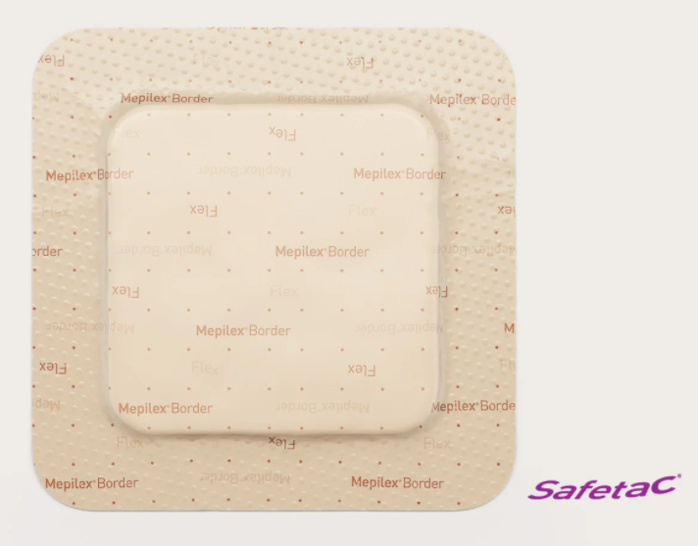
Mepilex Flex
#84931
5-layer dressing.
Can be utilized ANYWHERE on the body with great results!
Great for prevention of pressure injuries for devices.
NOT designed to be cut.

Slide 7
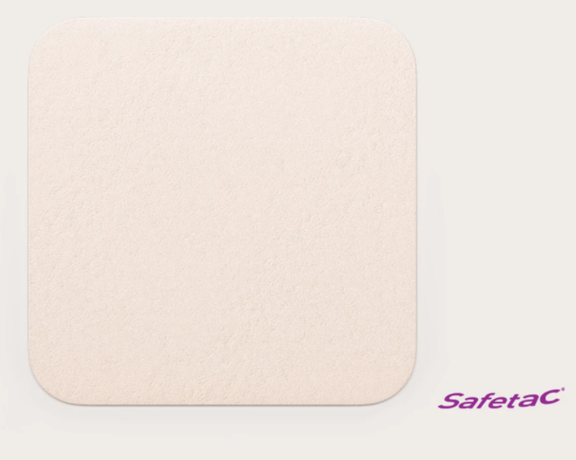
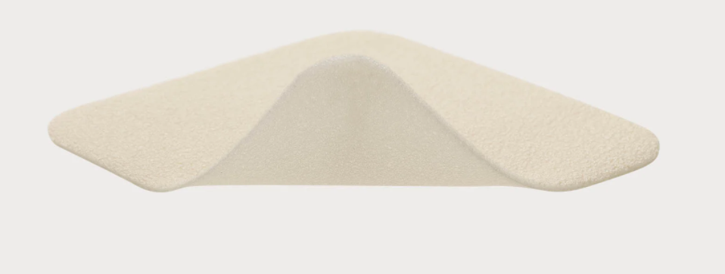
Mepilex Lite
#75441
3-layer dressing.
Not as protective from pressure as the other foam dressings available.
CAN be cut into multiple shapes/ sizes and allows for protection from almost any device!

Slide 8
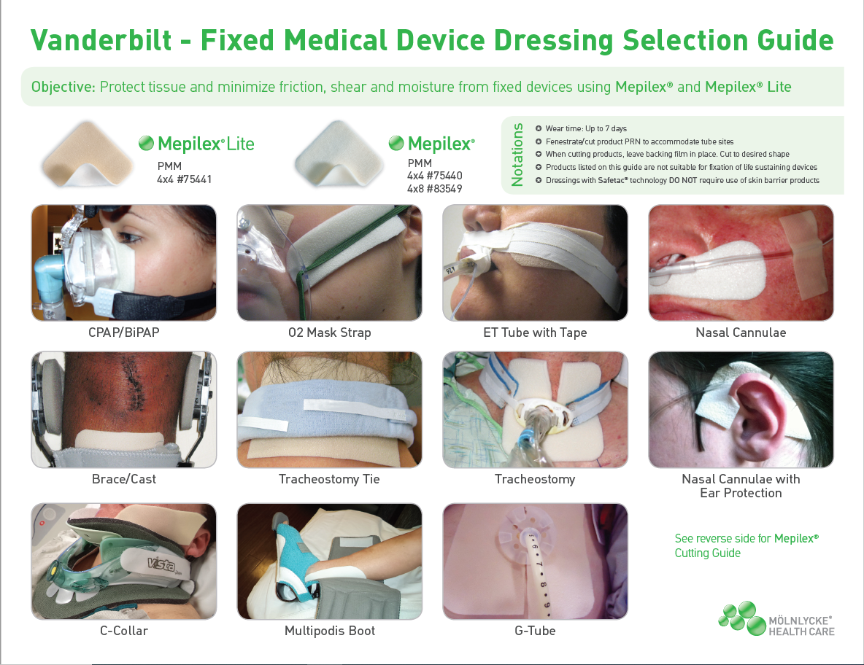
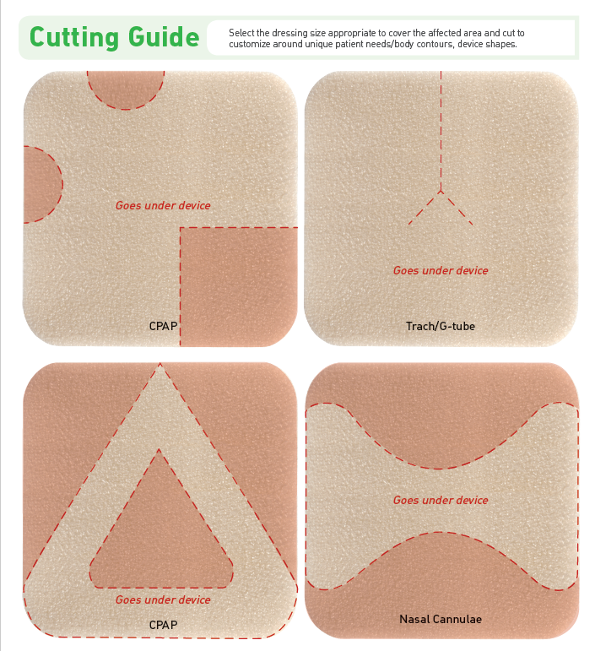
Mepilex Lite

Slide 9
Protecting Patients from Devices
You can also utilize Mepilex foam ON a device to help protect your patients!
Not the ideal application but is better than no protection at all.
May need to confirm with Providers before use on certain devices.

Slide 10
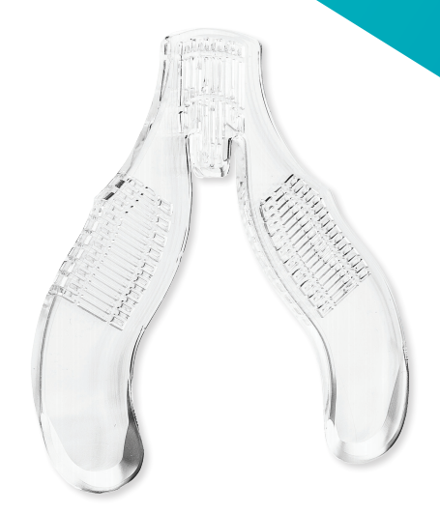
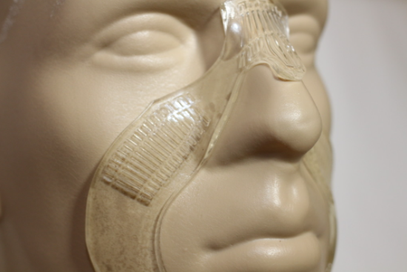
Protecta-Gel
Available from Respiratory Therapy Department by request!
Helps to protect sensitive and high risk areas of the nose and face from pressure injuries!
Use for patients with CPAP, BiPAP, or other devices that may need additional padding to this area.

Slide 11
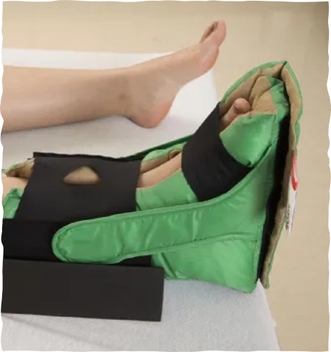
Offloading Boot
#172731
Used to offload the heel and protect the ankle from pressure.
Ensure heel is in the appropriate pocket and completely offloaded multiple times during your shift!
Available in Bariatric as well #1004407

Slide 12
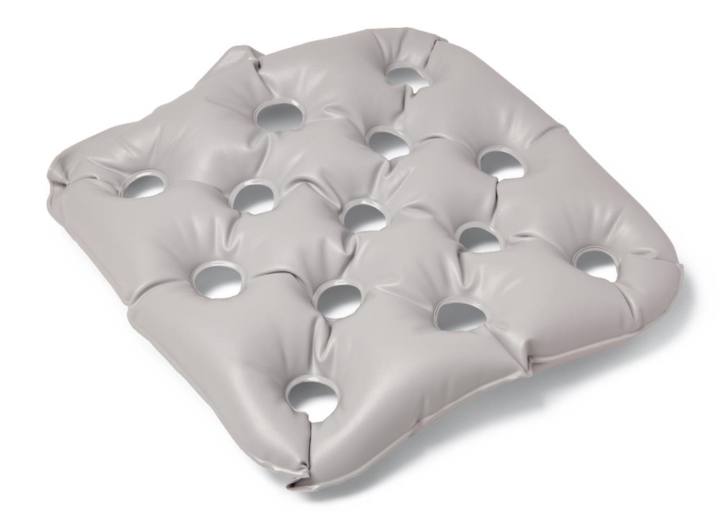
Chair Cushion
#1782
Should be used when at risk patient is sitting in ANY chair.
Does NOT take the place of repositioning while in chair.
Available in Bariatric size as well #89576

Slide 13
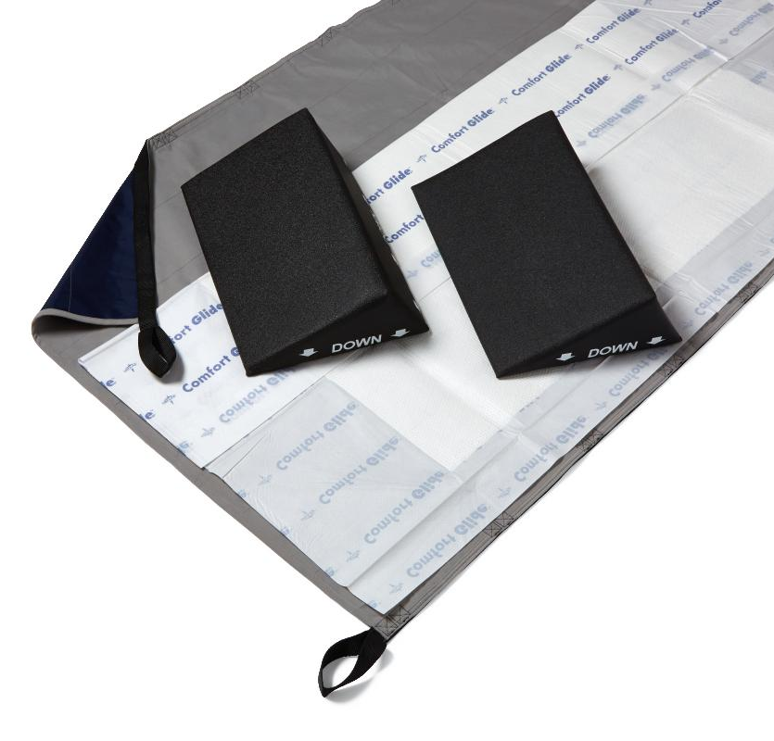
Repositioning Sheets and Wedges
#143154 #143155
Sheets are used to help reduce shear/ friction during bed mobility.
Wedges are designed to assist with proper turning for offloading pressure to bony prominences.
Available in Bariatric as well #151400; #151398

Slide 14
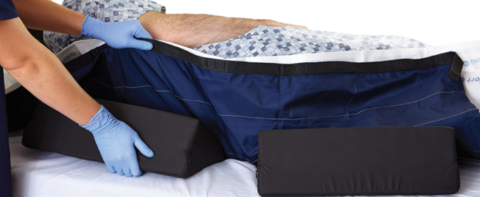


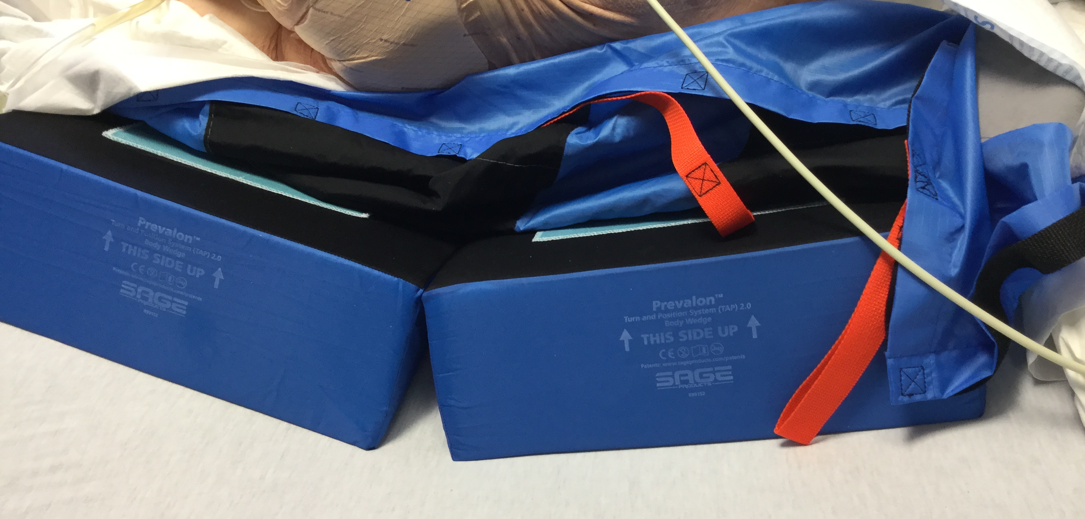
Mind the Gap!
The purpose of the wedge is to OFFLOAD the sacral area, so you need the gap!
Placing the wedges where they touch just changes the surface the sacral area is on from the bed, to the wedges, and won’t prevent pressure injuries!

Slide 15
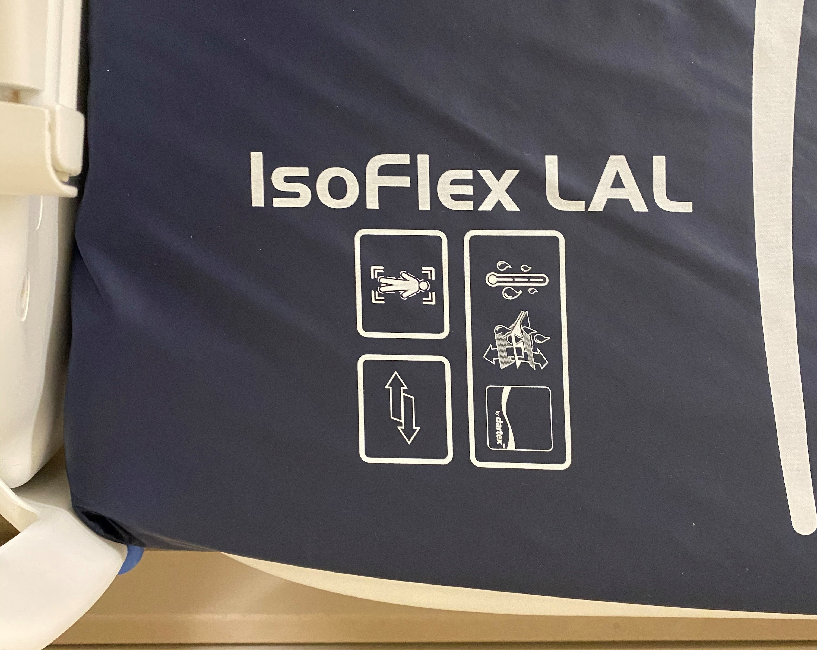
Isoflex Mattress
“Standard” bed for acute care units/ step downs.
Appropriate for unstable spine or pelvis.
Gel matrix bed that helps with offloading pressure.
Much better at pressure relief than most low air loss surfaces!

Slide 16
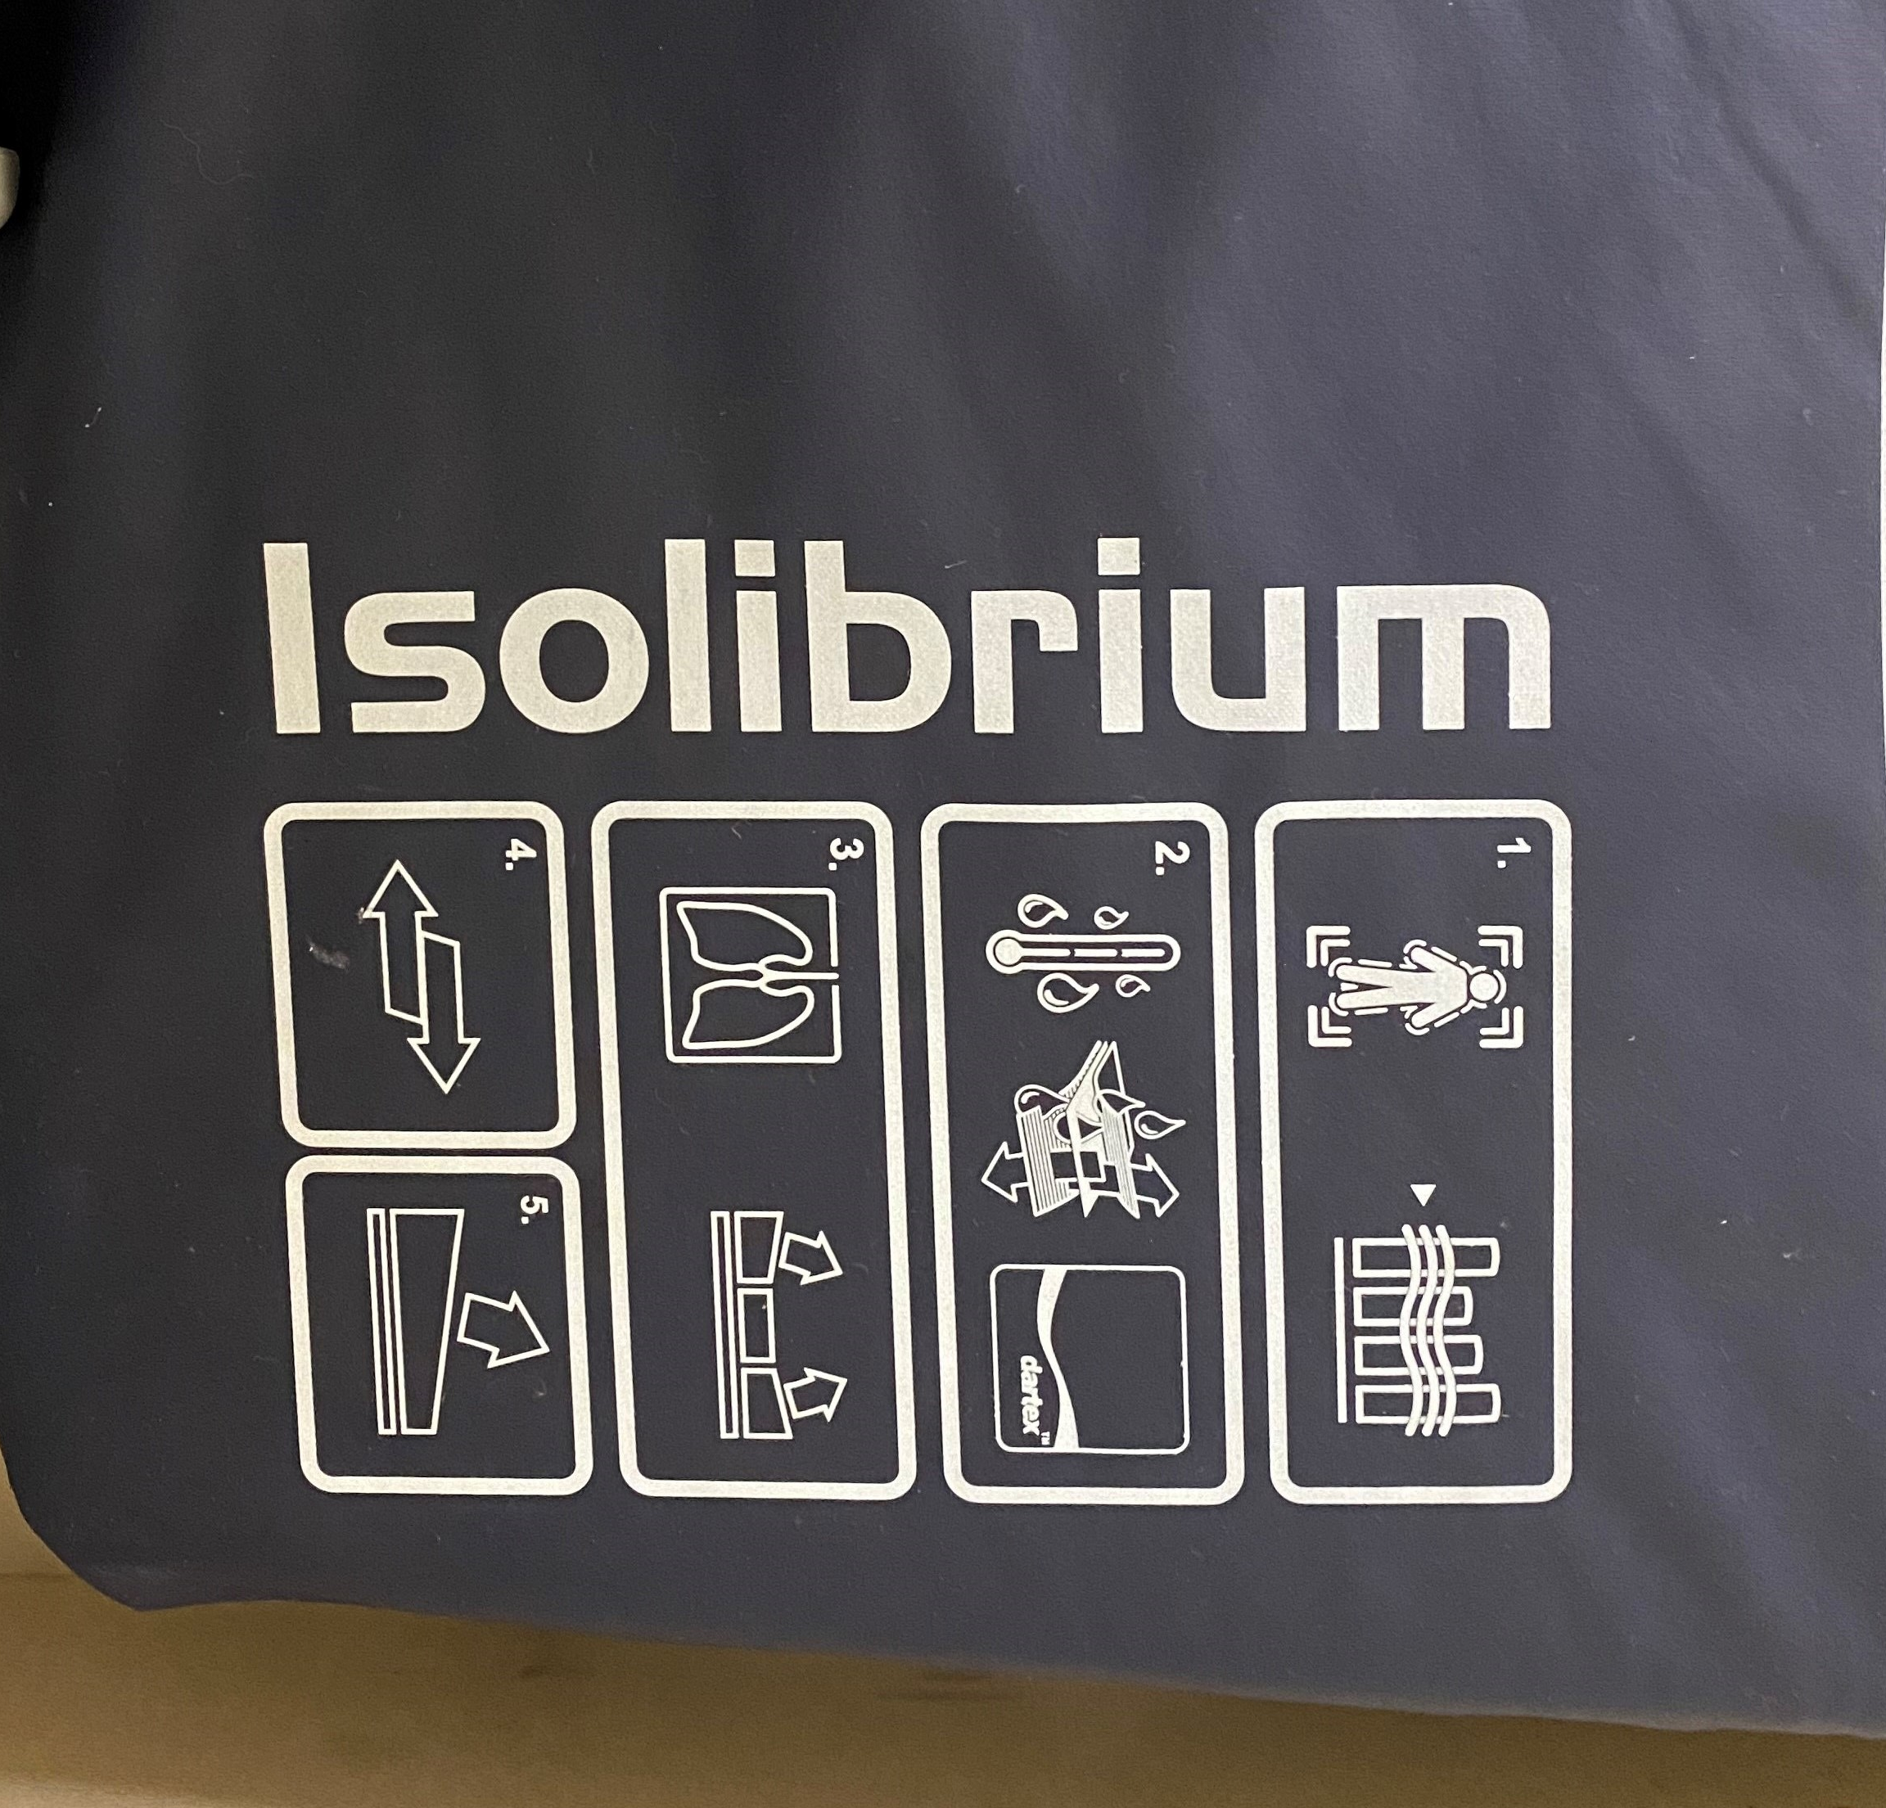
Isolibrium Mattress
“Standard” bed for ICU.
NOT appropriate for unstable spine or pelvis!
Gel matrix and low air loss surface combination.
Excellent at assisting with dynamic offloading of pressure for patients!

Slide 17
Specialty Beds
Dolphin Beds
  Immersion beds for certain patients with pressure injuries, flaps, or other clinical needs.
  Does NOT take the place of turning your patients!
Bariatric Beds
  Ordered to give larger patients additional room for bed mobility, offloading pressure, and comfort.

Slide 18
Questions?
https://www.vumc.org/pip/resources
If you have specific questions, concerns, or have a challenging patient to properly offload…
Contact Adult Wound Team Via Estar Paging

