Slide 1
HAPI Tool
Finding relevant information in eStar

Slide 2
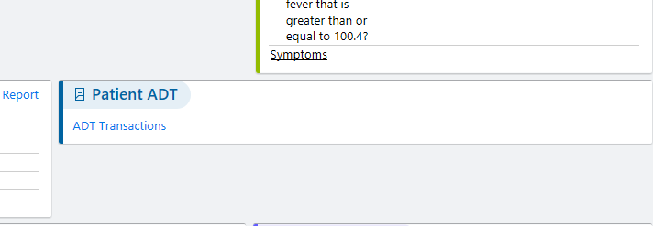
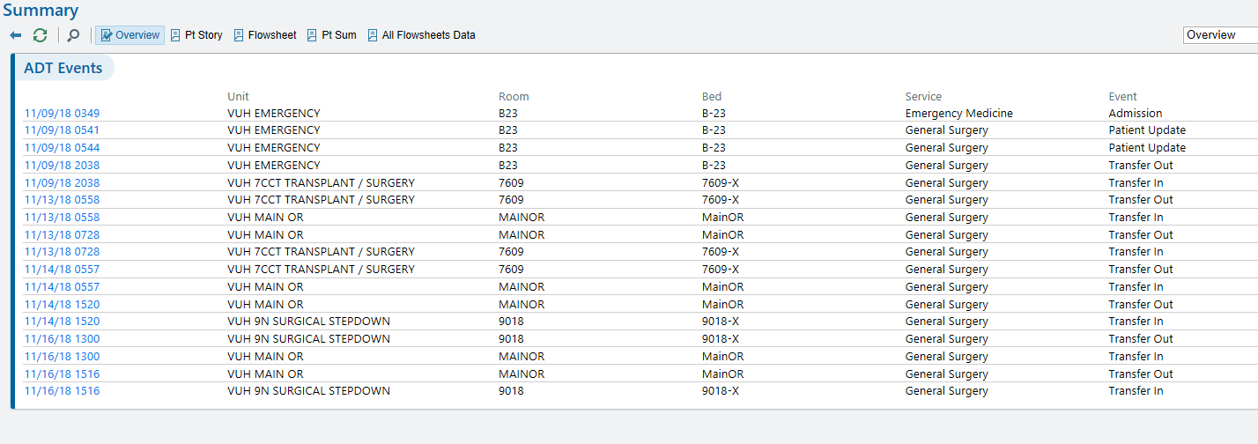
ADT Events
Summary Tab
  ADT Transactions
    Shows transfer date/time between units and can also help estimate time in OR

Slide 3
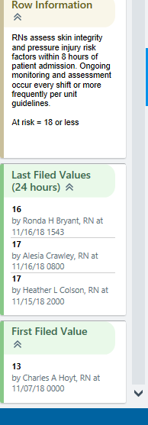
Braden row
Shows First Filed Value (Admit Braden) and Last Filed (Current)

Slide 4
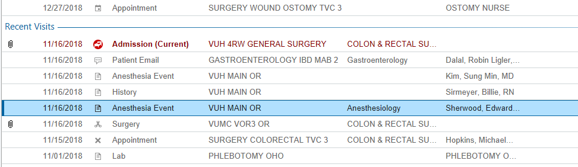
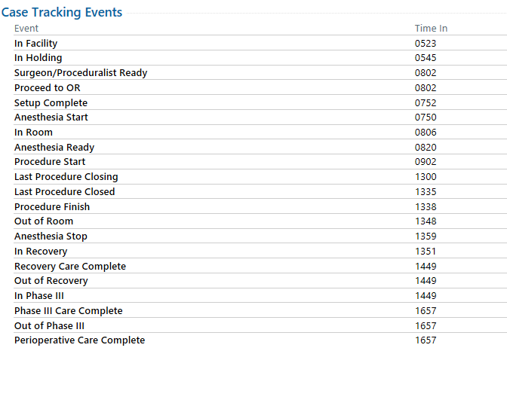
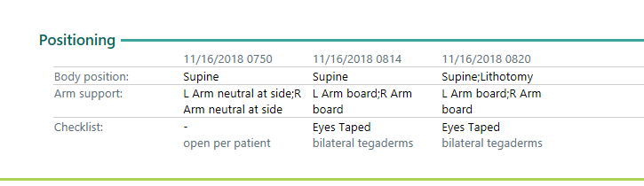
OR Information (Time in OR, Positioning)
CHART REVIEW
  Encounters
    Anesthesia Event

Slide 5
Contributing Factors
PI development is a multifaceted process
In some cases PI’s are unavoidable
  Even though the provider evaluated the individual’s clinical condition and pressure ulcer risk factors; defined and implemented interventions consistent with individual needs, goals, and recognized standards of practice; monitored and evaluated the impact of the interventions; and revised the approaches as appropriate (NPUAP)
  Public policy is not consistent among settings
Intrinsic and extrinsic risk factors
Some risk factors are not modifiable

Slide 6
HOB elevation
It is understood that often HOB elevation is clinically necessary
HOB elevation of 30 degrees or more increases pressure over the sacrum/ischial areas
May be a non-modifiable risk factor if patient clinically needs HOB elevated

Slide 7
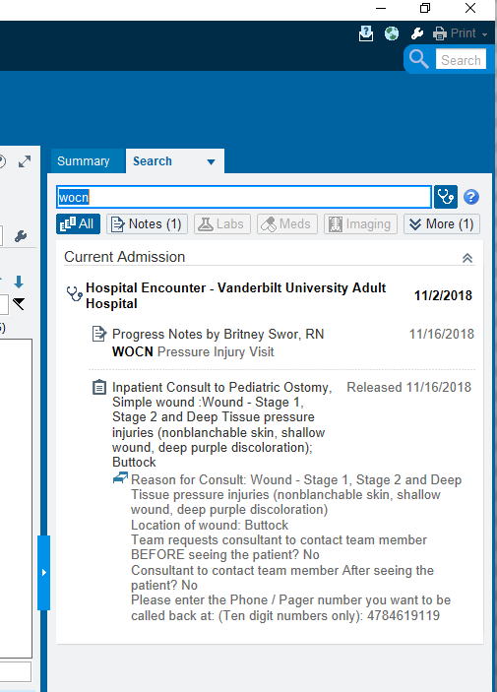
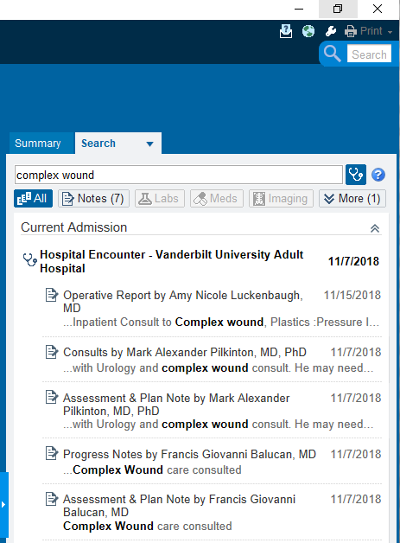
Wound Consults
Use Search box in upper right corner of screen
“WOCN” for Simple wound
“Complex Wound” or “Plastic Surgery” for Complex

