Slide 1
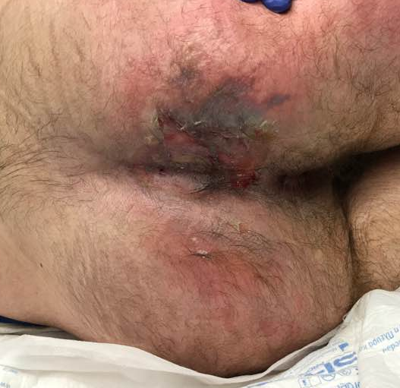
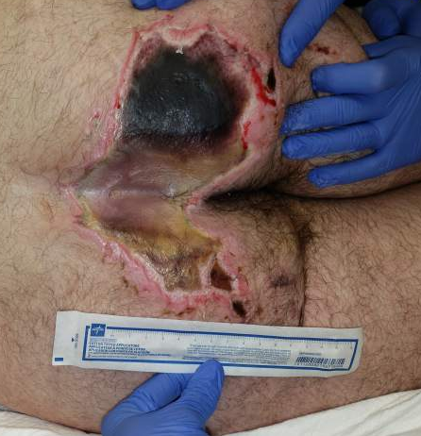
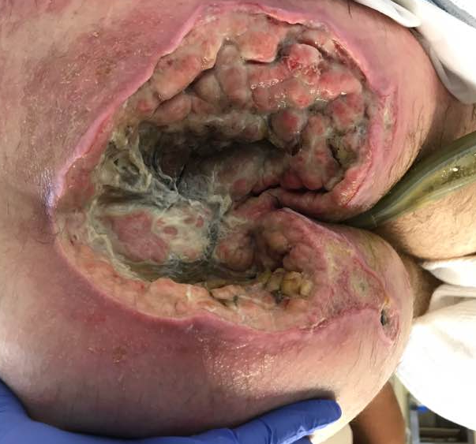
26 year old
No pressure injury on admission
Photos below show evolution over a 1 month time period
Patient required additional surgeries as a result of the pressure injury

Slide 2
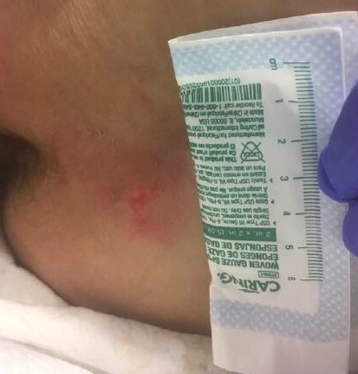
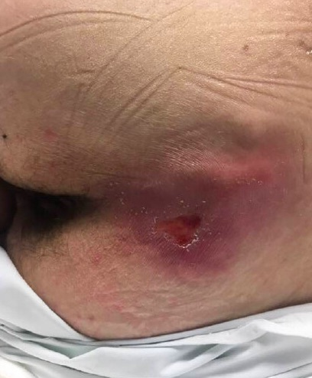
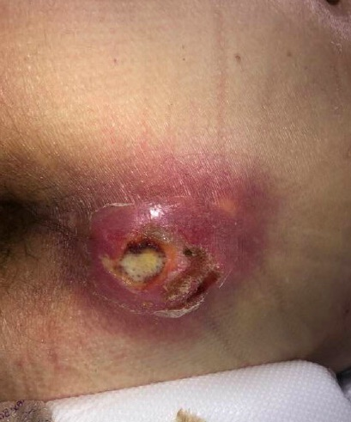
41 year old
At first, skin was intact
Patient refused to turn/reposition and developed a pressure injury
Patient continued to refuse repositioning and pressure injury got worse
Staying off of the pressure injury is most important intervention

