Slide 1



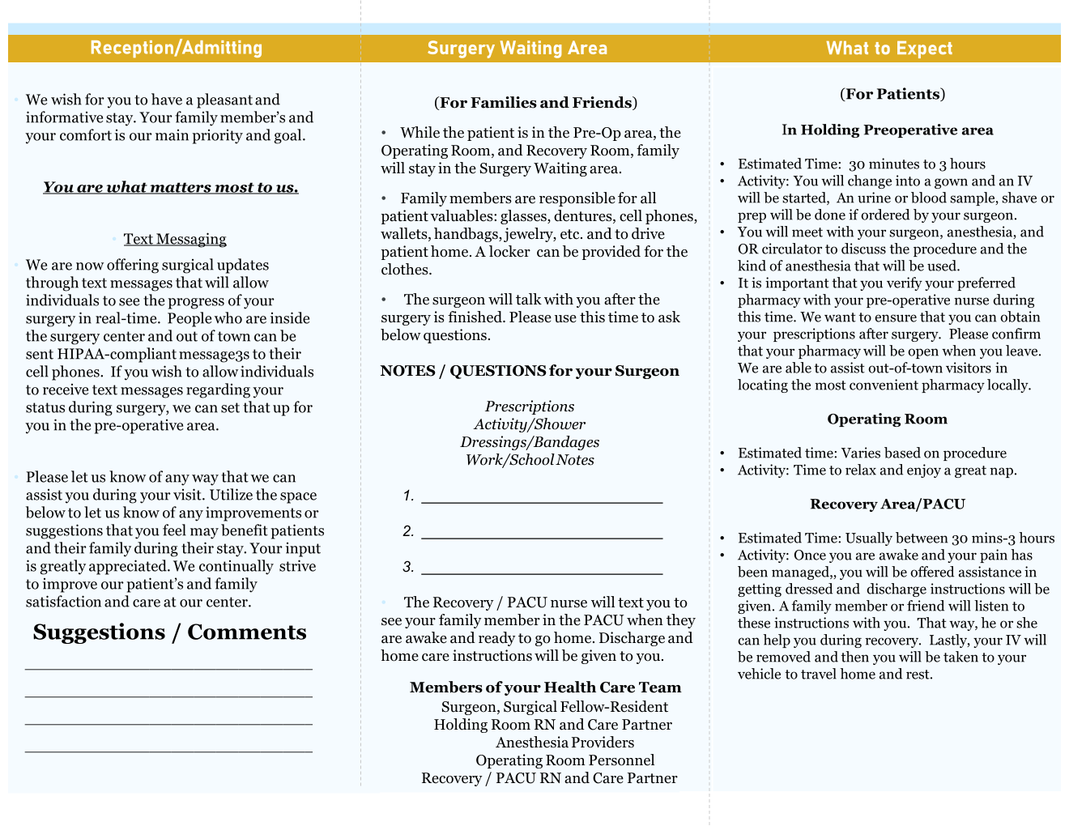
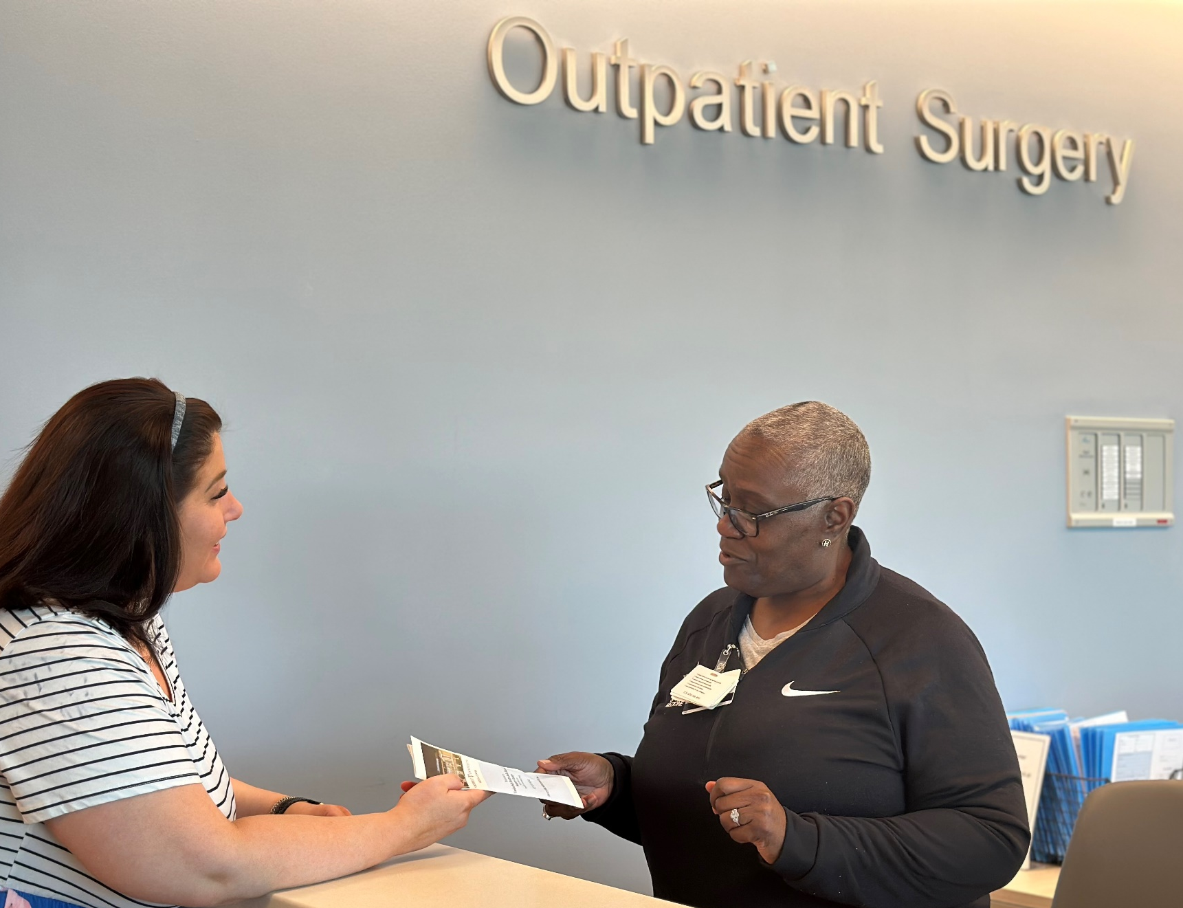

Implementation of Pre-operative Surgical Instructional Brochure Utilizing ERAS, Research, and Evidenced Based Practice
Lead Investigator: Cathy Lee RN 4, BSN, CPAN, CAPA
Team Members: Stephanie Blair RN 2 BSN, Tina Powell RN 2 BSN, Ron Osea RN 3 MSN
Cathy Rogers Business Process Manager
Gladys Donaldson and Dorothy Anderson Surgery Scheduler Specialists
DEPARTMENT OF PERIOPERATIVE SERVICES
Vanderbilt Health Belle Meade
Ambulatory Surgery Center
INTRODUCTION
Research and Brochure
RESULTS
Increased number of surgical delays, cancellations, and lowered Press Ganey patient satisfaction scores due to patients receiving conflicting information regarding arrival times, NPO information,
directions to the center, and additional pre-operative instructions.
Post brochure implementation research questionnaire revealed 97% improvement in decreased cancellation and delays with throughput improvement noted. Surgeons, patients, scheduling office expressed satisfaction with new pre-operative instructions and brochure.
Vanderbilt Health Belle Meade is designing and implementing a brochure to aid you as a patient and your families about what to expect during your surgical stay with us. We would like to know about the surgical process and the peri-anesthesia areas. Below are a few questions to gather information. Please feel free to include any further information that you feel that we would need to include. Thank you for your time and attention to this matter.
Yes | No | Would you like to know what to expect with pre-operative and post-operative routine and stay?
Yes | No | Would you like contact information and how to reach them?
Yes | No | Would you like to have an area to write questions for your surgeon and healthcare team member so you will remember to ask?
Additional Comments:
CONCLUSION
BACKGROUND/STUDY PURPOSE
Collaboration of perianesthesia staff, anesthesiologists, and scheduling staff provided a brochure to give patient in the surgeon's office and day of surgery enabling patients to have decrease stress, surgical day education, and complete perioperative instructions. Improvement noted day of surgery with patient intake, less delays, less cancellations, and increase perioperative efficiency and effectiveness.
To identify present pre-operative instructions given and formulate a solution to address issues causing cancellations and delays; thereby decreasing patient's stress and dissatisfaction day of surgery with end results to improve throughput.
Research Data
Yes | No | Question
98% | 2% | Would you like to know what to expect?
99% | 1% | Would you like contact information?
95% | 5% | Would you like an area to write questions?
Comments Pen and paper in waiting room, brochure in different languages, snacks in waiting room, ability to charge devices.
METHODS
REFERENCES
Research questionnaire formulated with 50 patients
polled. Data tabulated and presented to administration, anesthesia team, and scheduling offices. Pre-operative surgical brochures formulated utilizing ERAS protocol, peri- anesthesia evidenced based practice, and research data information. Brochure included latest NPO protocol, text messaging system, and day of surgery flow, health care team, and educational plan. This information garnered from patient questionnaire and requests.
Almutary H, Almashi A. Preoperative Patient Education: Perceptions and Actual Practice among Nurses Working in Surgical Units. SAGE Open Nurs. 2024 Jan10; 10;1023779608231226090.doi: 10.1177/23779608231226090. PMID: 38222266; PMCID: PMC10785712.
Darville-Beneby, R., Lomanowska, A. M., Yu, H. C., Jobin, P., Rosenbloom, B. N., Gabriel, G., … Clarke, H. (2023). The Impact of Preoperative Patient Education on Postoperative Pain, Opioid Use, and Psychological Outcomes: A Narrative Review. Canadian Journal of Pain, 7(2). https://doi.org/10.1080/24740527.2023.2266751Darville-Beneby, R., Lomanowska, A. M., Yu, H. C., Jobin, P.,
Crosson, J. Enhanced recovery after surgery - The importance of the perianesthesia nurse on program success. JOPAN. 2018; 33(4) August: 366- 371.
Gilmartin J, Wright K. The nurses' role in day surgery: a literature review. International Nursing Review 2007; 54 (2)
https://onlinelibrary.wiley.com/doi/full10.1111/j.1466-7657

